Slide 1
Feeding the monster: fueling mechanisms of AGN
Ioana Duţan
Advisors: Peter Biermann & Alan Roy

Slide 2
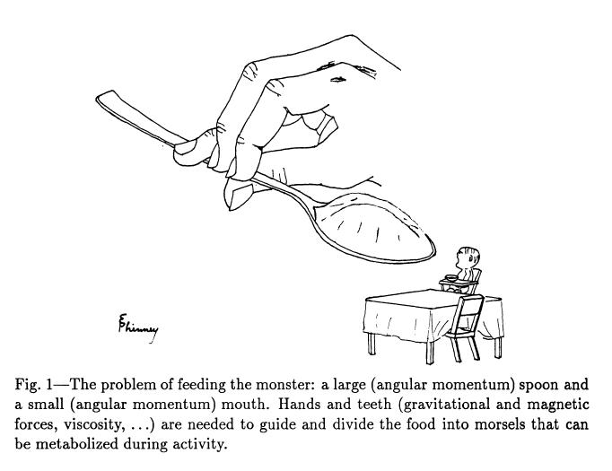
Phinney, 1994

Slide 3
Large-scale mechanisms:
bar potentials & galaxy interactions

Slide 4
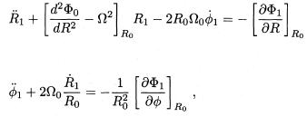
THEORY:
Gaseous orbits in a weak bar potential:
Bar-driven spirals and the effects of resonances
(Wada, 1994)
behavior of a non-self-graviting gas in a rotating potential with a
weak bar-like distortion
describe particle closed orbits under an epicycle approximation
(nearly circular orbits)
(R, Φ, z) in a frame that rotates with
equations of motions in the frame which co-rotates with the potential
non-axisymmetric potential = bisymmetric potential:

Slide 5
epicyclic freq
Closed elliptical orbits
LINDBLAD RESONANCES: + Outer LR
- Inner LR
COROTATION RESONANCE
gaseous orbits: damping term!!
damping rate

Slide 6
closed orbit
behavior of this damped closed orbits in a model galaxy:
use the Toomre’s potential as the axisymmetric potential
and the amplitude of the distortion from the axisymmetric part
Sanders, 1977
ε = strength of the bar potential
ε = 0.05-0.1, weak bar potential
angular momentum transport:

Slide 7
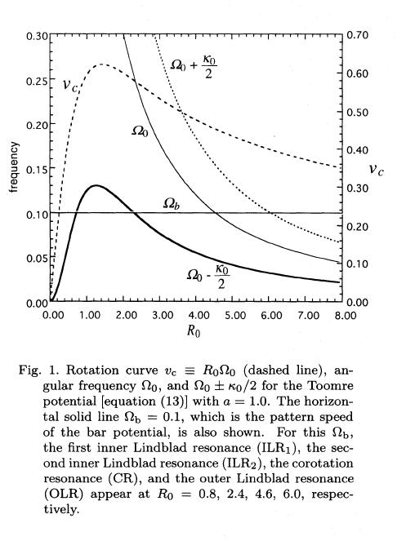
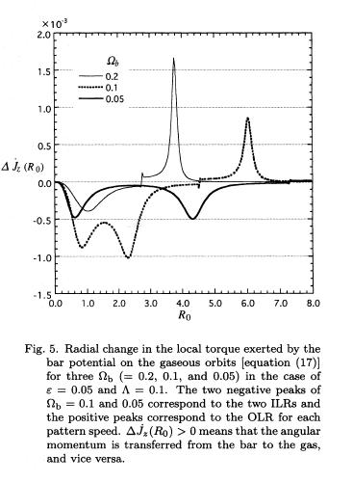
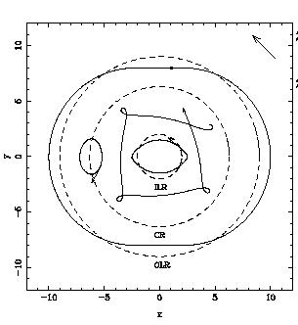

Slide 8
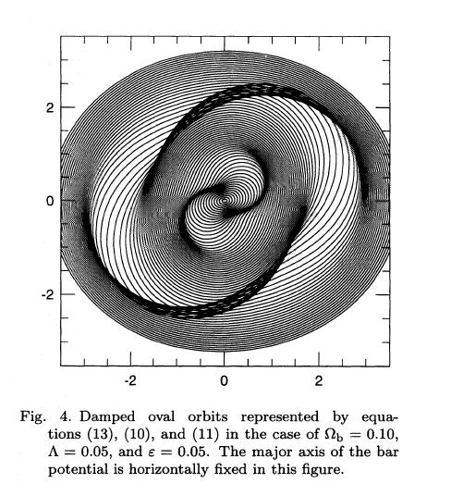
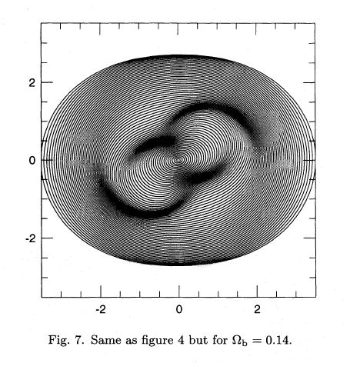

Slide 9
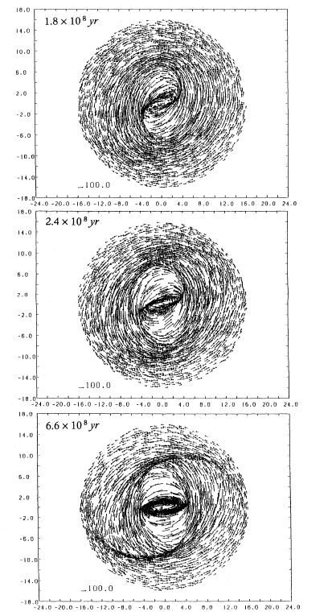
SIMULATIONS:
SPH (Smoothed Particles
Hydrodynamics) code
equations of motions

Slide 10
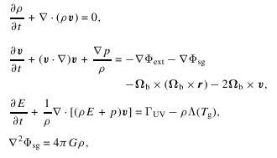
SIMULATIONS:
Multi-phase gas dynamic in a week barred
potential
(Wada & Koda, 2001)
2D hydrodynamical simulations for a single fluid + self-gravity of
the gas + radiative cooling + heating processes
solve the eqs. of motion on a rotating frame of a bar potential
Cooling function (10-10⁸ K)
heating rate

Slide 11
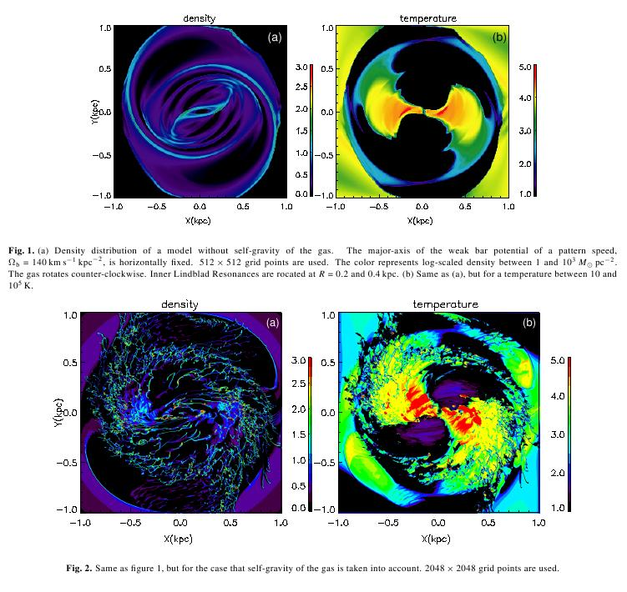

Slide 12
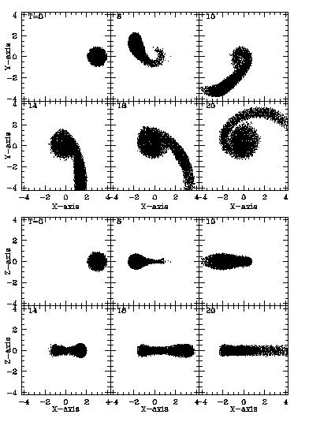
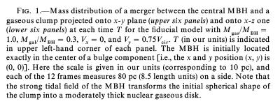
SIMULATIONS:
Merging between a central massive BH and
a gas clump
(Bekki, 2000)
merging between a central BH of
~10⁷ M_{Sun} and a spherical clump
of ~10⁷ M_{Sun} and size of ~10 pc
clump is describe by a SPH code

Slide 13
SIMULATIONS:
Effects of a SMBHs binary on a nuclear gas disk
(Matsui et al., 2006)
gravitational potential of SMBHs binary has a non-axisymmetric
component
changes of gravit. potential due to orbital motions of SMBHs
binary may induce resonance phenomena ~ barred galaxies
similar resonances may trigger star formation in nuclear gas disk
SMBHs binary may yield some peculiar gaseous features in the
nuclear disk – evidence of a SMBHs binary
3D Tree + SPH code
SPH + self-gravity of gas in the fixes stellar potential + radiative
cooling + star formation + thermal heating from supernova +
Salpeter IMF for newly formed stars
model: NGC 6240 – 5x10⁸ M_{Sun}, 750 pc separation

Slide 14
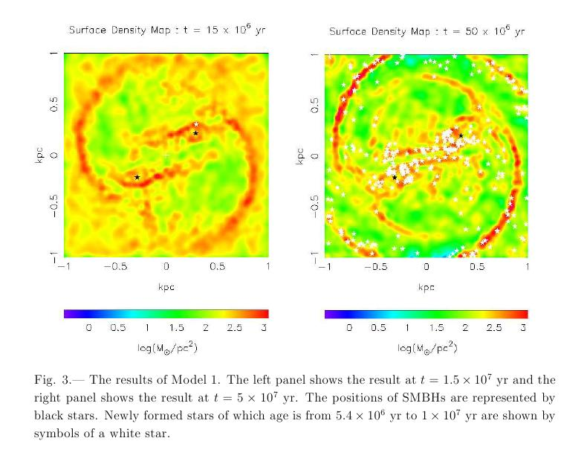

Slide 15
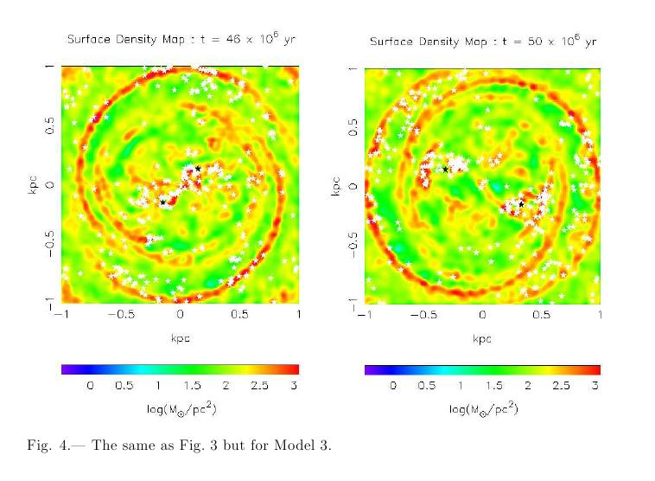

Slide 16
OBSERVATIONS:
Molecular gas in NUclei of GAlaxies (NUGA):
Gravitational torques and AGN feeding
(Garcia-Burillo et al., 2005)
NUGA project is the first high-resolution (0.5”-1”) CO survey of
12 low-luminosity AGN (Seyferts, LINERs, transition HII -- LINER)
for LLAGN, mass accretion rates (typical bolometric luminosity)
range 10⁻² – 10⁻⁵ M_{Sun}/yr
total mass budget is dominated by the stellar contribution →
neglect the effect of the gas self-gravity
estimated the gravitational torques exerted by the stellar potential
(from the NIR images) on their molecular circumnuclear disks
(from NUGA CO maps)
whether other mechanisms are required to explain the low level
of nuclear activity in these galaxies

Slide 17
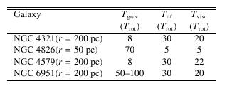
FUNNY BEHAVIOR!!
Scenario…

Slide 18
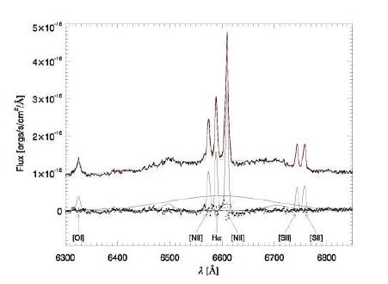
OBSERVATIONS:
Streaming motion towards the SMBH
in NGC 1097
(Fathi et al., 2006)
GMOS-IFU and HST-ACS to map the gas kinematics (velocity field) and
structure within the inner 0.5x1.0 kpc of NGC 1097
velocity field was derived
from the central wavelength of
gaussians fitted to the narrow
H comp. and to the [NII]
emission-lines

Slide 19
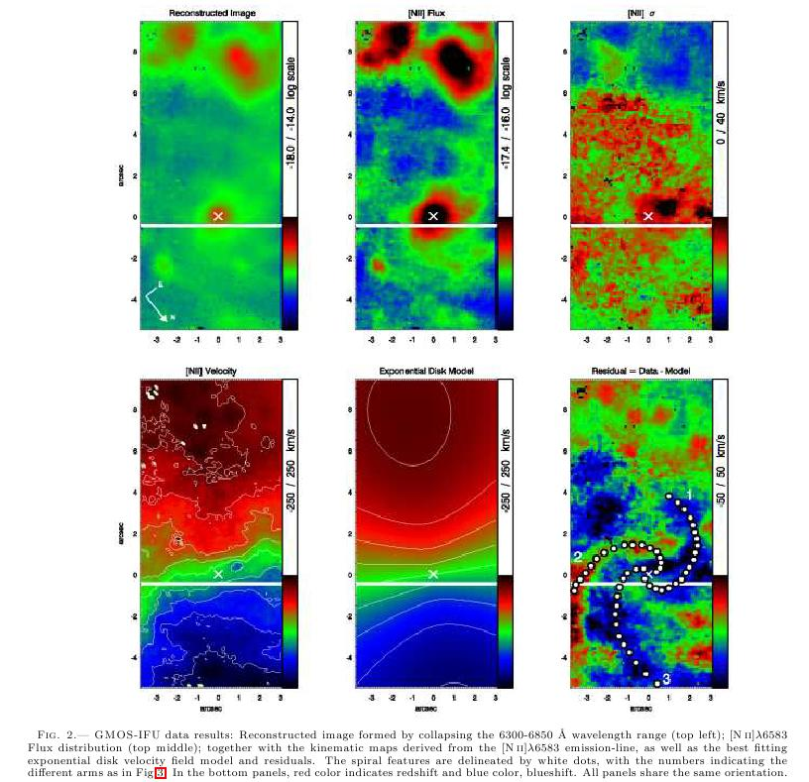
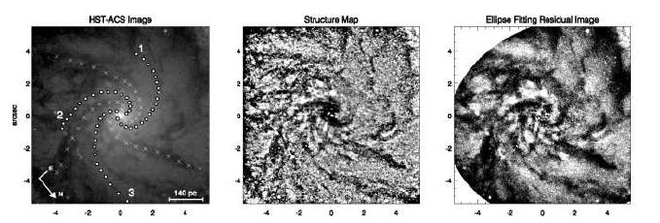

Slide 20
Conclusions:
large-scale gas can be driven from galactic scales by
gravity torques of non-symmetric perturbations, such as
bars, spirals, galaxy interactions
inflow generated by a rotating bar potential does not extend
all the way into scales where turbulent viscosity or cloud-cloud
collisions could take over
not all the spirals are barred or show oval distortions, and only
a few percent of them are AGN

Slide 21
Conclusions:
“bars within bars”: as the gas accumulates, it may become
self-graviting, and fragment into one or more smaller clumps.
If many clumps are formed, they can exchange angular moment
leading to futher concentration of a fraction of the gas; this may
become gravit. unstable again and form a gaseous bar, which
causes futher inflow…
magnetic stresses can deal with the excess angular momentum
in strongly magnetized accreting gas
ordered magnetic field on scale of ~10pc in the form of loops and
arcs, if dynamically important, drive accretion in the inner few tens
of parsecs from the BH

