Slide 1
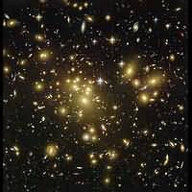
Digging into the past: Galaxies at redshift z=10
Ioana Duţan

Slide 2
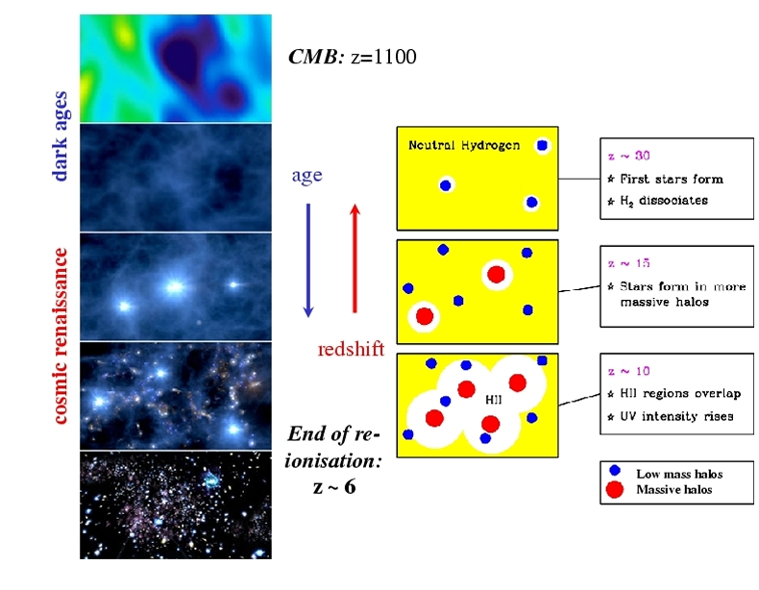
A review by epoch:
Recombina-
tion: z~1100
Reionization:
z=20→6
During this, the univ.
underwent a phase
transition from
neutral to ionized

Slide 3
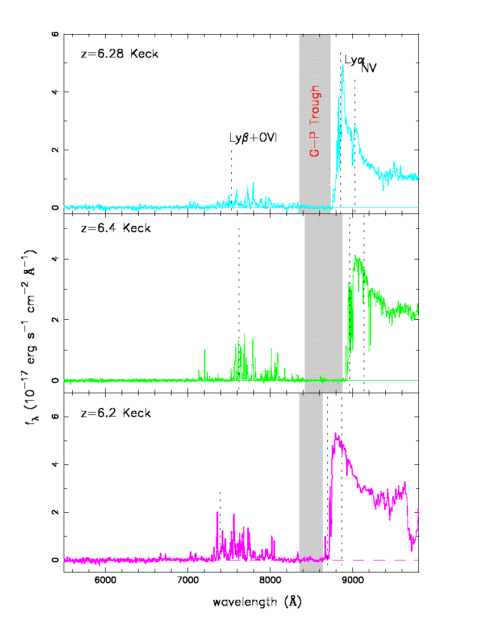
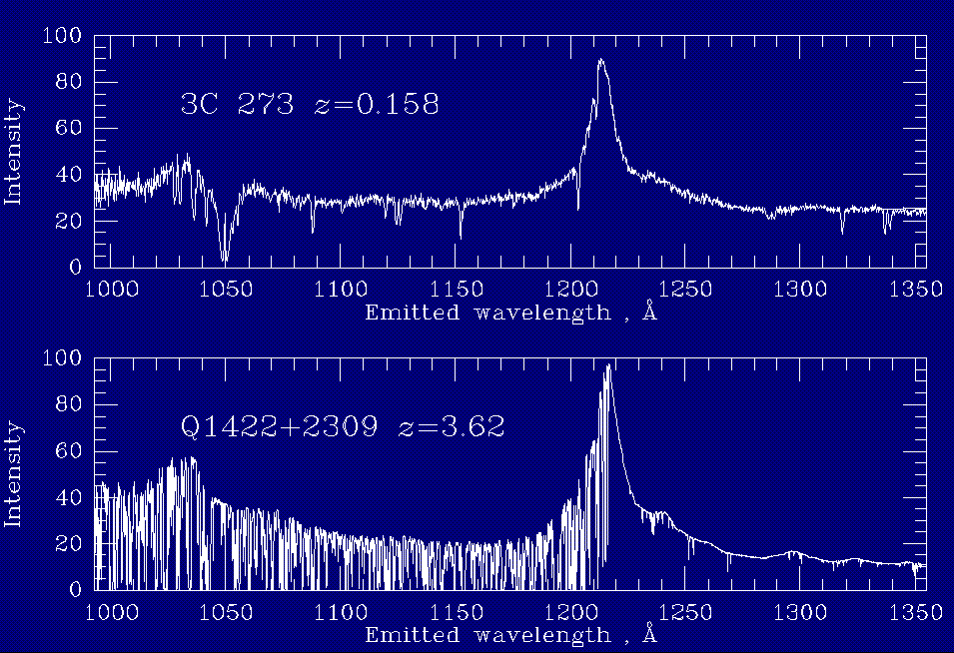
SDSS: Reionization z~6
Gunn-Peterson trough (no Lyα flux) at z>6
G-P effect, the quantification of the optical depth that would be expected if the gas in the Universe were neutral
Fan et al 2003

Slide 4
Uncertainly in epoch of reionization:
QSOs spectra suggest the Universe was not fully reionized at
z~6.
WMAP places reionization between z=10-20.
Is the Universe reionised twice? (Cen, 2003)
Pello et al. (2004): ISAAC/VLT observations of a lensed galaxy at
redshift z=10.
Is it possible to see a Lyα emitting galaxy at such a high z?
Might be z=10 galaxies population responsible for reionization?
Loeb et al. (2004) used this possibility to put some
preliminary constraints on the ionization state of the IGM
around that galaxy:
Was the Universe reionized at redshift z=10??

Slide 5
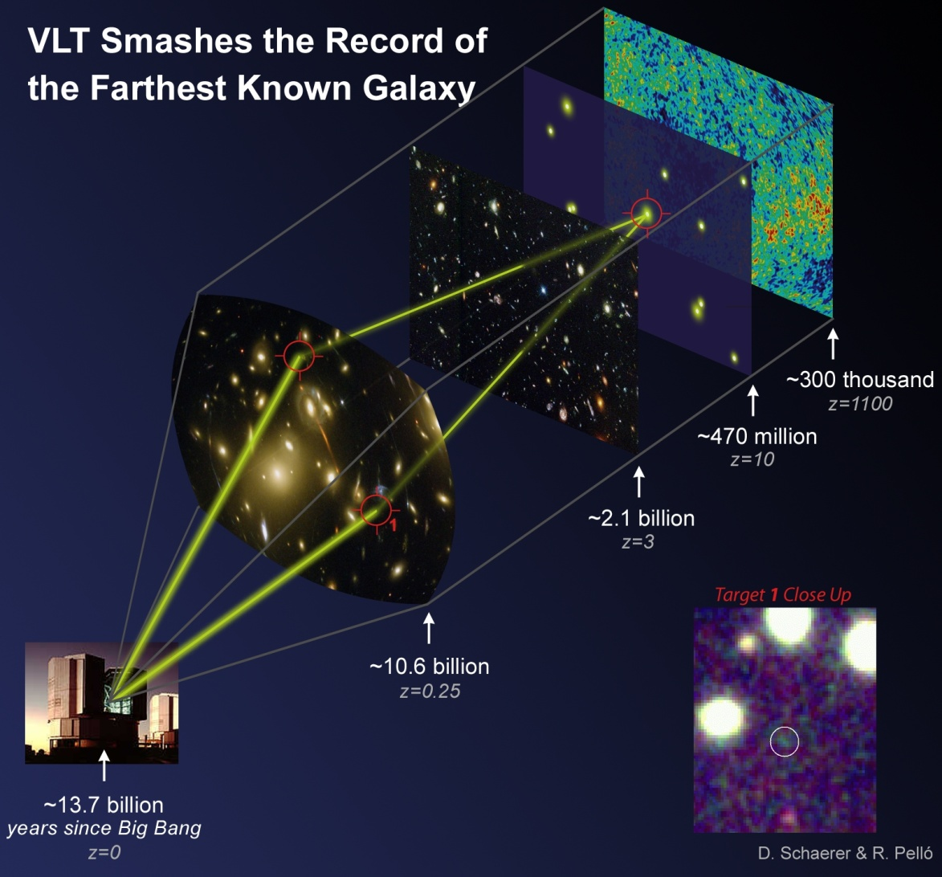
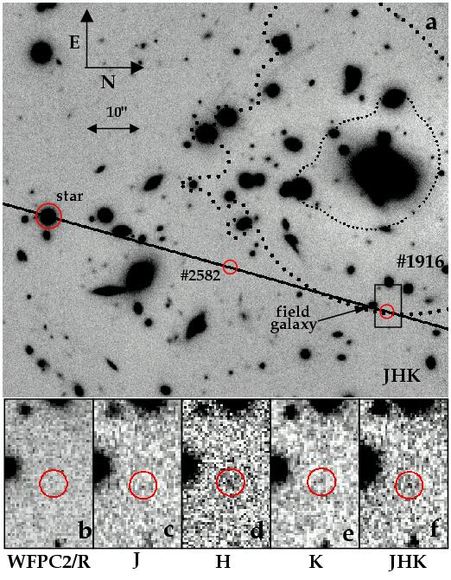
ISAAC/VLT observation of a lensed galaxy at redshift z=10:
Pello et al. (2004)
photometric signature
of an absorption trough
at shorter wavelengths
spectroscopic
detection of an emission
line at 1.33μm (NIR),
presumed to be a Lyα,
redshifted from its rest
UV 121.6nm
strong lensing by
Abell 1835 (“Zwicky tele-
scope”), with a magnifi-
cation factor ~ 25-100
IR 1916
Abell 1835

Slide 6
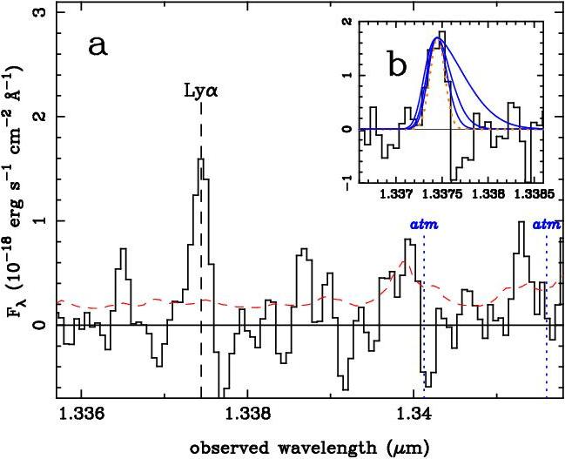
Spectrum of #1916:
velocity dispersion:
upper limit 200 km/s,
with best fits below 60 km/s
Typical Lyα emission line
have gaussian widths of
~ 60-80 km/s.

Slide 7
Properties of the z=10 galaxies and implications:
Gravitational lensing A1835:
- magnification factor (ratio of the lensed to the source flux):
25-100
- it is located close to the critical line, the object must be
multiply imaged by the cluster (NOT seen with their data)
Estimation of star formation rate (SFR):
- they measured an amplified Ly line flux and a UV continuum
flux density
- we know: SFR~L_{Lyα} and SFR~L_{UV}
- they estimated a SFR of 0.03-0.09 M_{Sun}/yr based on the line
flux, and 2-3 M_{Sun}/yr based on the UV continuum
- the lower SFR derived from the Ly reflects the effect of
photon destruction by scattering in the IGM

Slide 8
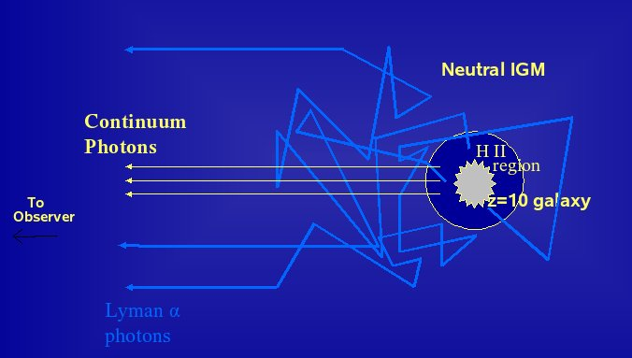
Was the Universe Reionized at z=10? Loeb et al. (2004)
They reconsider the interpretation of the observations of
Pello et al., accounting for different possible IMFs and
source age
Either the large-scale region surrounding this galaxy must have
been largely reionized by z=10, with a neutral H I fraction < 0.4
Or the stars within the galaxy must be massive > 100 M_{Sun} , and
capable of producing a sufficient large H II region around it
They derive the maximum
Lyα line flux for a given UV
continuum flux of galaxy prior to the reionization epoch.

Slide 9
Basic absorption parameters:
Loeb et al. model
The absorption profile owing to H I in the IGM depends on:
redshift z_{s} and halo mass M of the source
age of the source, t_{S} ( ~10⁷-10⁸ yr)
total rate at which H ionizing photons from the galaxy enter the
IGM, dN_{γ}/dt:
proton mass
overall number of ionizing photons per baryon in galaxy
results depend on these
efficiencies
Nγ depends on the IMF of the stars

Slide 10
N_{γ}=4300, for a metallicity of 1/20 of the solar value, this comes
from the locally-measured IMF (Scalo, 1998)
=44000, for zero metallicity stars of M > 100M_{Sun}, this comes
from an extreme Pop III IMF
Star formation rate:
Maximum physical size that can be ionized by a ionizing source
embedded within the neutral IGM:

Slide 11
Lyα-emitting galaxies: They use Lyα-galaxies to probe the reionization
To study the detectability of high-redshift galaxies, we must
convert the SFR of a galaxy in a halo of a given mass to a flux
level for both the Ly line and the UV continuum:

Slide 12
To evaluate the impact of absorption on the Ly line, an estimation
of the width of the line is required.
Assuming a Gaussian profile, they estimated the velocity
dispersion by Vc/1.41, Vc is the virial circular velocity of the halo.

Slide 13
Results: the derived parameters for z=10 galaxies and its host halo, depending on the IMF and the source lifetime
Observed: 2.2 x 10⁴¹ erg/s
expected intrinsic velocity dispersion
intrinsic line luminosity expected
in the absence of H I absorption
maximum physical size of the H II

Slide 14
Conclusions:
The Scalo IMF predicts a much weaker line that observed and is
ruled out, assuming that the IGM surrounding the H II region is
neutral. An extreme Pop III IMF is easily consistent with the
observations even for a short burst (10⁷ yr).
If the galaxy discovered by Pello indeed has a redshift z=10, then
either its stars are very massive (> 100 Msun), or the large scale
IGM around it has already been mostly reionized (with a neutral
fraction < 0.04

