Slide 1
Test-kinetic and particle-in-cell simulations of localized
plasma and field structures and their interactions
Gabriel Voitcu¹ and Marius Echim^{1,2}
¹Institute of Space Science, Magurele, Romania
²Belgian Institute for Space Aeronomy, Brussels, Belgium

Slide 2
Outline
Test-kinetic simulation method:
  forward Liouville approach
  backward Liouville approach
  example: kinetic structure of a proton cloud injected across a transverse magnetic field
Particle-in-cell simulations (PIC):
  three-dimensional electromagnetic PIC simulations
  example: transport and penetration of small-Larmor radius plasma clouds across transverse magnetic barriers
Conclusions

Slide 3
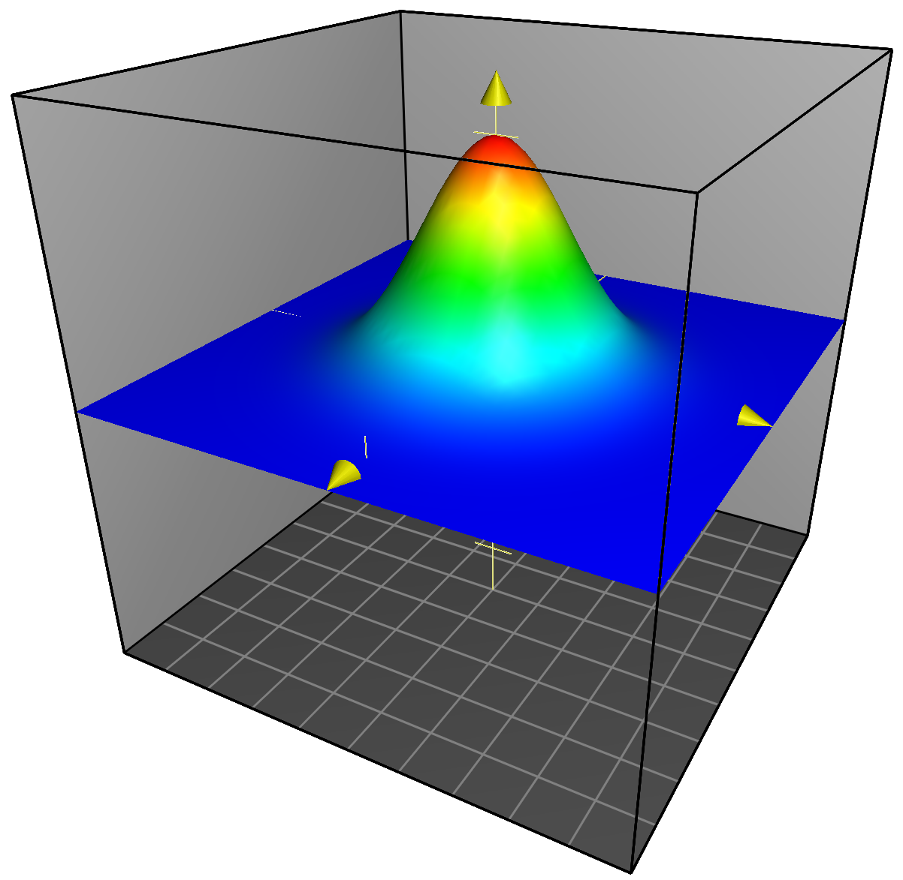
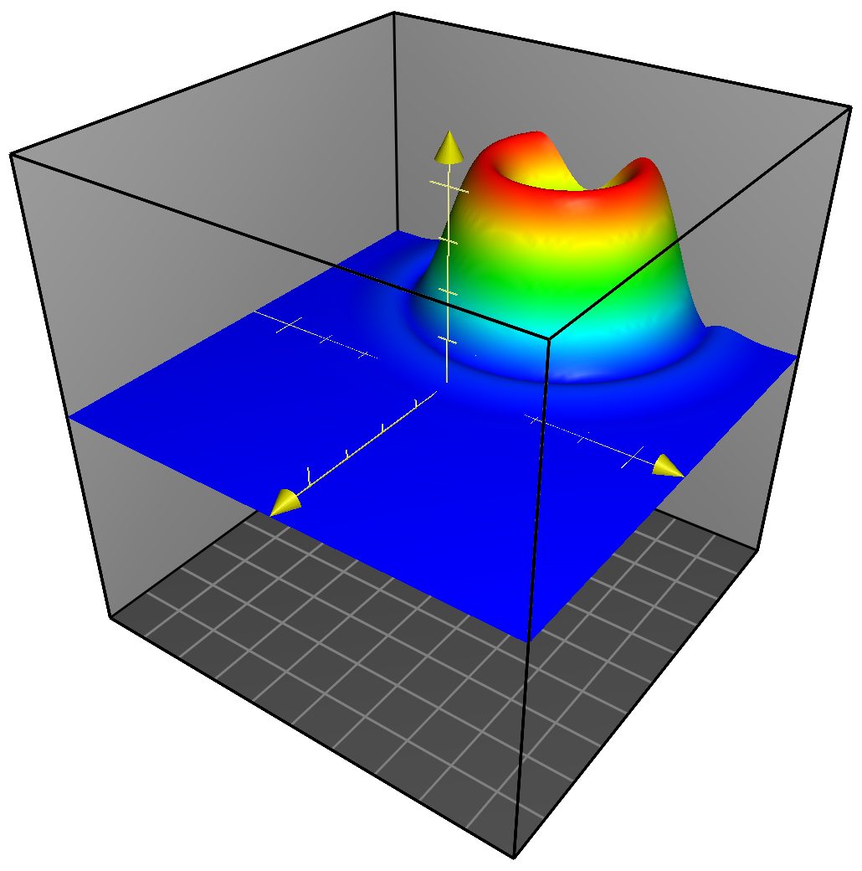
Liouville mapping
Test-kinetic simulations
Test-kinetic simulations provide a useful tool to investigate the dynamics of charged particles in prescribed electric and magnetic fields, especially in complex situations where the use of self-consistent kinetic methods is not practical.
Four different approaches (Marchand, 2010):
(i) trajectory sampling
(ii) forward Monte Carlo
(iii) forward Liouville
(iv) backward Liouville
E-field and B-field are assumed
to be known in the entire
simulation domain at any
instant of time
Source region where f is known
Region of interest where we want to compute f
f − known
f = ?
particle trajectory in phase space
velocity space
velocity space
One can compute any number of particle orbits and then “propagate” f along them by applying Liouville’s theorem.

Slide 4
Test-kinetic simulations: forward Liouville approach
at time t=0
at time t > 0
fields
Source region
VDF is known:
f₀ (v_{x0}, v_{y0}, v_{z0})
f in the region of interest
f (x, y, z, v_{x}, v_{y}, v_{z})
FORWARD APPROACH:
positive time step Δt > 0
Liouville’s theorem:
along a particle trajectory df/dt=0

Slide 5
Test-kinetic simulations: backward Liouville approach
at time t=0
at time t > 0
fields
f₀=f₀ (v_{x0}, v_{y0}, v_{z0}) if the particle’s guiding center is localized in the source region
− or −
f₀=0 if the particle’s guiding center is localized outside the source region
BACKWARD APPROACH:
negative time step Δt < 0
f in the region of interest
f (x, y, z, v_{x}, v_{y}, v_{z})
Liouville’s theorem:
along a particle trajectory df/dt=0

Slide 6
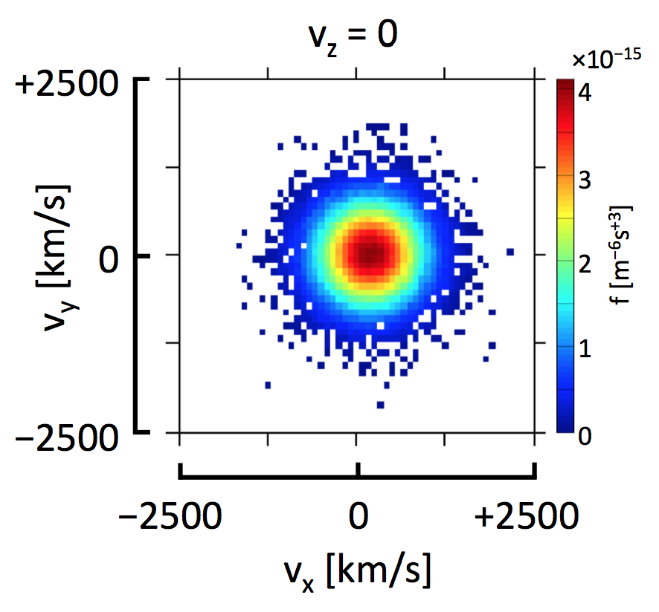
The kinetic structure of a proton cloud injected across a transverse magnetic field
VDF@t=0
z
x
E_{y}
y
E_{x}
right side
E_{x}
0
E_{y}
left side
VDF@t>0
source region
f=?

Slide 7
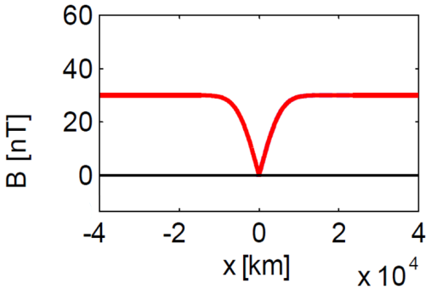
FWD results
The shape of the cloud is asymmetric; an energy-dispersed structure is formed.
Ring-shaped VDFs are obtained close to the edges of the cloud (e.g. D3, E4).
Non-gyrotropic VDFs are obtained close to the trailing and leading edges (B4, G4).
(Up) Protons position in the xOy plane. The local value of the number density is color coded. The spatial mesh on which VDF is computed is shown.
5
4
3
(Right) Projection in the perp. velocity space, for v_{z}=0, of the protons VDF.
2
Voitcu and Echim, Phys. Plasmas, 2012
1

Slide 8
BWD results
FWD
f_{BWD} is numerically integrated over a rectangular domain corresponding to the spatial bin used to compute the VDF with the forward approach.
for regions with smooth variations of f the two approaches provide similar results.
significant differences are observed for bins localized in regions with a steep spatial variation of f.
BWD averaged
FWD
Voitcu, Echim and Marchand,
Comput. Phys. Commun., 2012

Slide 9
Particle-in-cell simulations
In particle-in-cell simulations plasma dynamics is studied by following the trajectories of a large number of particles in their self-consistent electric and magnetic fields.
Due to the limited computing power, real particles are replaced by finite-size superparticles with the mass and charge much larger than those of real particles.
The self-consistent electromagnetic field is computed by solving the Maxwell’s equations using finite-differences in both space and time. The grid spacing must resolve the electrons Debye length and the time-step must resolve the electron plasma frequency.

Slide 10
A typical particle-in-cell cycle
The particle positions and velocities and the electric and magnetic fields at t=0 are defined according to some appropriate initial conditions.
The fields are interpolated from the grid points to the particle positions using the same weighting scheme that has been previously used.
The positions and velocities of all the simulated particles are pushed forward in time by integrating the Newton-Lorentz equation of motion.
The Maxwell’s equations are integrated in order to calculate the electric and magnetic fields at the location of each grid point.
The charge and current densities at each grid point are obtained from the particle positions and velocities using an appropriate weighting scheme that is dependent on the particle location.
from Birdsall and Langdon (1991)

Slide 11
Transport and penetration of small-Larmor radius plasma clouds across transverse magnetic barriers
Voitcu, Ph.D. Thesis, 2014
B<B_{c}
B>B_{c}
from Livesey and Pritchett (1989)

Slide 12
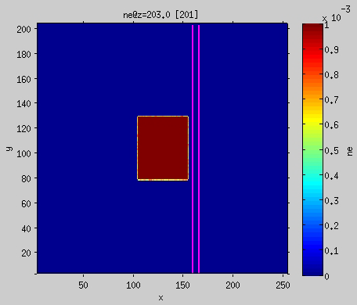

B<B_{c}
B>B_{c}
Number density of electrons in the perpendicular plane to the magnetic field.

Slide 13
Transport and penetration of small-Larmor radius plasma clouds across transverse magnetic barriers
The adiabatic breaking process takes place when a non-diamagnetic plasma element is streaming into an increasing transverse magnetic field as described theoretically by Lemaire (1977, 1985) and demonstrated experimentally by Demidenko et al. (1967, 1969, 1972).
B<B_{c}
B>B_{c}
Voitcu, Ph.D. Thesis, 2014
IP model (Lemaire, 1977, 1985):
convection energy
gyration energy

Slide 14
Conclusions
The test-kinetic method gives a first approximation of the kinetic structure of a plasma configuration for which the electric and magnetic fields are obtained from either theoretical models, MHD simulations or experimental data. It is an useful tool especially in complex situations where the use of self-consistent kinetic methods is not possible.
In particle-in-cell simulations we follow the trajectories of a large number of particles in their self-consistent electric and magnetic fields. PIC codes are successfully used to study self-consistently plasma phenomena at kinetic scales.
We performed numerical simulations to investigate the kinetic effects and their role on the transport and entry of localized plasma elements across finite-width magnetic barriers.
Our simulations confirm physical processes advocated previously by theoretical models and observed in laboratory experiments, but also new ones related to the deflection of low-energy plasma clouds/jets by high magnetic barriers.

Slide 15
Thank you for your attention!

