Slide 1
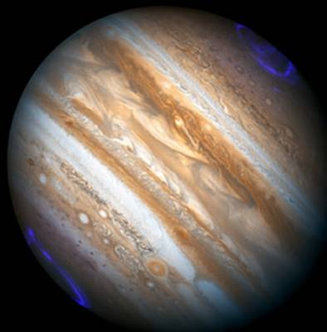
Characteristics of Jupiter's magnetospheric turbulence observed by Galileo
STORM2015, Constanta, Romania, 2015/9/6-12
International Workshop and School on Solar system plasma turbulence, intermittency and multifractals
Chihiro Tao [1,2],
Fouad Sahraoui [2], Dominique Fontaine [2], Judith de Patoul [2,3], Thomas Chust[2], Satoshi Kasahara [4], and Alessandro Retinò [2]
[1] IRAP, CNRS/OMP/Université de Toulouse, France [2] LPP, CNRS/Ecole Polytechnique, France
[3] EMPS/CGAFD, University of Exeter, UK [4] ISAS, JAXA, Japan

Slide 2
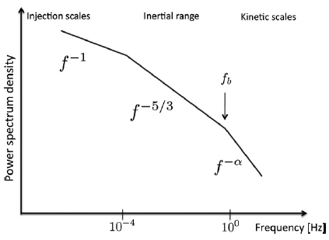
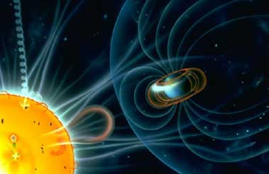
1. Intro. Turbulence and Space Plasma
2
*Turbulence is a ubiquitous phenomenon seen both in fluid and plasma
*Turbulence couples multi-scales
*Space plasma in various regions provides various parameters
solar wind -- planetary environment
(for fluid)
[Bourouaine et al., 2012]
http://www.daystarfilters.com/Sun_Day/SunEarth.shtml

Slide 3
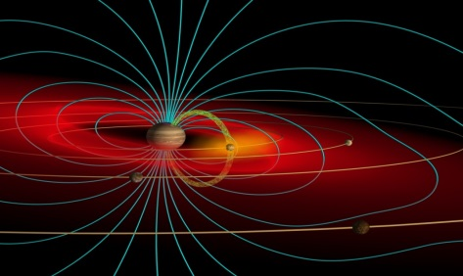
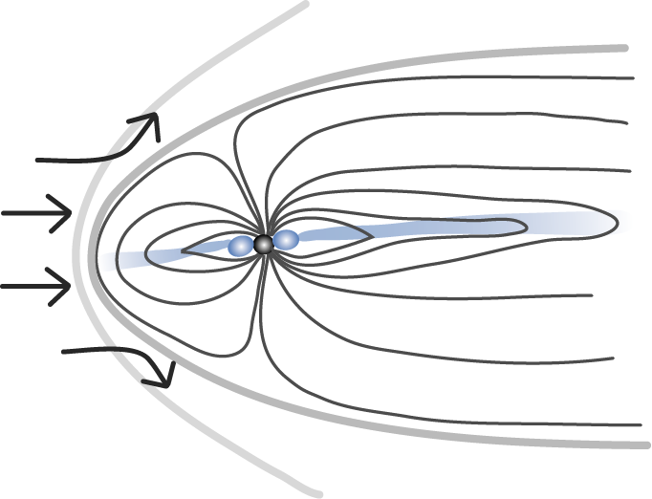
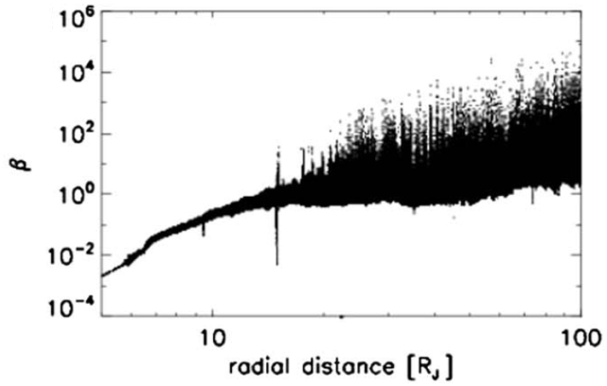
1. Intro.: Jovian magnetosphere
3
Rotation-dominant, energetic particle accelerator
・Fast rotation (9h55m)
・Strong magnetic field (momentum x20,000 Earth’s)
・Plasma source at Io locating inner magnetosphere
→ Sulfur ion, Oxygen ion, …, Proton
→ Plasma rotate in the vast magnetosphere region
・Planetary magnetosphere would provides turbulence under unique environment with parameters
(e.g., Jupiter magnetosphere 0.01<β<1000)
+ dawn-dusk asymmetry (rot. + solar wind)
Io
plasma torus
http://www.lowell.edu/users/spencer/
Jovian magnetosphere
lobe
current sheet
Io plasma torus
magnetic field
solar wind

Slide 4
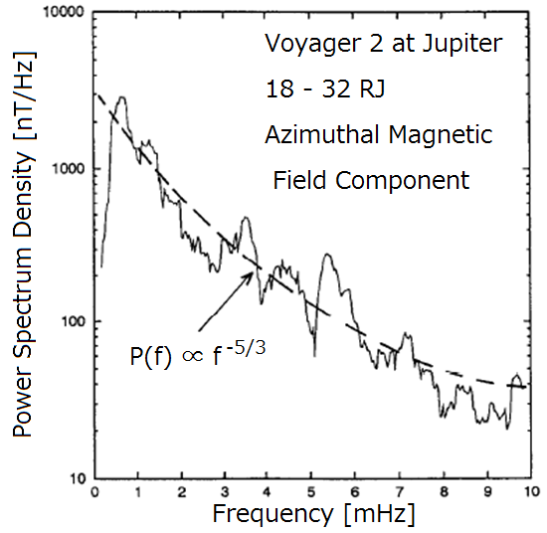
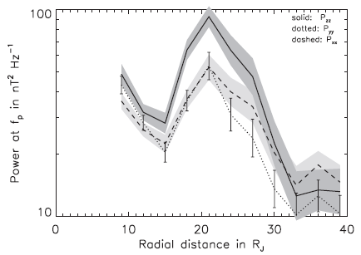

1. Intro.: Jovian magnetosphere
4
“Turbulence-like field fluctuations” in the Jovian magnetosphere
◆less resonant peak → turbulence is dominant feature and a good index of activity
◆spectral index ~ -5/3 [Glassmeier, 1995]
◆small δb/B₀ & index~2 at the inner magnetosphere (< 26 R_{J}), [Saur et al., 2002]
cf. solar wind δb/B₀~1
Effect of turbulence on
◆heating the expanding plasma from Io [Saur et al., 2004]
◆electric potential drop which accelerates electrons & create Jovian aurora [Saur et al., 2003]
Voyager data [Glassmeier, 1995]
Galileo data [Saur et al., 2002, 2003]
Power at 2.4 mHz [nT²/Hz]
P(f) ∝ f ^{–5/3}
aurora

Slide 5
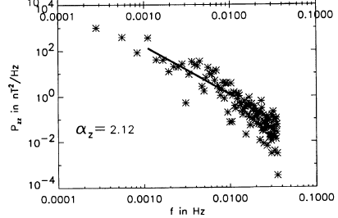
1. Intro.: Motivation of this study
5
Previous works used low time-resolution data
in the limited radial distance and time.
Questions:
(1) Spectral feature, existence of break point?
(2) How turbulence feature varies in global various region?
(3) Relation between turbulence characteristics and magnetospheric phenomena?
(4) Comparison among different planetary magnetospheres
We use high time-resolved magnetometer data observed by Galileo
→ Characterize Jovian magnetospheric turbulence feature and its relation with magnetospheric dynamics
Fig. Spectral power of 1 hour interval at 20 R_{J} [Saur et al., 2002]

Slide 6
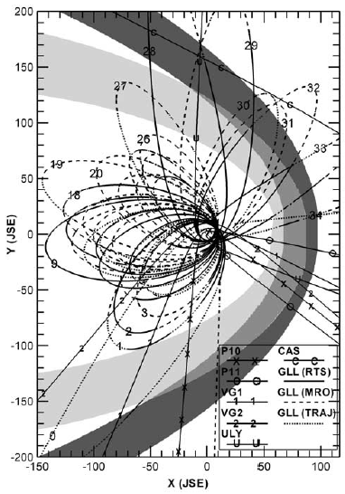
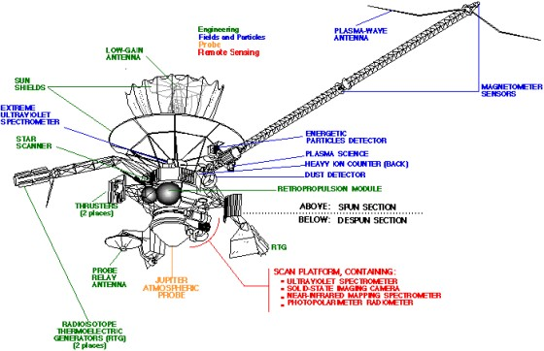
2. Data set : Galileo
6
[Khurana and Schwarz, 2005]
Jovian magnetospheric orbiter
Dec. 1996 - Sep. 2003
covering many radial and local time (LT)
bow shock
magnetopause

Slide 7
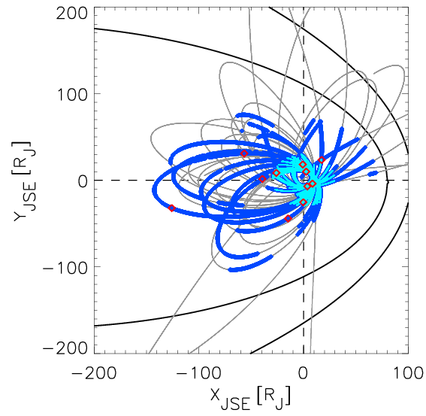
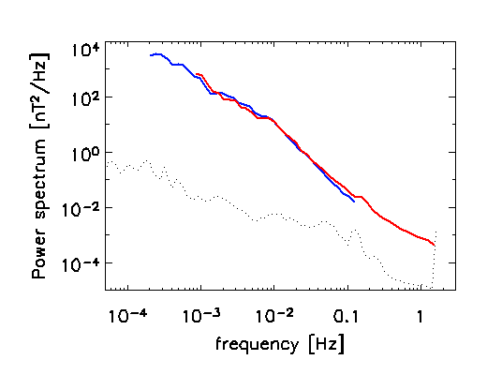
2. Data set : MAG data
7
Galileo in the magnetosphere
MAG: flux gate magnetometer [e.g., Kivelson et al., 1992]
High resolution (HR) data :
moon flyby: 24 events (not used in this study)
magnetosphere: 23 → 11 events (above noise level) Δt~0.33 sec., 35-280 min.
Low resolution (LR) data : Δt~24 sec. →June 23, 1996 – Nov. 11, 2002
LR/HR obs.
plasma obs.
Wavelet analysis
(using Morlet function)
Spectra

Slide 8
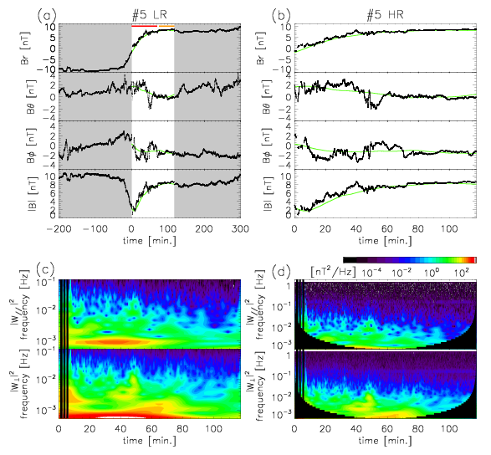
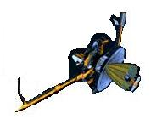
3. Analysis: Spectrum (ex.1997/07/04 14:09)
8
Low resolution data High resolution data
B_{Φ}
Br
Br
B_{θ}
B_{θ}
B_{Φ}
|B|
Wavelet analysis
B-perpen. B-aligned

Slide 9
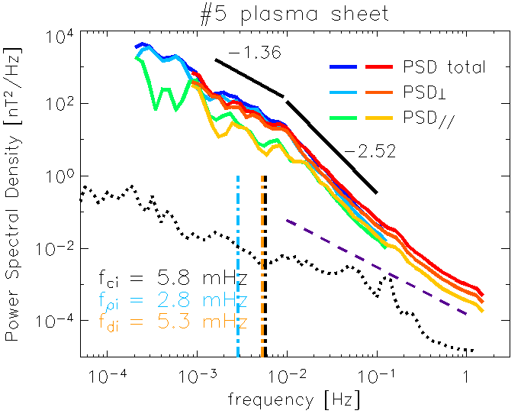

4. Spectrum: over view (HR+LR)
9
breaking frequency
Radial distance 64.6 RJ
spectral index
Fig. An example of spectrum from HR and LR data
-Spectral break is seen at ~0.01 Hz in both LR and HR data
-Spectral index is 1.3 (2.4) at lower (higher) frequency range
-B// (B⊥) is dominant at lower (higher) frequency range

Slide 10
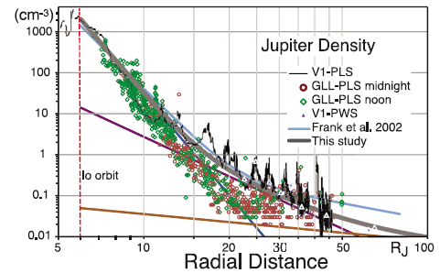




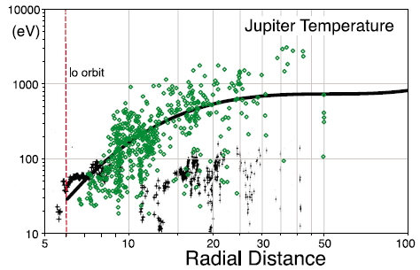
3. Analysis: Plasma parameters
10
Characteristic plasma parameters
-ion cyclotron frequency (fci)
-ion inertial length (di)
-ion gyro-radius (ρi)
-plasma beta (βi)
→ From ion inertia length and ion gyro-radius,
corresponding characteristic frequencies
are obtained as follows by Taylor Assumption:
-ion inertial length (fdi)
-ion gyro-radius (fρi)
Magnetic field : directly observed value
Ion density and temperature :
-If data exists: PLS [Frank et al., 1992] observation
-If not: refer to an empirical model [Bagenal and Delamere, 2011].
Energetic particle profile based on EPD observation
[e.g., Mauk et al., 2004] is added.
GLL Observation
Fig. Observed and modeled radial profiles of density (upper) and temperature (lower) radial profiles [Bagenal and Delamere, 2011]

Slide 11
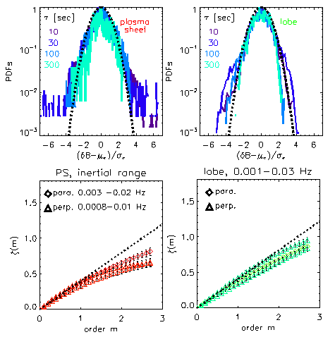
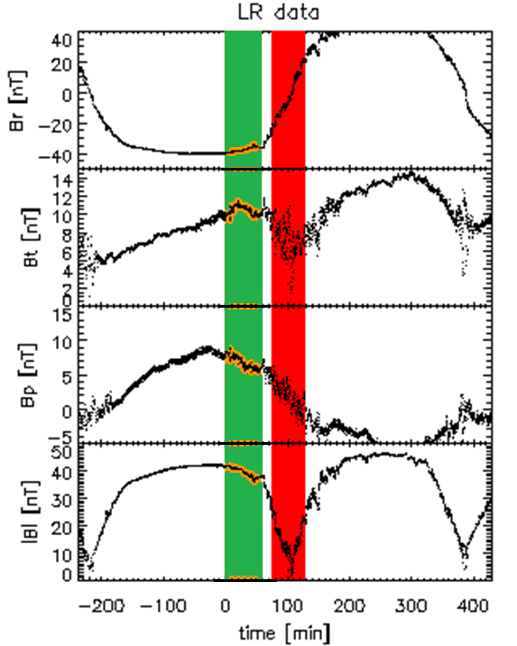
4. Spectrum: intermittency
11
Intermittency →dissipation self-similary or not
δB ≡ δB(t+τ)-δB(t)
S_{m}(τ)=<δB(t,τ)^{m}> ∝τ^{ξ(m)}
m: order S_{m}(τ): structure function
Br
B_{θ}
B_{Φ}
Intermittent feature is
seen in the inertial frequency range of current sheet
less in the lobe
|B|

Slide 12
HR events
12
-11 events (of 23) with power well above the “minimum” level
# | Start time | Galileo (x,y,z)_{JSE} [RJ] | R [RJ] | LT [h] | β | index 1 | index 2
1 | 1996/06/30 02:00 | (-25.9, 8.57, 0.186) | 27.3 | 22.7 | 2.43 | 1.78 | 2.11
2 | 1996/09/11 02:38 | (-39.2, 1.5, -0.22) | 39.3 | 23.8 | 1.72 | 0.59 | 1.89
3 | 1997/03/30 18:49 | (-14.7, -43.9, -0.037) | 46.3 | 4.7 | 3.41 | 0.98 | 2.53
4 | 1997/05/06 13:00 | (-0.2, -25.3, -0.38) | 25.3 | 5.9 | 1.17 | 0.71 | 1.94
5 | 1997/08/23 14:07 | (-125.8, -31.9, -0.52) | 129.8 | 0.9 | 3.22 | 1.05 | 2.33
6 | 1997/07/04 14:09 | (-56.6, 30.9, -0.12) | 64.5 | 22.0 | 1.43 | 1.50 | 2.48
7 | 1997/07/28 13:50 | (-0.7, 18.2, -0.04) | 18.2 | 18.1 | 1.08 | 1.38 | 2.26
8 | 1999/05/03 15:59 | (8.5, -3.8, -0.02) | 9.3 | 10.4 | 0.15 | 0.96 | 2.07
9 | 1999/07/01 23:52 | (3.6, -6.9, 0.00) | 7.8 | 7.8 | 0.10 | 1.04 | 2.19
10 | 2002/11/03 15:27 | (17.2, 23.5, -0.29) | 29.2 | 15.5 | 2.41 | 1.96 | 2.40
11 | 2002/11/04 21:48 | (2.4, 9.9, -0.12) | 10.2 | 17.0 | 0.26 | 1.30 | 1.68

Slide 13
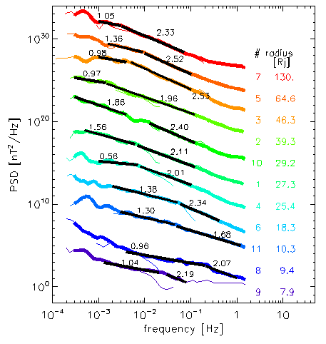
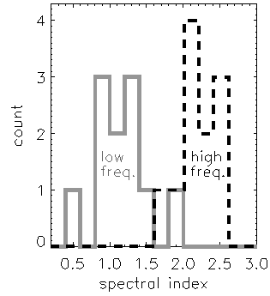
4. Spectrum : spectral index
13
Spectra from LR and HR data
Histogram of spectral index
Spectral index 0.5-1.9 for f < fb
1.7-2.5 for f > fb

Slide 14
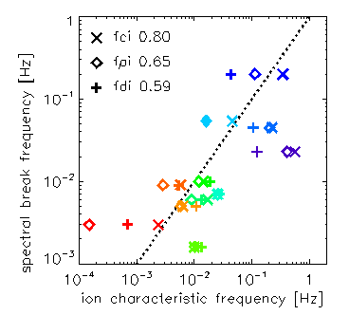
4. Spectrum: break point
14
Spectra from LR and HR data
Ion characteristic (x-axis) and break frequencies (y-axis)
Spectral breaking frequency is
-close to frequency at ion inertial length and gyro radius

Slide 15
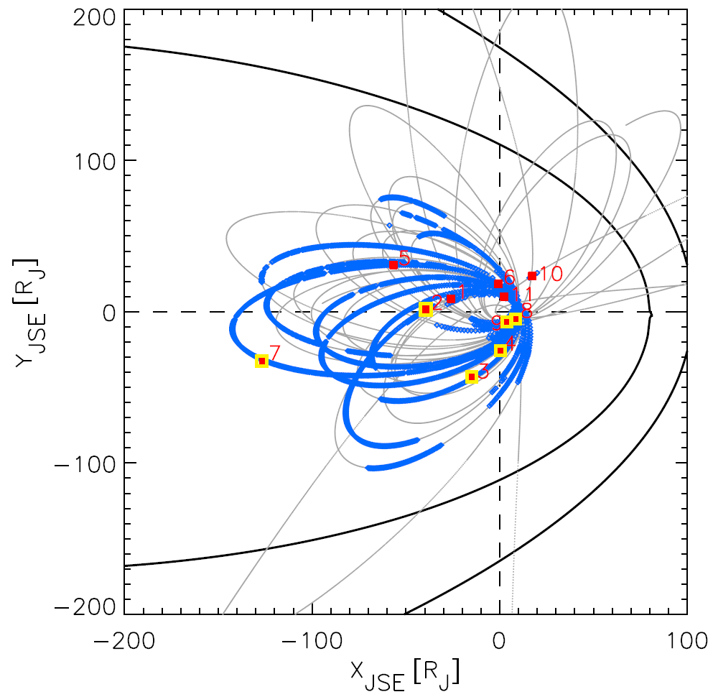
4. Spectrum: small spectral index
15
Spectra from LR and HR data
■ slope >1.36
■ slope <1.05
Small slope events
Small slope cases are seen in the dawnside observations

Slide 16
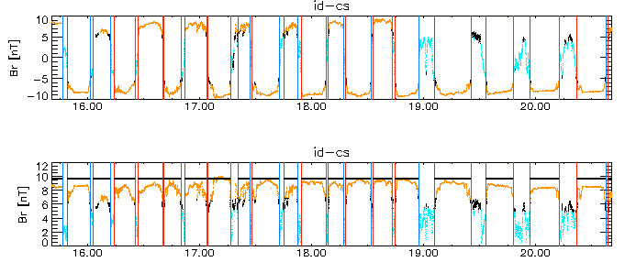
5. Statistical analysis
16
Galileo in the magnetosphere
Low resolution (LR) data : Δt~24 sec. →June 23, 1996 – Nov. 11, 2002
*Separate current sheet & lobe (automatically)
LR/HR obs.
plasma obs.
Br [nT]
|B| [nT]
Fig. An example of CS/lobe separation

Slide 17
17
5. Statistics: Radial dependence
-Most concentration of PSD by normalization with fci.
x-axis: frequency normalized by fci
normalized by fρi normalized by fdi
LF α HF α
(for fluid)
[Bourouaine et al., 2012]

Slide 18
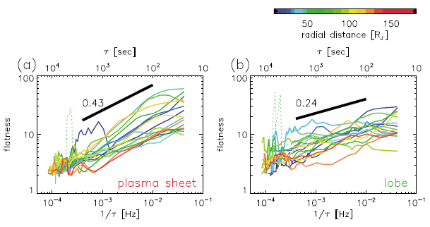
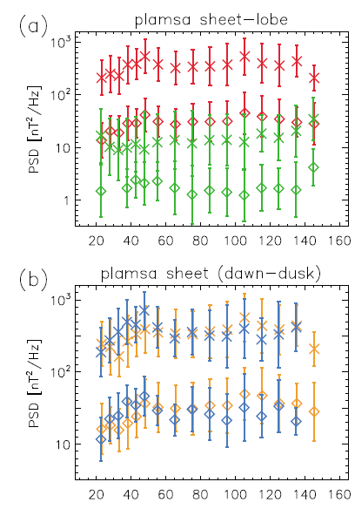
5. Statistics: Radial dependence 2
18
Plasma sheet
lobe
-Large deviation of flatness from Gaussian (=3) for plasma sheet case than lobe.
-PSD is large in the plasma sheet with enhancement at ~50 R_{J} and ~100 R_{J}.
-PSD enhancements at ~50 R_{J} is seen in the duskside and ~100 R_{J} in the dawnside.
dawn
dusk
Radial distance [Rj]

Slide 19
6. Discussion
19
1. Dependence of the breakpoint frequency
on the ion gyrofrequency, than ion scales
(cf. Ion inertial scale for solar wind)
→ Possible role of ion cyclotron waves and resonance
in the dissipation of magnetic energy into particle heating
*There is also an ambiguity in the plasma data,
model, and Taylor assumption
→ Expect to JUICE (future mission 2030-)
2. (Intermittency at current sheet) > (Intermittency at lobe)
This regional dependence is similar as seen in the Earth magnetotail
[Weygand et al., 2005]
→ reflecting local structures (i.e., reconnection and resulting flow).

Slide 20
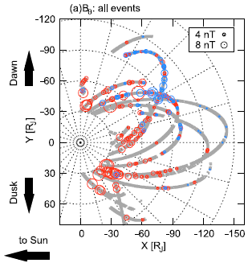
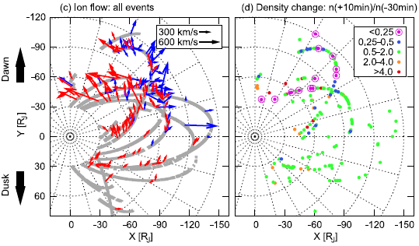
6. Discussion
20
3. Large total power in the duskside (dawnside) at <50 R_{J} (>80 R_{J})
4. Small spectral index at the dawnside is close to -1 in the “energy-containing scale”
*Reconnection-like magnetic features is observed at these locations, while ion flow and density change is associated with those in the dawnside [Kasahara et al., 2013].
*Large slope variation in the low-frequency range is due to the magnetospheric dynamics, as suggested in the case of Saturn [von Papen et al., 2014].
[Kasahara et al., 2013]

Slide 21
7. Summary and Conclusions
22
We analyze Galileo/MAG high and low resolution data using a wavelet method.
(1) Spectral feature, existence of break point?
★ We confirmed (at least) two spectral index.
-- The spectral index is 0.5-1.9 for lower and 1.7-2.5 for higher range of break point.
-- Spectrum break is close to frequency at ion gyrofrequency and ion scales.
(2) How turbulence feature varies in global various region?
★ The turbulence power and intermittency is strong in the plasma sheet than lobe.
★ The power enhances at ~50 R_{J} at the duskside and ~100 R_{J} at the dawnside.
(3) Relation between turbulence characteristics and magnetospheric phenomena?
★ Dawn-dusk asymmetries of PSD radial profile and slope at “energy-containing scales” would be related with magnetospheric reconnection and ion flow features.
statistical distribution so far. → event study?
(4) Comparison among different planetary magnetospheres
★ Dominance of intermittency in the plasma sheet is the same with Earth.
★ Spectral feature is due to plasma parameter. Detail → accurate obs. by JUICE etc.
Tao et al., Properties of Jupiter’s magnetospheric turbulence observed by
the Galileo spacecraft, J. Geophys. Res. Space Physics, 2015

