Slide 1
Solar System Plasma Turbulence, Intermittency and Multifractals
International Workshop and School
Effect of data gaps:
Comparison of different spectral analysis methods
Catalin Negrea ^{1,2,3} Costel Munteanu^{1,4,5}
¹ Institute of Space Science, Magurele, Romania,
² CIRES, University of Colorado at Boulder,
³ NOAA/SWPC, Boulder, CO, USA,
⁴ Department of Physics, University of Oulu, Finland
⁵ Department of Physics, University of Bucharest, Magurele, Romania

Slide 2
Basic Spectral Analysis
Spectral analysis tools are used in a multitude of scientific fields.
Ideal case, uniform sampling:
$(x_{0},x_{1},…,x_{l},…,x_{n})$ $X_{j}=\sum_{l=0}^{n}{x_{l}e^{−i2πf_{j}{ t}_{l}}}$ $(X_{0},X_{1},…,X_{j},…,X_{N})$
$(0,∆t,…,l ∆t,…,n ∆t)$ $f_{j}=j\frac{1}{n ∆t}$ $(0,f_{1},…,f_{j},…,f_{N})$
The frequency set used by the FFT allows for very fast calculations.
It is also an orthogonal set of frequencies, such that the amplitude determined for any of these frequencies is independent of all others.
Fast Fourier Transform

Slide 3
Basic Spectral Analysis
Real case, non-uniform sampling:
$(x_{0},x_{1},…,x_{l},…,x_{n})$ $X_{j}=\sum_{l=0}^{n}{x_{l}e^{−i2πf_{j}{ t}_{l}}}$ $(X_{0},X_{1},…,X_{j},…,X_{N})$
$(0,t_{1},…,t_{l},…,t_{n})$ $?$
Currently, there is no known method that can determine an orthogonal set of frequencies for the general case of a non-uniformly sampled dataset.
This allows for various errors to occur (spectral leakage, parasitic harmonics, side lobes).
This is a general property of the Power Spectrum, independent of the method used to calculate it.

Slide 4
Methods Used
Our goal is to quantify the errors and biases of the following methods in order to establish their domain of applicability:
Fast Fourier Transform & Linear Interpolation (FFT):
Discrete Fourier Transform (DFT):
$X_{j}=\sum_{l=0}^{n}{x_{l}e^{−i2πf_{j}{ t}_{l}}}\frac{{∆t}_{j}}{2}$
Z Transform (ZTR):
$X_{j}=\sum_{l=0}^{n}{x_{l}e^{−i2πf_{j}{ t}_{l}}}$
Lomb-Scargle (LST):
$X_{j}=\sqrt{\frac{1}{N}\left[\frac{{\left(\sum_{i}{\left(x_{i}−\overline{x}\right) cos⁡ω(t_{i}−τ)}\right)}^{2}}{\sum_{i}{\cos^{2}⁡ω(t_{i}−τ)}}+\frac{{\left(\sum_{i}{\left(x_{i}−\overline{x}\right) sin ω(t_{i}−τ)}\right)}^{2}}{\sum_{i}{\sin^{2}⁡ω(t_{i}−τ)}}\right]}$

Slide 5
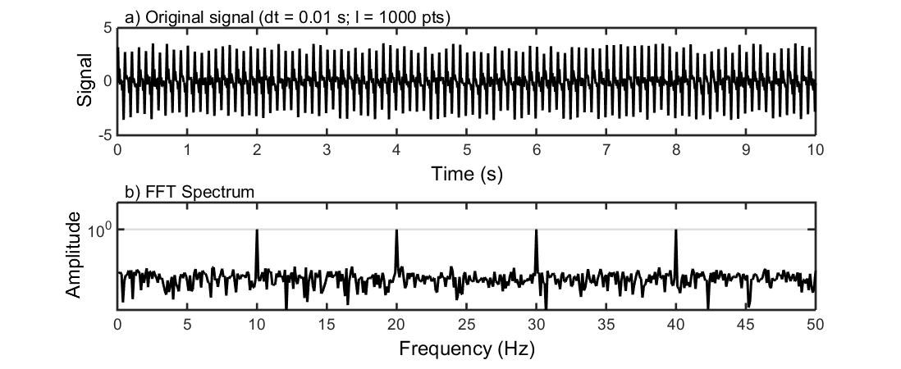
Tests on Synthetic Data
Synthetic, continuous dataset:
A superposition of sinusoids with added noise.
To this “data” we apply a series of gaps and re-compute the Amplitude Spectrum using all four methods.

Slide 6
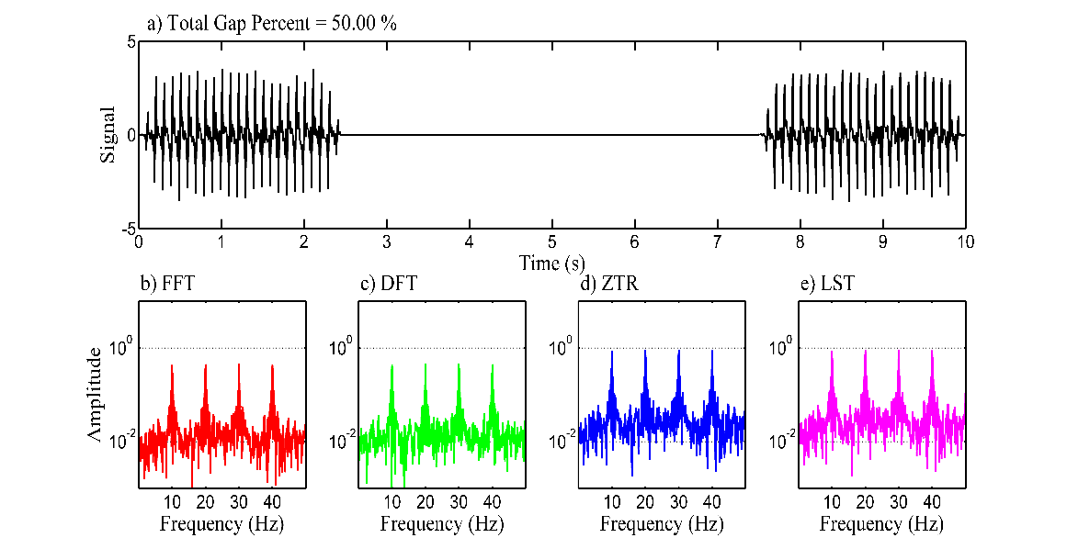
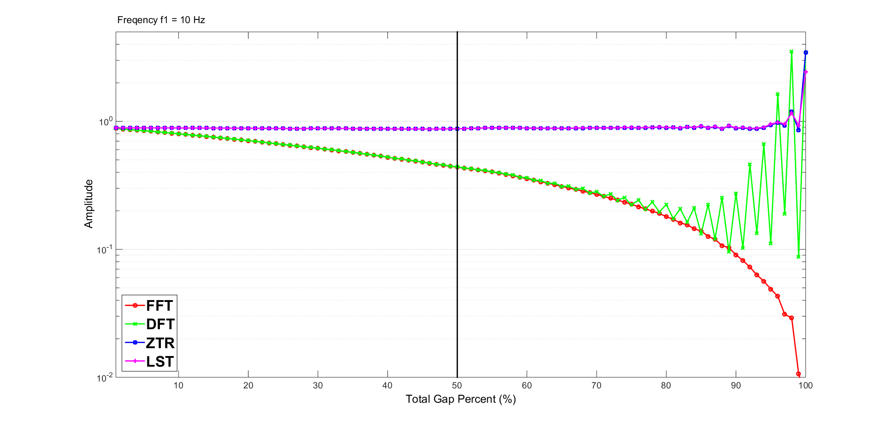
Tests on Synthetic Data
In the case of a single large gap, ZTR and LST obtain good results, even for gaps of 90%.
The drawback is a decrease of the Signal-to-Noise Ratio.
FFT and DFT show a bias dependent on the gap size.
This behavior of all four methods is the same for all four synthetic harmonics.

Slide 7
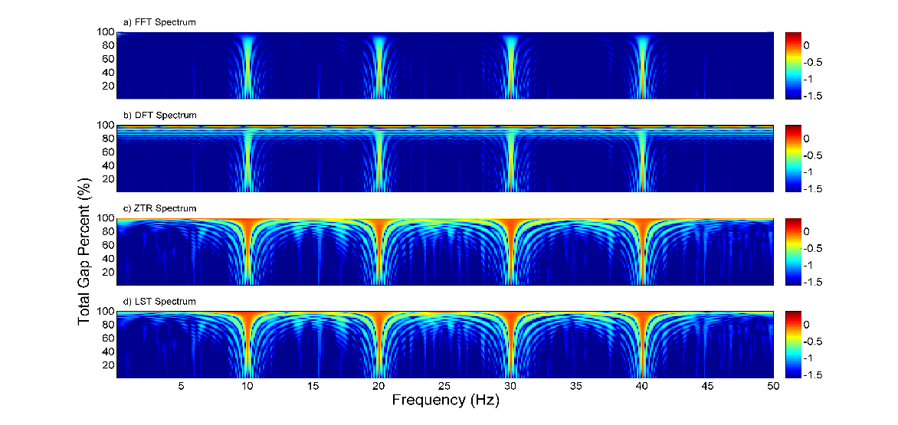
Tests on Synthetic Data
A more in-depth analysis shows a growth of the side-lobes associated with each harmonic as the gap size increases for the ZTR and LST.
For applications where we need to find the amplitude of a dominant harmonic with a known frequency, LST and ZTR are likely to perform well even in the case of extremely large data gaps (~90%).
This is achieved at the cost of an increase in side-lobe level.

Slide 8
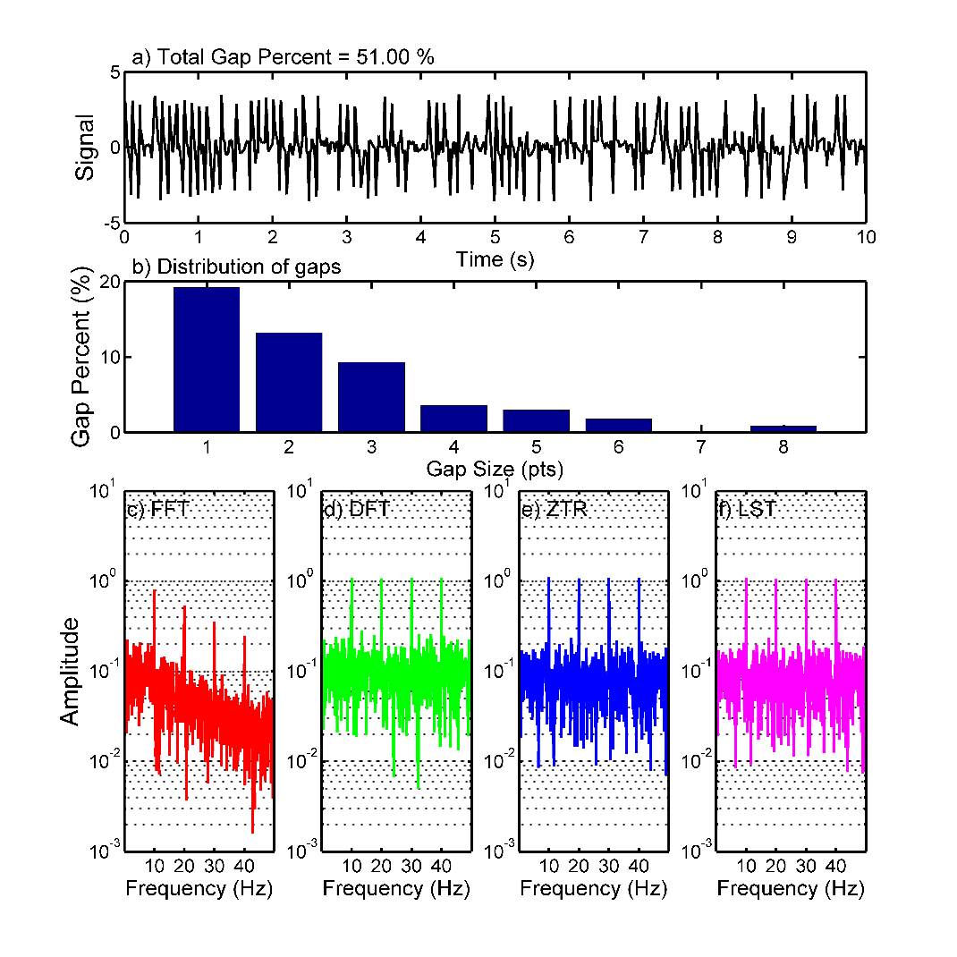
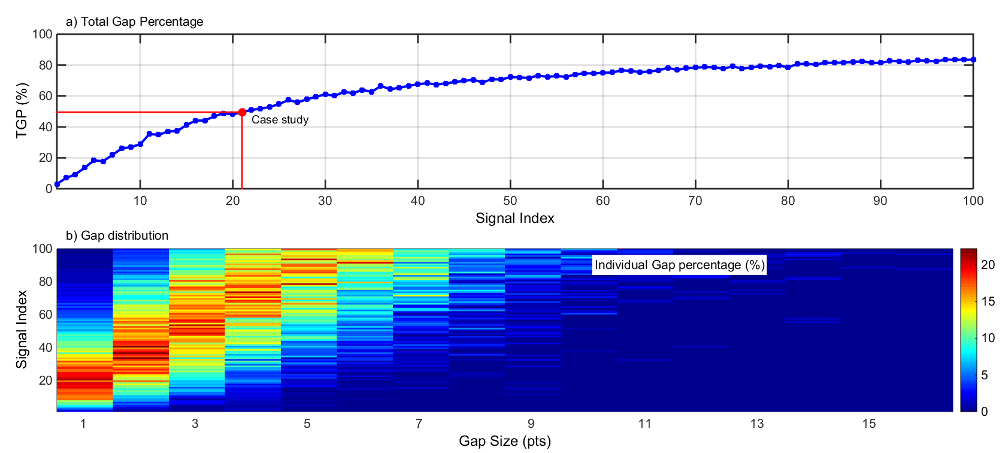
Tests on Synthetic Data
Another frequently encountered situation is the presence of multiple, small gaps of varying size and position.
We simulate this scenario by applying gaps distributed in accordance with a gamma distribution.
The resulting time series are analyzed with the four methods tested.

Slide 9
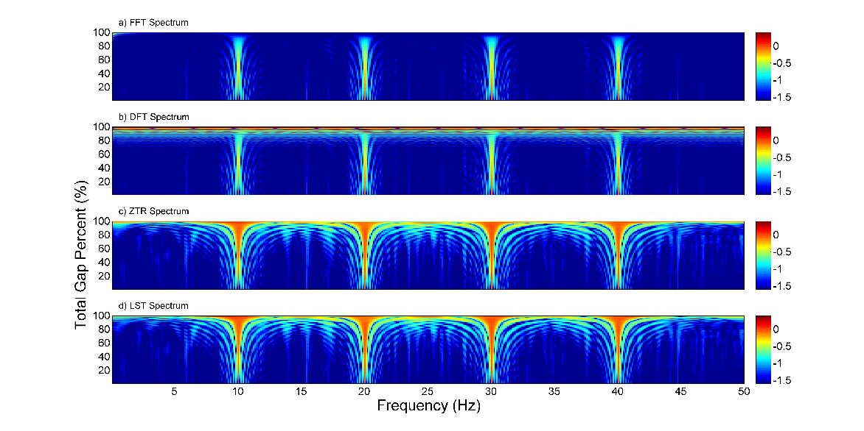
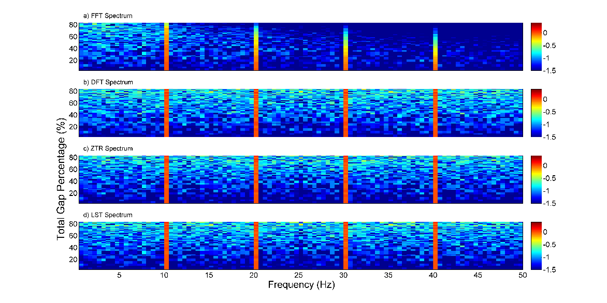
Tests on Synthetic Data
Similarly, the ZTR and LST correctly report the amplitude of all four harmonics even for large gaps. In addition, the DFT results are similarly accurate. The tradeoff is lower SNR, but in this case due to random noise.
The FFT again shows a bias dependent both on frequency and on the Total Gap Size.
Results for a Single Large Gap
Results for a Multiple Small Gaps

Slide 10
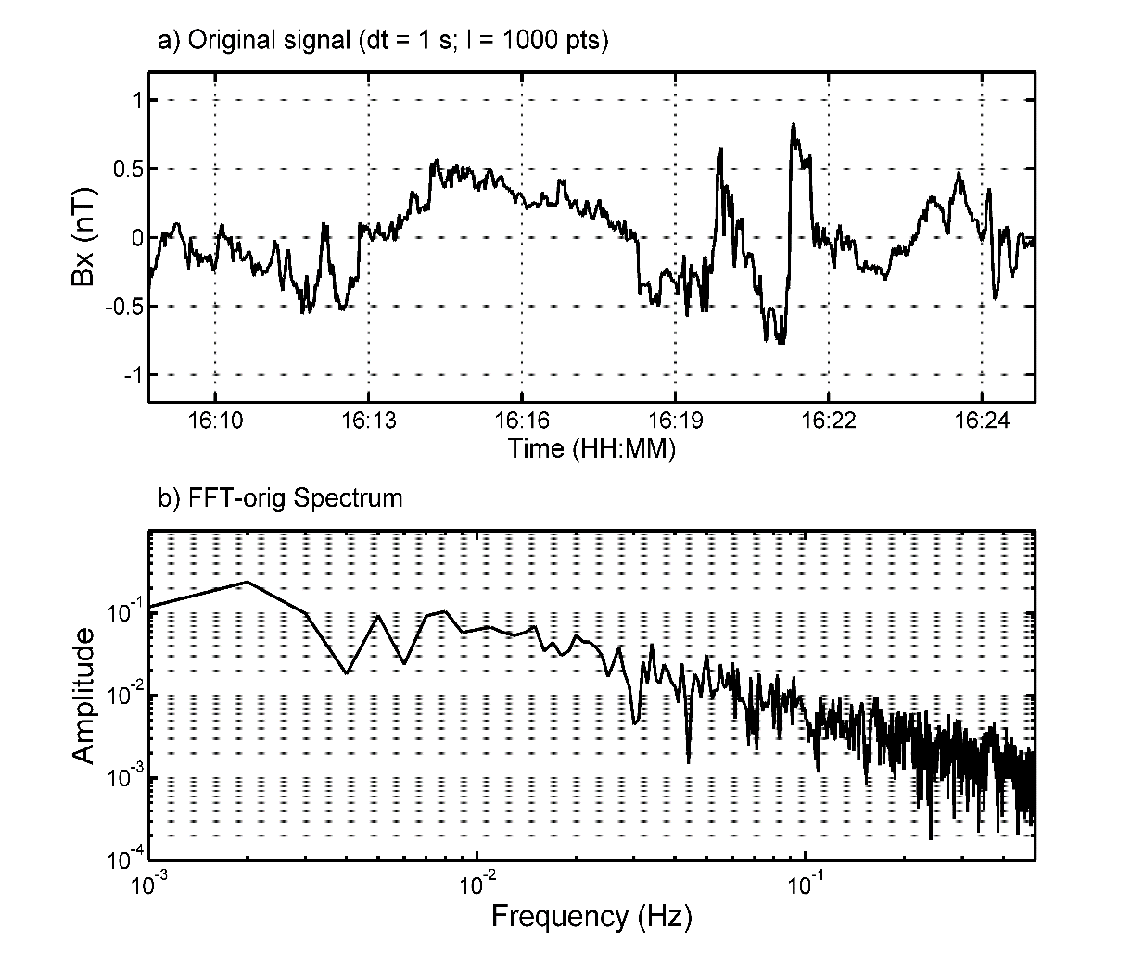
Tests on Venus Express Data
A continuous magnetic field dataset taken by Venus Express in 2007 was also analyzed.
The same methodology was used, applying different configurations of gaps to test the behavior of the 4 spectral analysis methods.

Slide 11
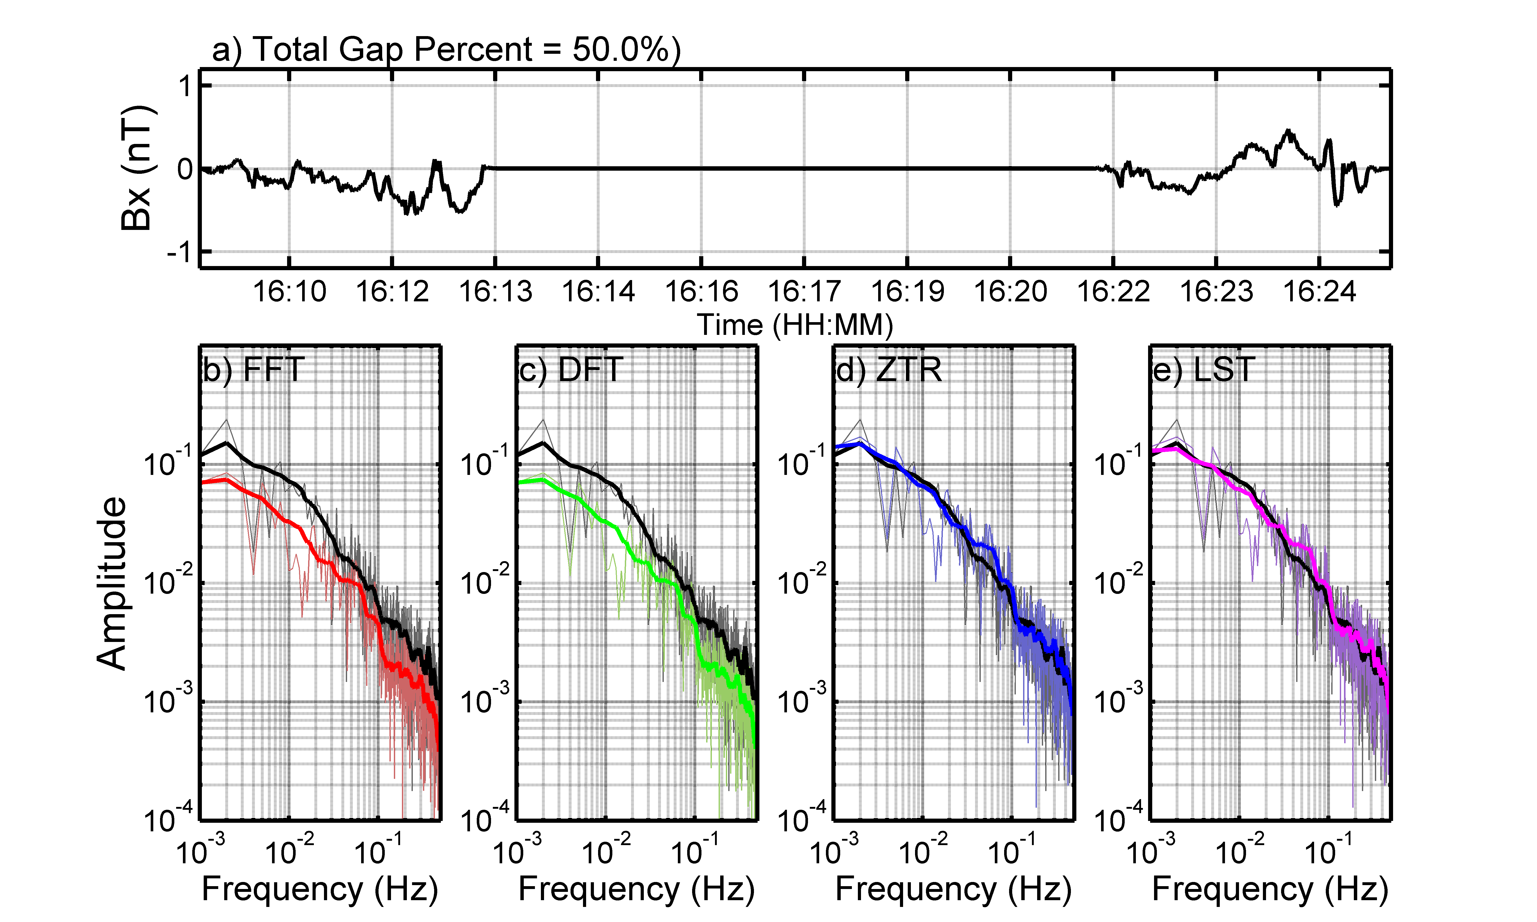
Tests on Venus Express Data
When applying a single large gap to the data, the ZTR and LST results show a positive bias, while the FFT and DFT results show a negative bias.

Slide 12
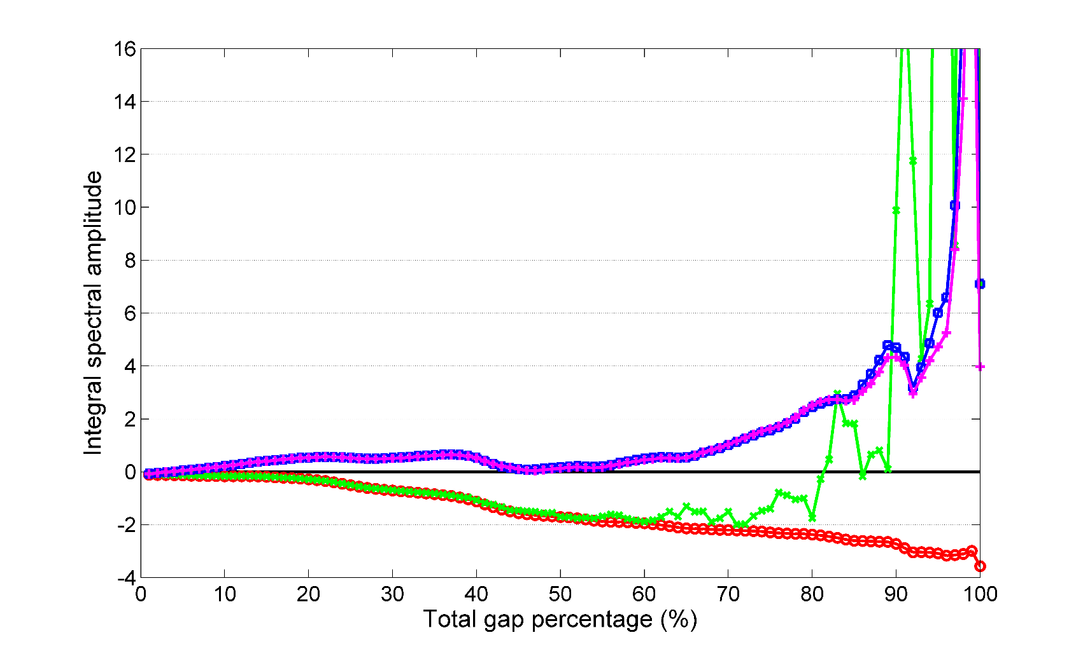
Tests on Venus Express Data
Integrating the Power Spectra gives a better idea of the behavior of each method as a function of gap size.

Slide 13
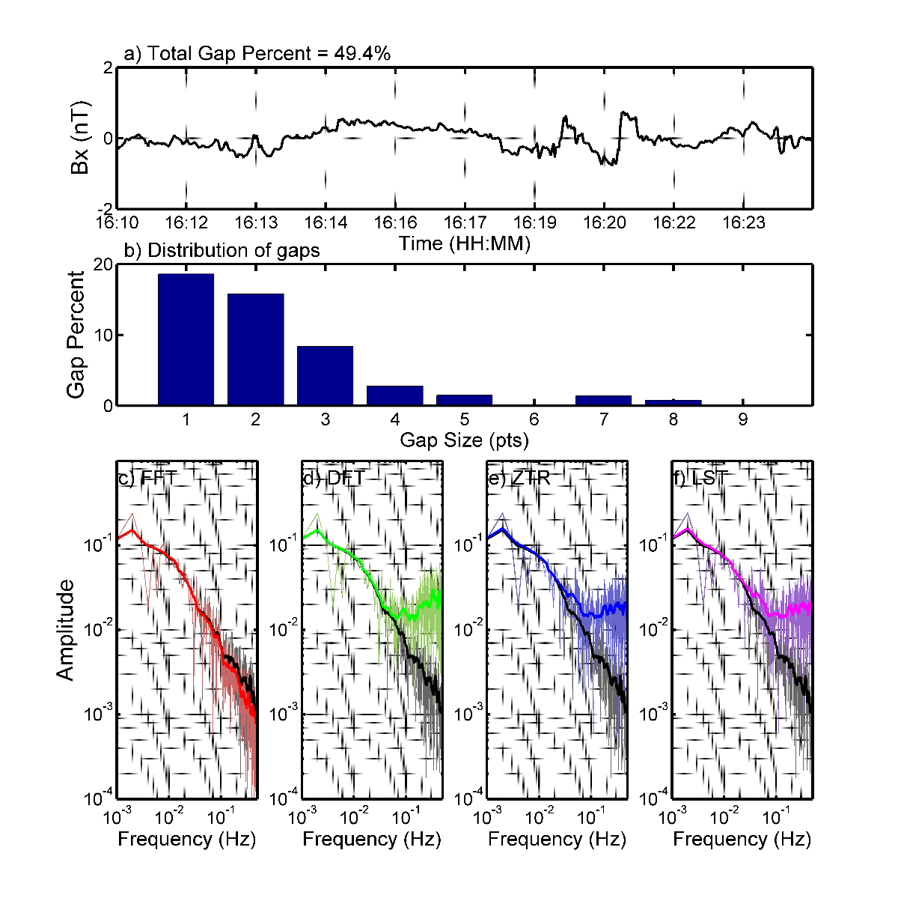
Tests on Venus Express Data
In the case of multiple small gaps applied on Venus Express data, the results are surprising.
The method that best preserves the shape (and slope) of the spectra is the FFT with linear interpolation.
The DFT, ZTR and LST report biased spectra, with a frequency dependence to this bias.

Slide 14
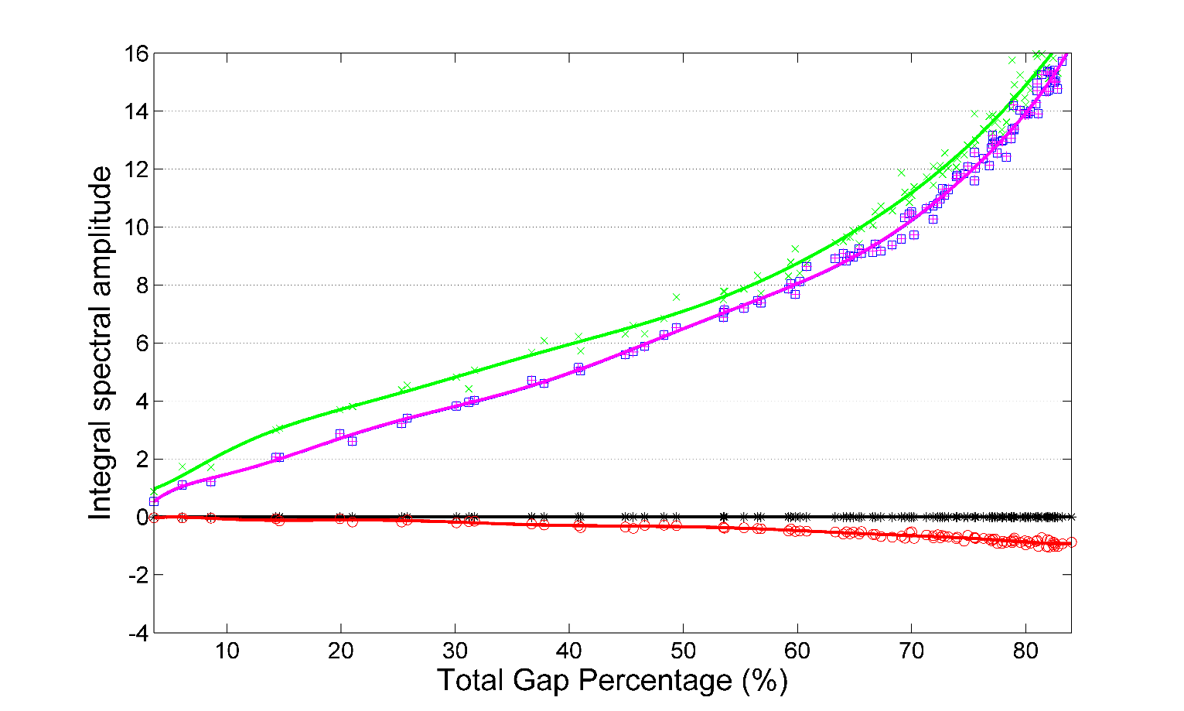
Tests on Venus Express Data
The behavior of the integral of the spectrum as a function of total gap percentage gives a better idea on the extent of this bias.

Slide 15
Conclusions
There is no generally valid solution for the problems caused by data gaps. The method chosen will depend on the type of data analyzed and on the signal of interest.
In the analysis of time series containing strong sinusoidal harmonics, the most accurate methods are found to be Lomb-Scargle and the Z-Transform. The reported amplitudes are accurate even in the presence of very large data gaps, with the price of a lower SNR.
For more turbulent spectra, the appearance of side lobs and spectral noise makes the effect of data gaps more pronounced for the DFT, ZTR and LST methods than for FFT. Thus, our results indicate that, at least when the data includes gaps, FFT is the best method to approximate reliably the spectral slope of a signal recorded in a turbulent environment.
Other, more complicated errors may also occur in the case of particular gap configurations.

Slide 16
Thank you!

Slide 17
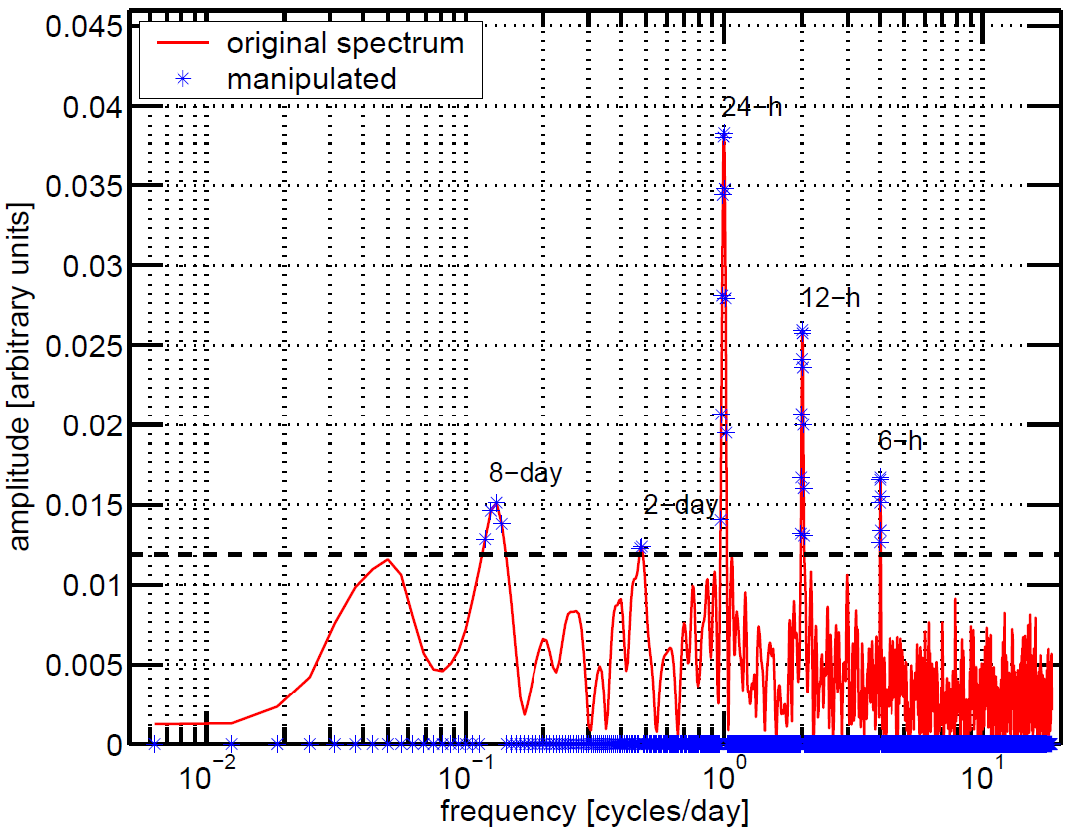
Confidence Test

