Slide 1
Multi-facets of Magnetospheric Phenomena
Anthony Lui
JHU/APL
Auroral activities and their implications
Magnetospheric substorms: early day research – gross global view
Magnetospheric substorms: recent day research – refined view
Multiscale and intermittency in substorm phenomena
Complexity analysis of substorm phenomena: fractal, multifractal, scaling, wavelet, phase transition, SOC, FSOC
Physical mechanism for energy transfer between scales in current disruption – inverse cascade
Summary

Slide 2
Introduction
There are several natural wonders, e.g., sunset, rainbow, and …
the northern lights.

Slide 3
Sunset

Slide 4
Introduction
There are several natural wonders, e.g., sunset, rainbow, and …
the northern lights.

Slide 5

Rainbow

Slide 6
Introduction
There are several natural wonders, e.g., sunset, rainbow, and …
the northern lights.

Slide 7
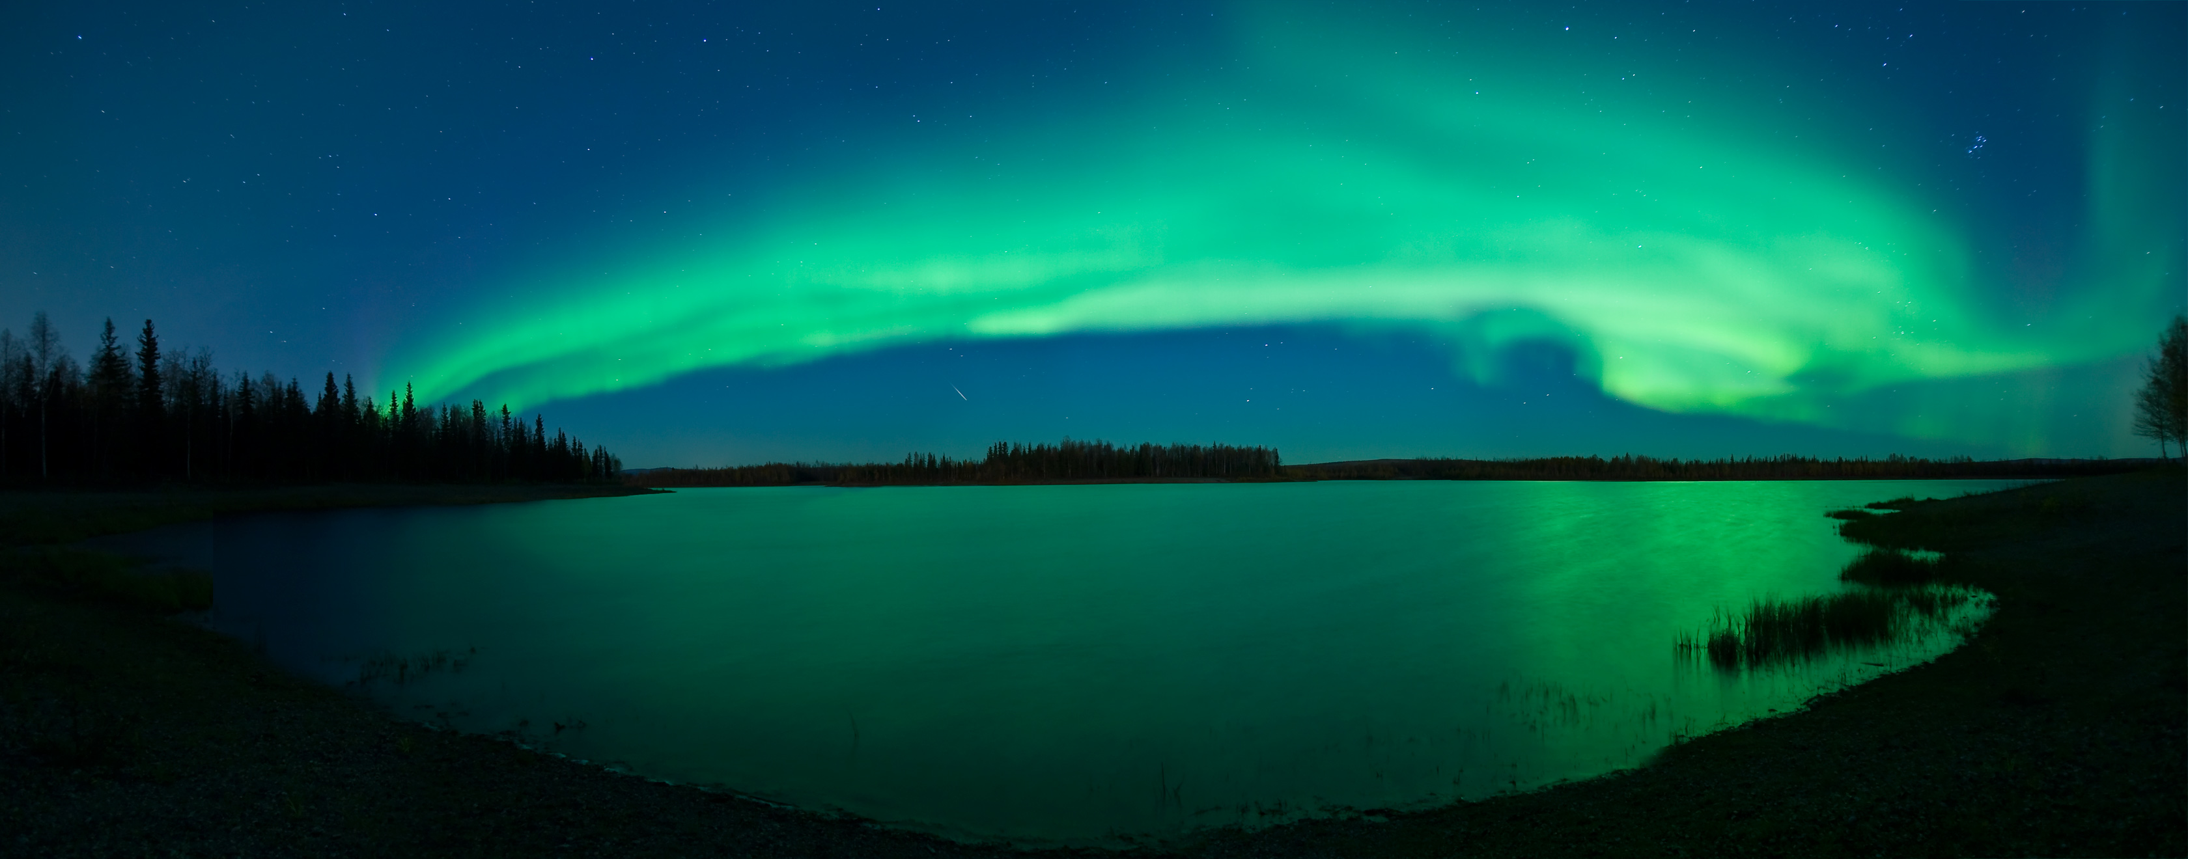
The Northern Lights (Auroras)

Slide 8
Dynamic Aurora Activity From International Space Station
https://www.washingtonpost.com/blogs/capital-weather-gang/wp/2015/09/09/colorful-green-and-red-aurora-lights-up-the-sky-as-far-south-as-virginia-photos/

Slide 9
Auroral Activities Are Projections of Magnetospheric Activities

Slide 10
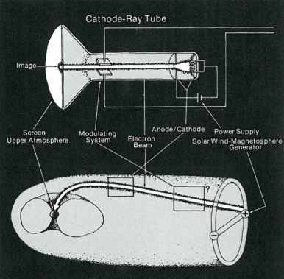
Analogy With Television

Slide 11
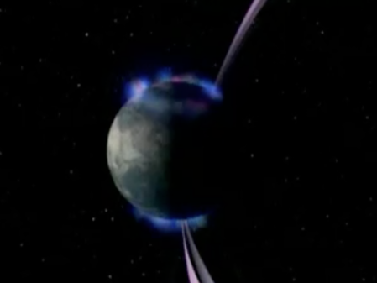
Auroras Connect to
High Above the Upper Atmosphere
Locations of auroras are sites where high energy electrons ‘rain’ down from high above the upper atmosphere. These electron motions are not balanced by those of ions and result in electrical currents.

Slide 12
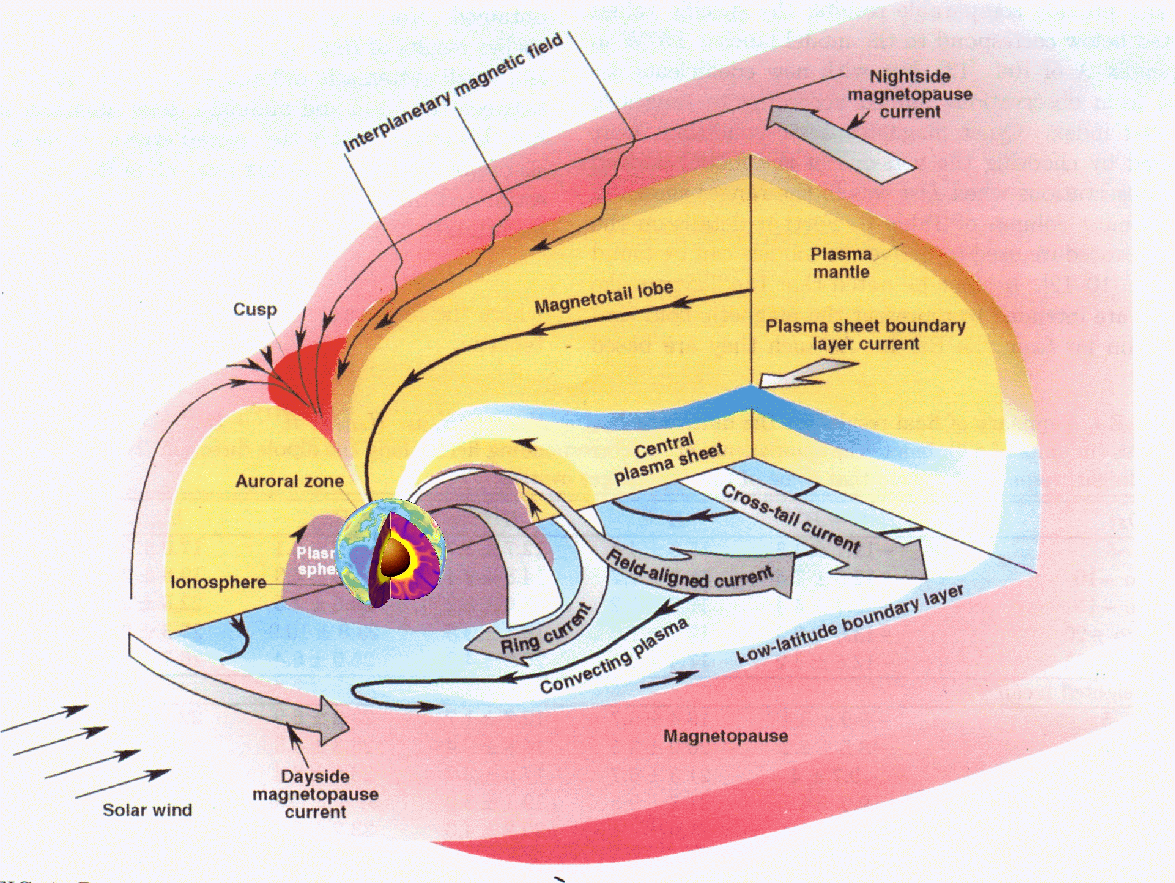
Regions Within the Magnetosphere

Slide 13
Auroral Substorms

Slide 14
Episodic Cycle of Auroral Activity

Slide 15
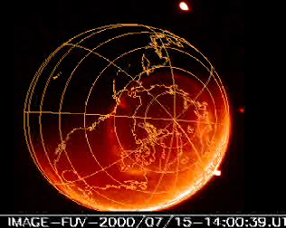
Satellite Movie of Auroral Susbstorm

Slide 16
The Early Days of Research on Magnetospheric Substorm Dynamics

Slide 17
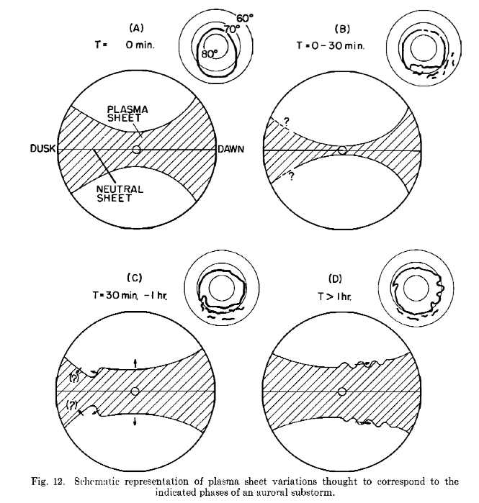
Plasma Sheet Configuration During Substorm
Akasofu et al. [1971]

Slide 18
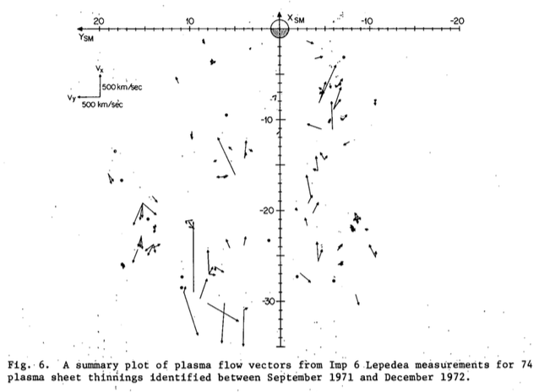
Plasma Flow During Plasma Sheet Thinning
Lui et al. [1977]

Slide 19
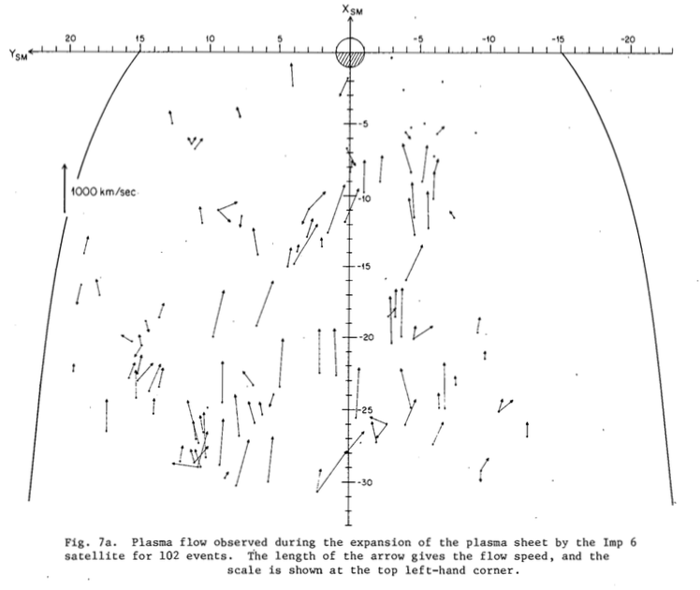
Plasma Flow During Plasma Sheet Expansion
Lui et al. [1977]

Slide 20
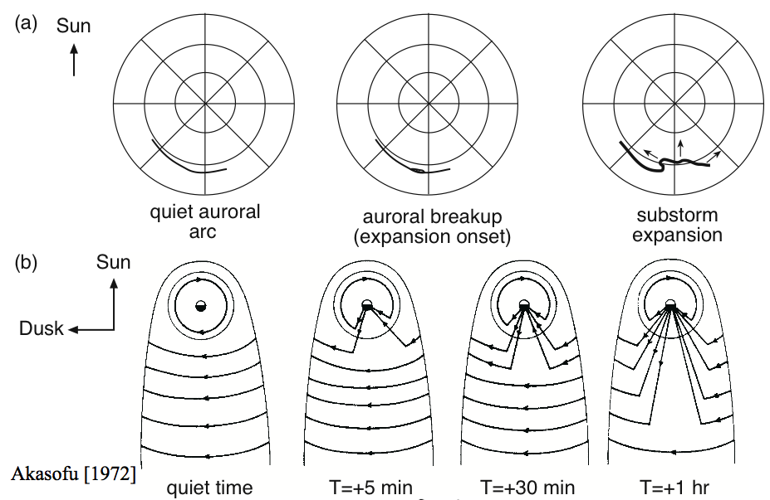
Substorm Current System
Akasofu [1972]

Slide 21
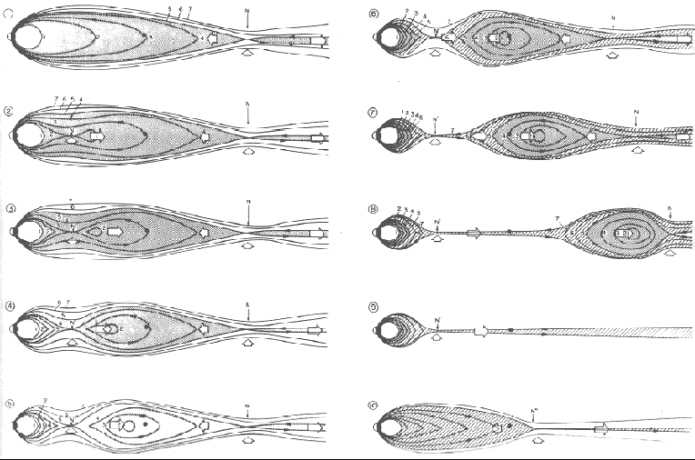
NENL Model Scenario for Auroral Substorm
The NENL forms at substorm expansion and moves tailward later (Hones, 1979).

Slide 22
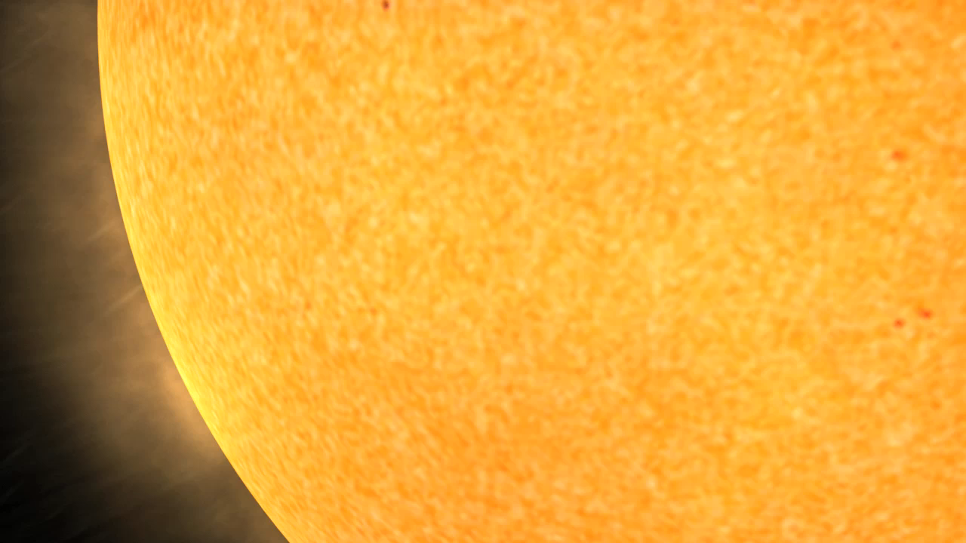
Movie of Magnetic Reconnection Substorm Model

Slide 23
Substorm Energy is Dissipated by Magnetic Reconnection

Slide 24
Later Observations Suggest Small Scale Features (Current Disruption) in Magnetospheric Substorms

Slide 25
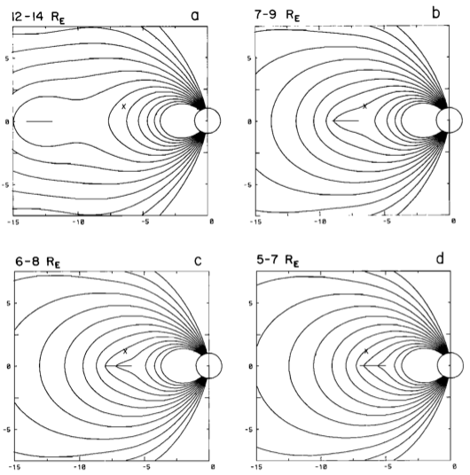
Strong Cross-Tail Current Before Substorm Onset
Before substorm expansion onset, magnetic field near the geostationary orbit changes from dipolar-like to tail-like. From a simple model of a current sheet, Kaufmann [1987] showed that a strong current sheet (300 mA/m) must develop near that altitude in order to cause such a field configuration change.
Z
X
X
Z

Slide 26
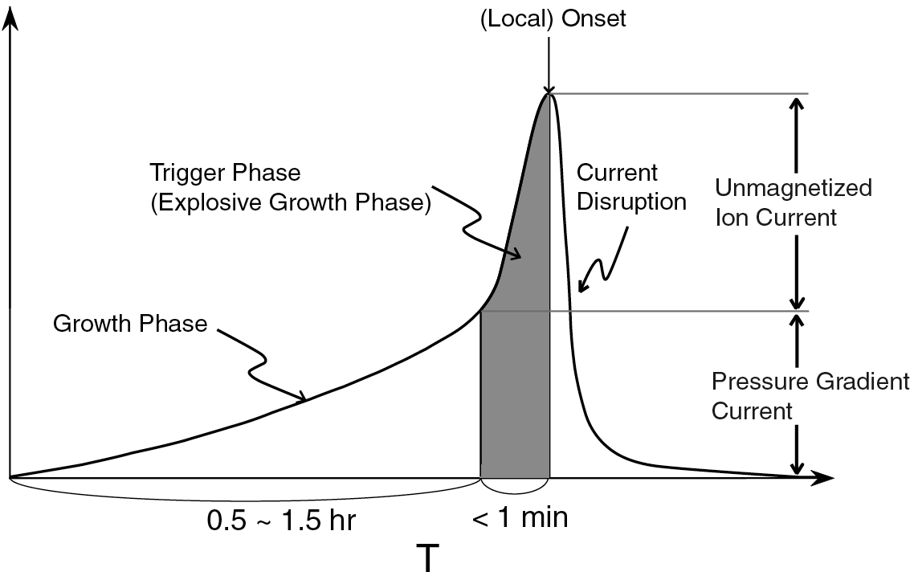
Current Intensification Prior to Disruption
From analysis of ISEE-1 and -2 magnetic field data Ohtani et al. [1992] reported that prior to current disruption, the current density in the near-Earth neutral sheet region typically increases explosively - coined the ‘explosive growth phase.’

Slide 27
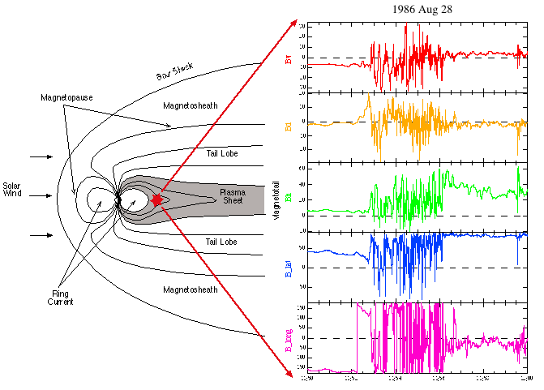
Signature of Current Disruption - 1
Bv
Bd
Bh
λB
φB
Transition Region
from dipole to tail-like
Takahashi et al. [1987]

Slide 28
Multi-frequency Turbulence
Lui and Najmi [1997]

Slide 29
Synoptic Flow Pattern
Plasma flow activity is transient, intermittent, and spatially localized.
Lui et al. [1998]

Slide 30
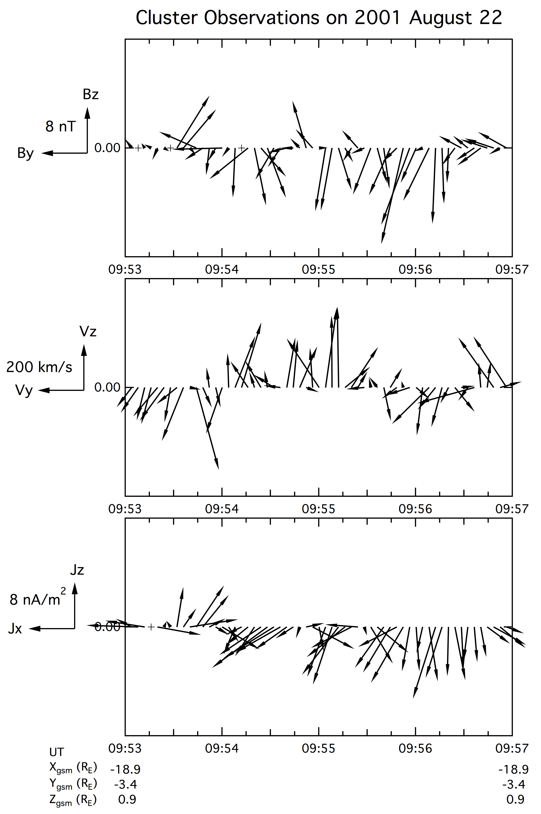
Signature of Current Disruption - 2
Magnetic field fluctuations, plasma flow activity, and current density variations are all transient and intermittent in nature.
Lui et al. [2007]

Slide 31
Signature of Current Disruption - 3
Lui [2001]
Current sheet becomes filamentary and the current density pattern displays complex distribution and topology including embedded reversals in current density direction. The associated jxB force is not ordered by the magnetic field pattern, in contrast to magnetic reconnection.

Slide 32
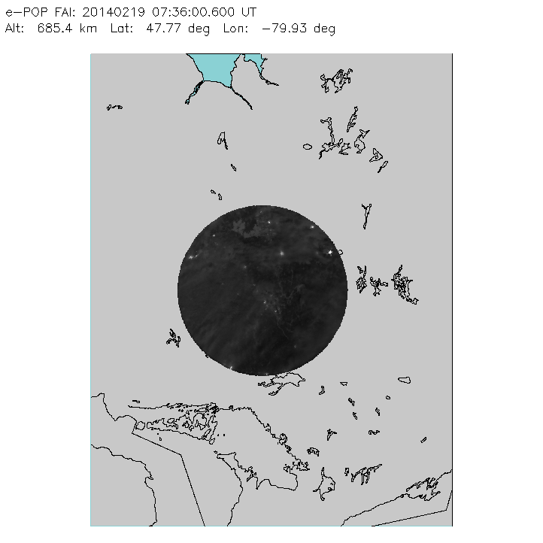
Movie of auroral activity seen by the Fast Auroral Imager on the Canadian satellite e-POP during a substorm on 2014 February 19 shows auroral activity to be transient, intermittent, and spatially localized.
Lui et al. [2015]

Slide 33
Another Substorm Model

Slide 34
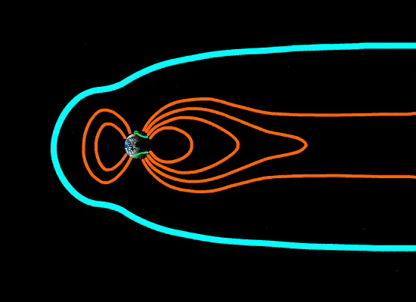
Movie of Current Disruption Substorm Model

Slide 35
Generalized Ohm’s Law
From first principle, all potential causes for the breakdown of the frozen-in condition are given by the generalized Ohm’s law for a collisionless plasma with inclusion of large amplitude and rapid fluctuations of electric and magnetic fields [Yoon and Lui, 2006].
The terms on the second line are called, respectively, inertial, Hall, electron viscosity, and anomalous resistivity (electric and magnetic field fluctuations).

Slide 36
Energy Transformation
The new variable E’ denotes the electric field in the rest frame of the plasma.
Note the absence of the Hall term because of the vector identity (J•JxB = 0) => it is not a relevant term.
If J•E’ > 0, dissipation in the plasma rest frame; field energies converted to particle energy.
If J•E’ < 0 (dynamo), particle energy converted to electric and magnetic field energies.
Lui et al. [2007]

Slide 37
Intervals of Interest
Lui et al. [2007]
C1: RUMBA
C2: SALSA
C3: SAMBA
C4: TANGO
The intervals of interest were in the midst of a substorm expansion period when the Cluster satellites were at a downstream distance of ~19 Re in the magnetotail.
Note that C1 & C2 were almost at the same Z_{gsm}, a feature that will be used in evaluating the electron viscosity term in the generalized Ohm’s law.

Slide 38
Terms in Generalized Ohm’s Law-1
Note different scales are used in these plots.
Similar profiles of E_{y}, Hall and E-Resistivity
In descending order of magnitude:
(1) E-resistivity
(2) Hall
(3/4) Electron viscosity/B-resistivity
(5) Inertial.
E_{y}
Hall
Inertial
e Viscosity
E-resistivity
B-resistivity
Lui et al. [2007]

Slide 39
Terms in Generalized Ohm’s Law-2
Similar features were seen.
Breakdown region is an electron diffusion region due to importance of resistivity, Hall, and electron viscosity terms.
Negative values of resistivity implies fluctuations give rise to a dynamo (rather than dissipative) effect.
E_{y}
Hall
Inertial
e Viscosity
E-resistivity
B-resistivity
Lui et al. [2007]

Slide 40
Electron Diffusion Region
If we move the Hall term to the LHS of the generalized Ohm’s law equation, one may examine whether the motion of electrons in the breakdown region remains tied to the motion of the magnetic field lines, i.e., whether or not it is an electron diffusion region.
If the breakdown is due to inertial, electron viscosity, or field fluctuations, then the breakdown region is an electron diffusion region.
Lui et al. [2007]

Slide 41
Table of Several Instances
Time | E_{y} | -(VxB)_{y} | Hall | Inertial | e viscosity | E-resist. | B-resist. | LHS | RHS
0942:04 | 20.2 | 11.4 | 6.4 | 0.010 | 0.52 | -0.9 | 0.20 | 8.8 | 6.2
0942:16 | 26.8 | 9.4 | 4.0 | 0.005 | 0.51 | 17.0 | -0.10 | 17.4 | 21.4
0942:40 | 22.6 | 3.1 | 3.8 | 0.009 | -0.57 | 16.8 | 0.35 | 19.5 | 20.4
0942:56 | 41.3 | 13.1 | 1.3 | 0.001 | -0.24 | 27.6 | -0.02 | 28.2 | 28.6
0943:36 | 25.9 | 6.2 | 2.9 | 0.008 | -0.47 | 18.0 | -0.30 | 19.7 | 20.1
0954:36 | 38.6 | -2.2 | 4.6 | 0.003 | 0.10 | 18.4 | -0.65 | 40.8 | 22.5
0955:16 | 27.7 | 0.26 | 2.0 | 0.000 | 0.35 | 9.9 | 0.24 | 27.4 | 12.5
With the two resistivity terms together, terms in descending order of importance are anomalous resistivity, Hall, electron viscosity, and inertial.
Sum of terms on the RHS agrees well (mostly within a factor of two) with that on the LHS with the consideration of measurement uncertainties.
Lui et al. [2007]

Slide 42
Current-Driven Plasma Instability Responsible For Substorm Onset
Lui et al. [2007]

Slide 43
Complexity Analysis of Substorms and Magnetic Fluctuations in Current Disruption (CD)

Slide 44
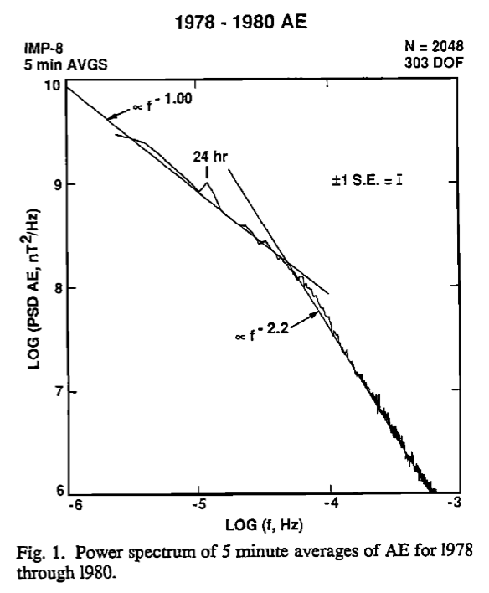
Power Spectrum Break of AE index
AE index is a measure of auroral electrojet strength and substorm intensity.
Tsurutani et al. [1990] demonstrated for the first time that there is a sharp break in the power spectrum of AE at ~5 hr.
At high frequency, it has a f^{-2.2} slope and at low frequency it has a f^{-1.0} slope
The power spectrum break suggests different dynamic processes for different frequency regimes.

Slide 45
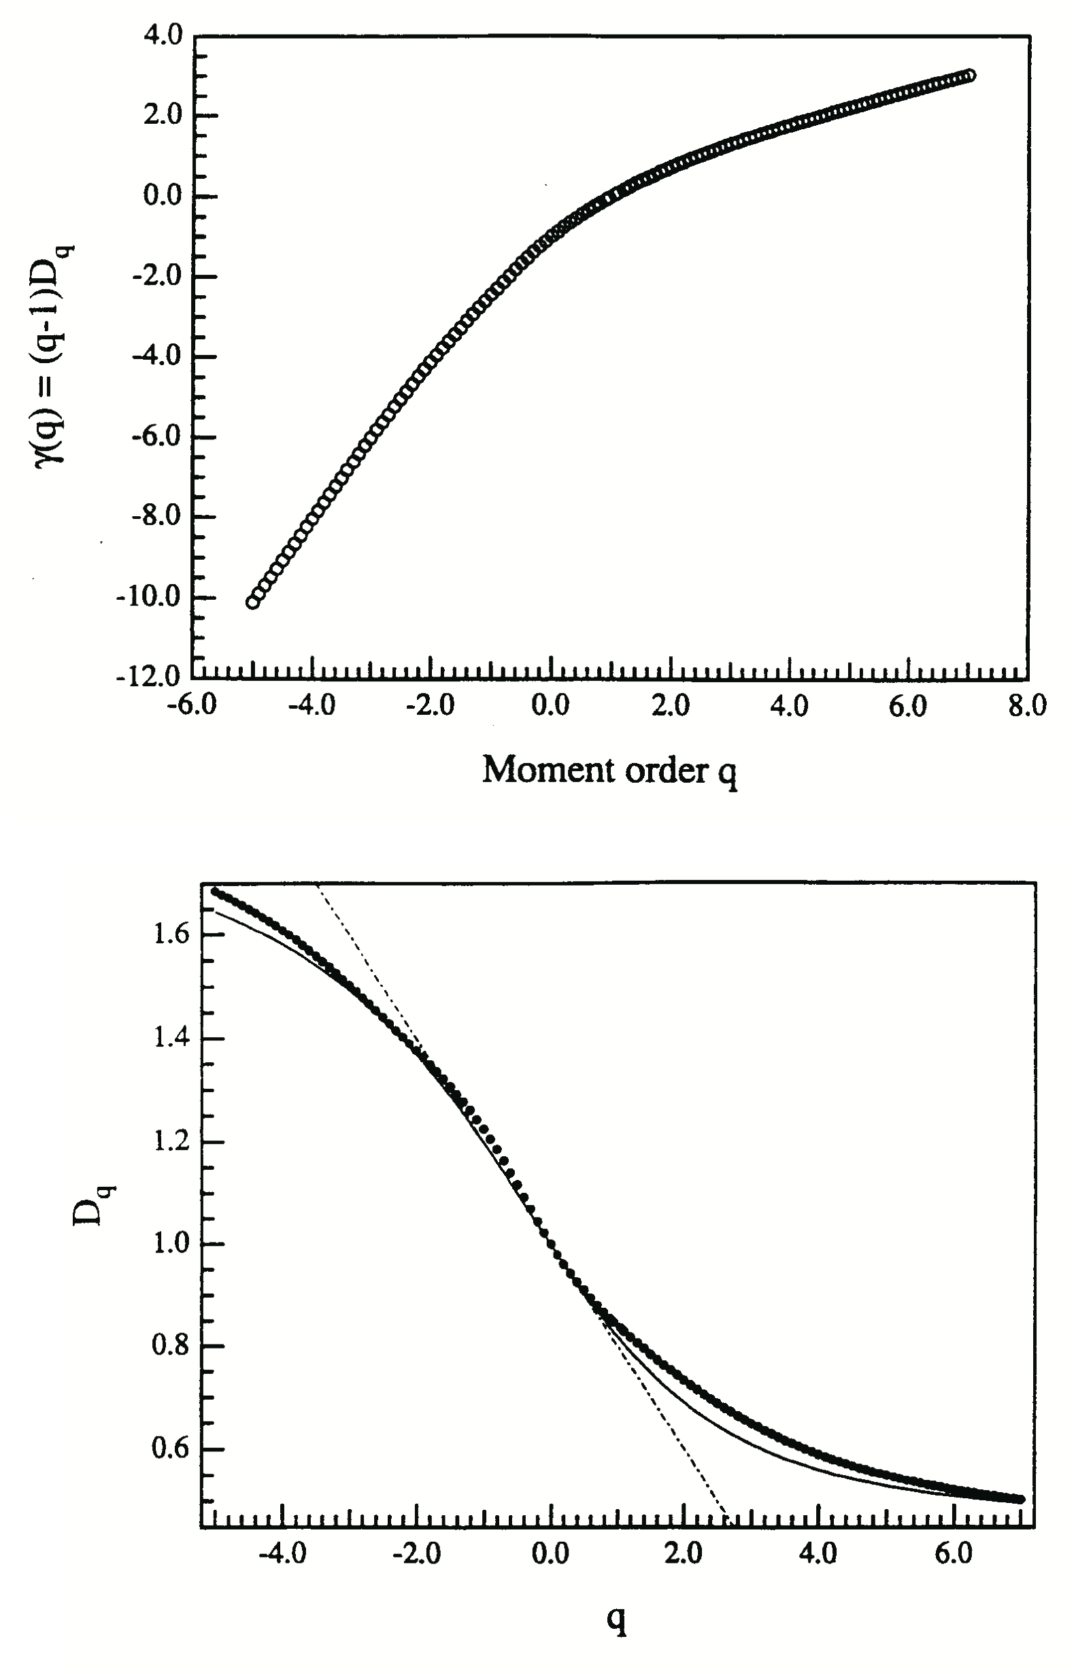
Multifractal Analysis
Consolini et al. [1996] found from multifractal analysis that the scaling exponent and the generalized dimension of the AE index change continuously over a range of scales.
Scaling exponent
Generalized dimension

Slide 46
Fractal Analysis of CD
The first report on the scaling properties of CD is by Ohtani et al. [1995].
With fractal analysis, they showed a break in the power spectrum of magnetic fluctuations and a characteristic time scale typically longer than the proton gyroperiod.

Slide 47
From Scale Analysis to Phase Transition Consideration in a System

Slide 48
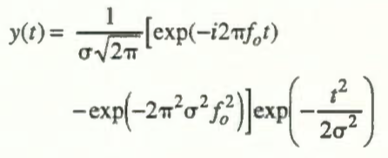
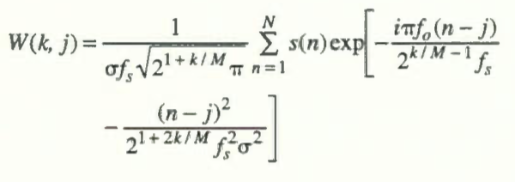
Wavelet Analysis of CD
Wavelet technique can analyze a non-stationary signal, i.e., one with the characteristic time scales that may change within the interval examined.
For dynamic situation, nonstationary signals cannot be ruled out.
Wavelet analysis does not suffer from this limitation.
Lui and Najmi [1997] showed that CD not only has multi-scale components but also is intermittent and exhibits an inverse cascade phenomenon.
f_{o}= 1, σ = 1, K=10, M=12
f_{s} = 8 (sampling frequency)

Slide 49
Holder Exponent Analysis
Consolini and Lui [2000]
The Holder exponent analysis from structure function shows that before CD, H is ~0.5, similar to Brownian motions, while after CD, H is ~0.7, implying longer persistency – new ordered phase having different symmetry (symmetry breaking) and the occurrence of reorganization.
Overall, results are consistent with CD behaving like a first order phase transition (i.e., first derivative of the free energy is discontinuous) in a system out of equilibrium near a critical point as discussed by Chang, 1992, 1998; Consolini, 1997; Chapman et al., 1998].

Slide 50
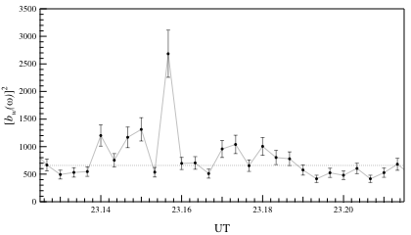
Summed Bicoherence
Summed bicoherence based on wavelet bicoherence analysis is higher during CD, indicative of higher coherency - strong interaction between excited waves.
Consolini and Lui [2000]

Slide 51
More From Bicoherence Results
Horizontal ridges are related to low frequency waves - their strong values as in 23:15:40 UT indicate coupling of single frequency waves to a broad spectrum.
Short-lived structures are indicative of intermittent phase-coupling.
Overall results are consistent with CD being a first order phase transition in a system out of equilibrium near a critical point.
ω₁
ω₂
Consolini and Lui [2000]

Slide 52
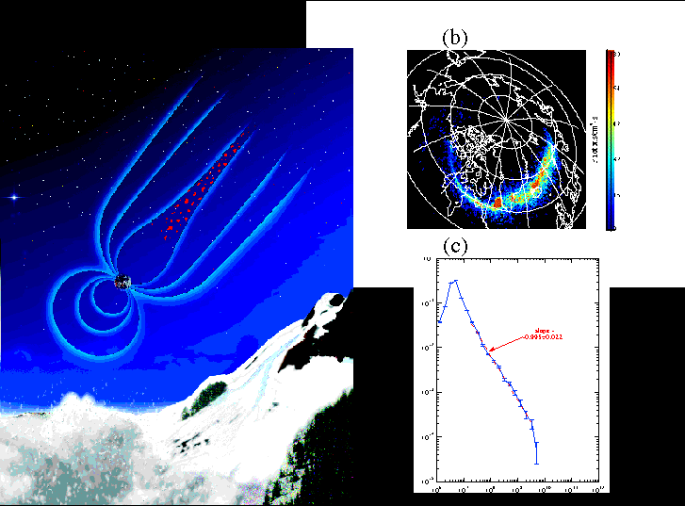
Avalanche-like Aspect of Substorm Activity
Lui et al. [2001]

Slide 53
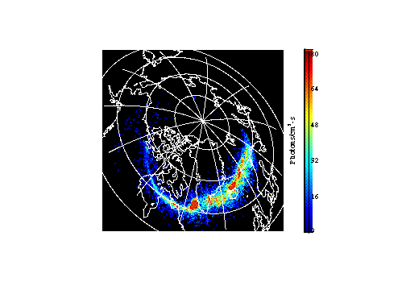
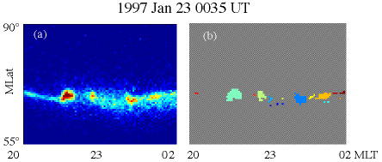
Avalanche-like Aspect of Substorm Activity
Lui et al. [2001]

Slide 54
Probability Distributions of Auroral Power
Quiet:
81,794
Auroral
Blobs
Substorm:
155,347
Auroral
Blobs
Size
Normalized Histogram
Power

Slide 55
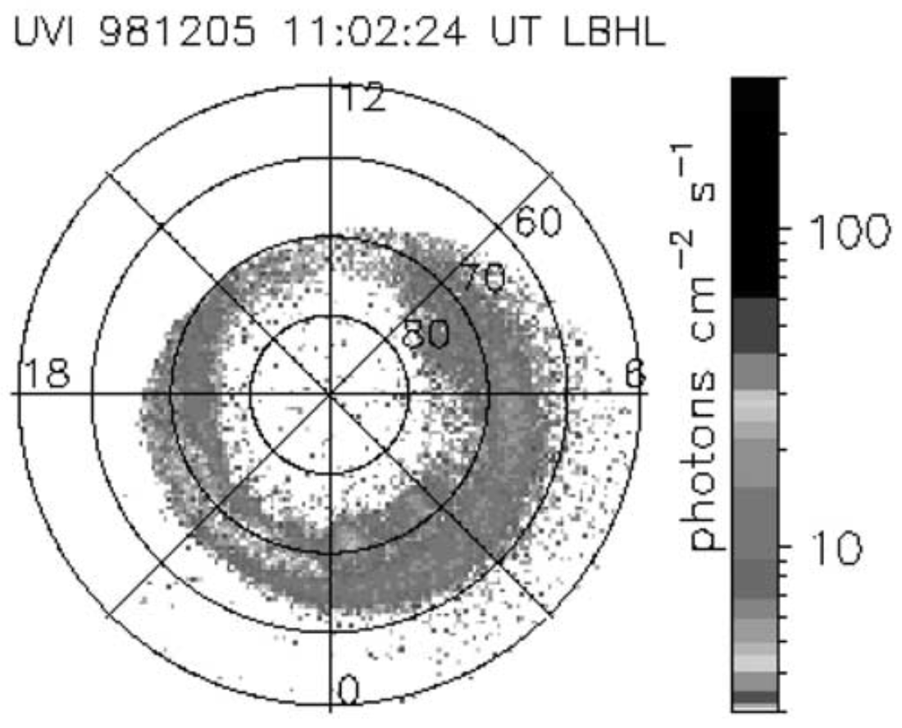
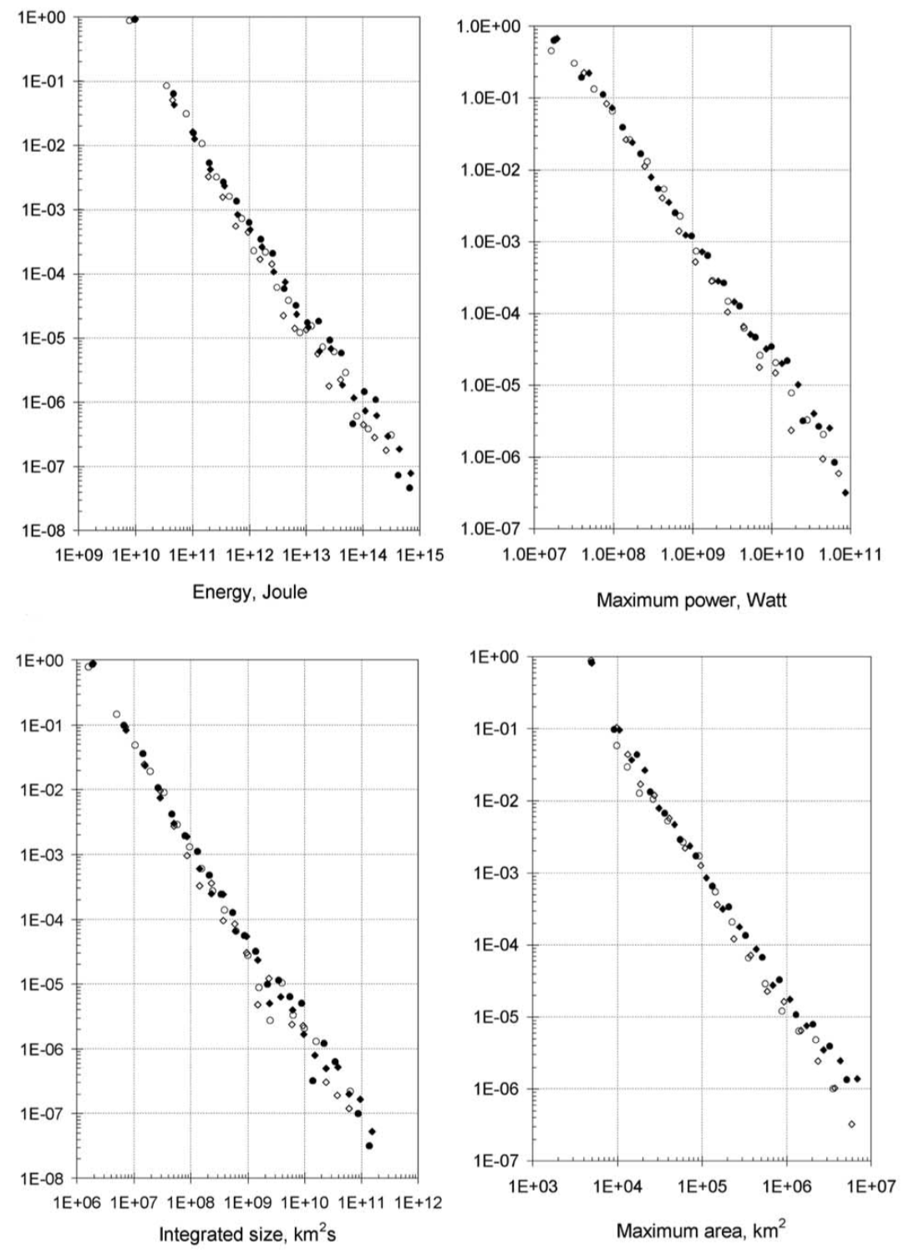
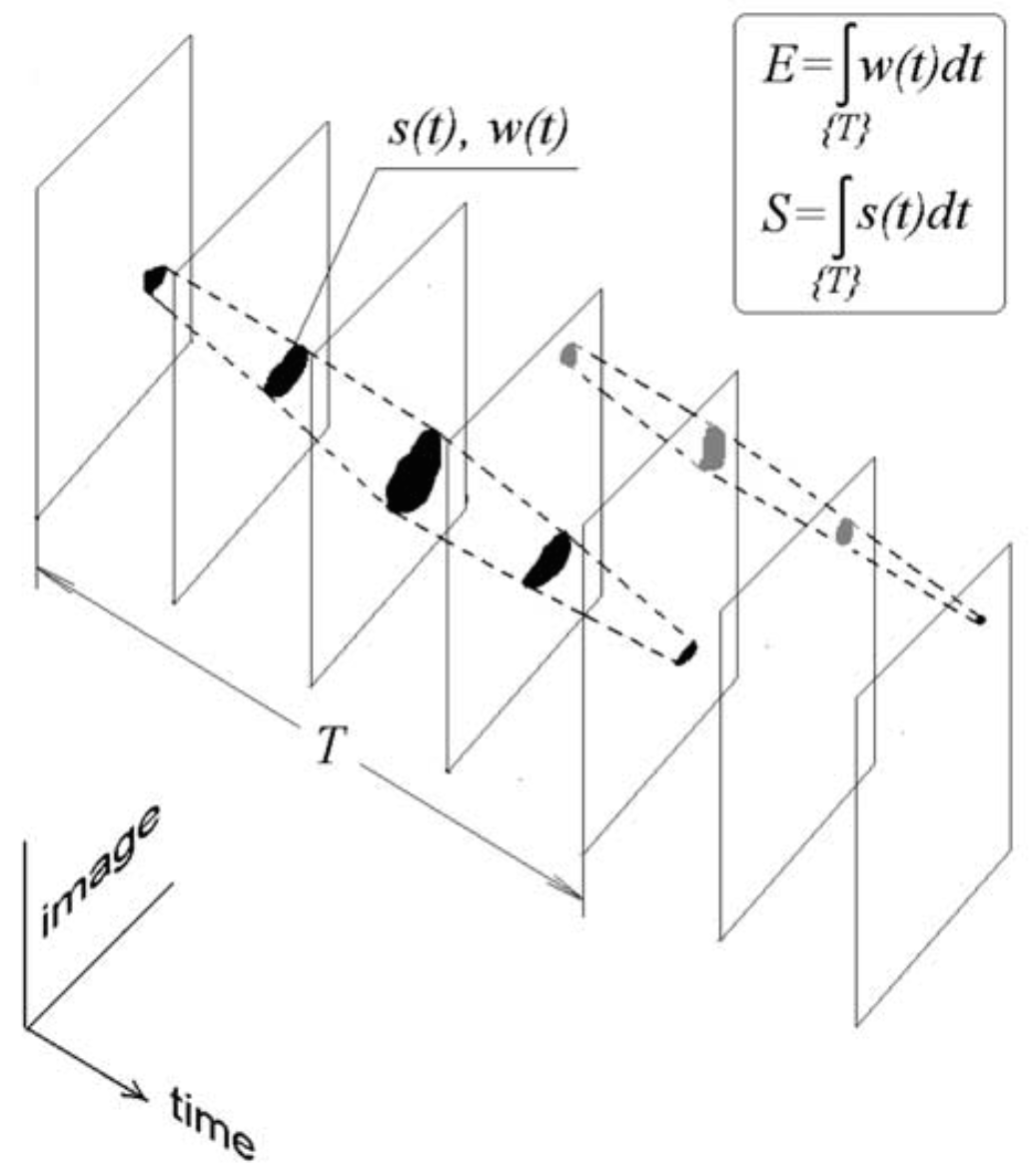
PDA of Integrated Size & Auroral Power
Power
Normalized Histogram
Size
Uristsky et al. [2002]

Slide 56
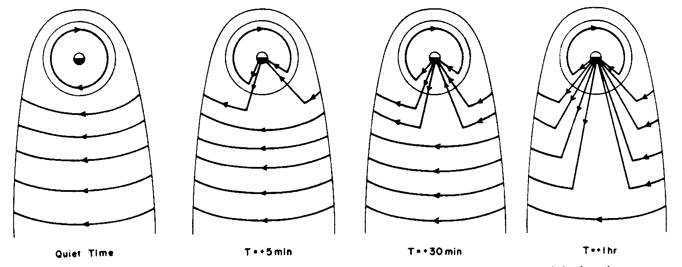
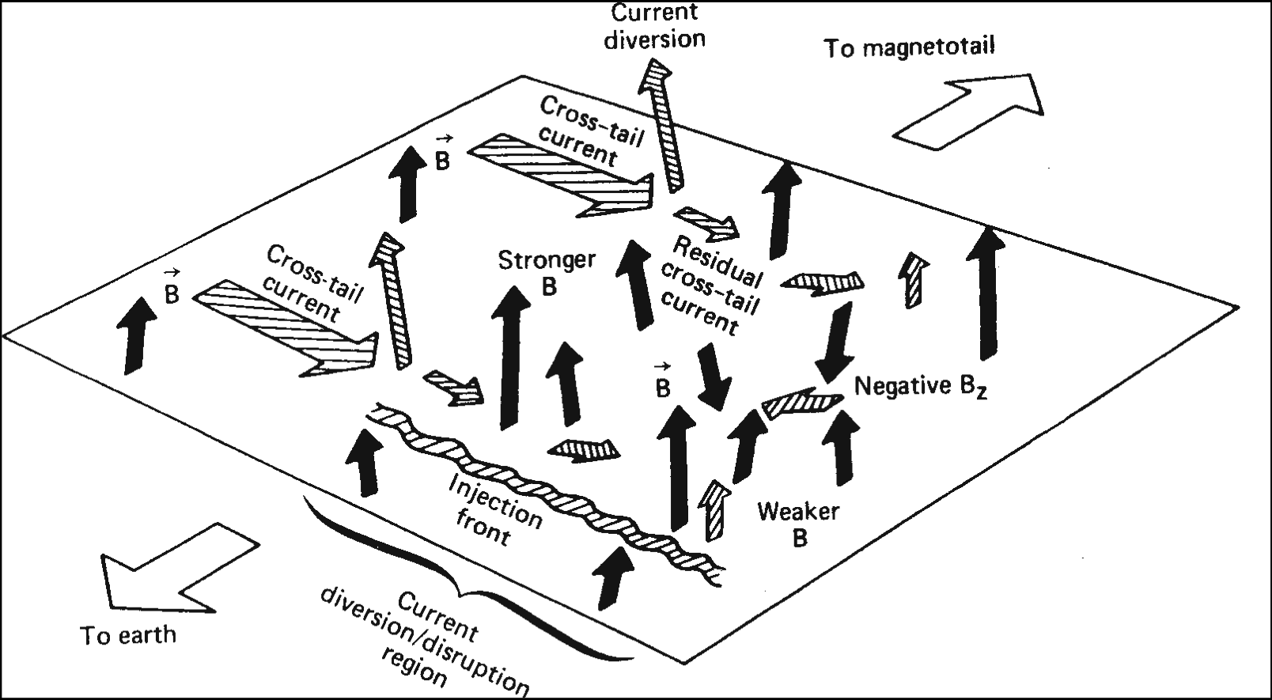
Plasma Turbulence Sites As the Small-scale Features in Substorm
This activity is suggested to lead to a substorm current wedge.
Lui et al. [1988]

Slide 57
Current Disruption and Lightning
A natural phenomenon involving electric discharge,
Associated thunderstorm covers a large region,
Each lightning stroke is very transient and localized.
A natural phenomenon involving electric discharge,
Asssociated substorm activity occurs over a wide local time,
Each substorm intensification is very transient and localized.

Slide 58
Forced and/or Self-Organized Criticality
Current density
Magnetic flux
Wu and Chang [2000]
Chang [1992, 1999] considered intermittent turbulence as merging and interactions of coherent plasma structures from plasma resonances. The underlying stochastic behavior of coherent structures can undergo complex changes similar to first and second order equilibrium phase transitions. When conditions are favorable, the topological entities can interact and evolve into forced and/or self-organized critical states. A 2D analog has been simulated by Wu and Chang [2000].

Slide 59
Mechanism For Energy Dissipation
(Plasma Physics Required)

Slide 60
Current Intensification Prior to Disruption
From analysis of ISEE-1 and -2 magnetic field data Ohtani et al. [1992] reported that prior to current disruption, the current density in the near-Earth neutral sheet region typically increases explosively - coined the ‘explosive growth phase.’

Slide 61
Current-Driven Plasma Instability Responsible For Substorm Onset
Lui et al. [2007]

Slide 62
A Simplified Phyiscal Picture of CCI
d(δV)
Lui et al. [1991]
m
=
q(δE + Vo × δB + δV × Bo)
i
dt

Slide 63
Local Instability Analysis
Local linear analysis of the CCI shows oblique whistler waves (at frequency of a small fraction of the lower hybrid frequency and λ~ion gyroradius) will be excited with a substantial growth rate when the relative drift between ions and electrons is ~half of ion thermal speed.
Lui et al. [1991]

Slide 64
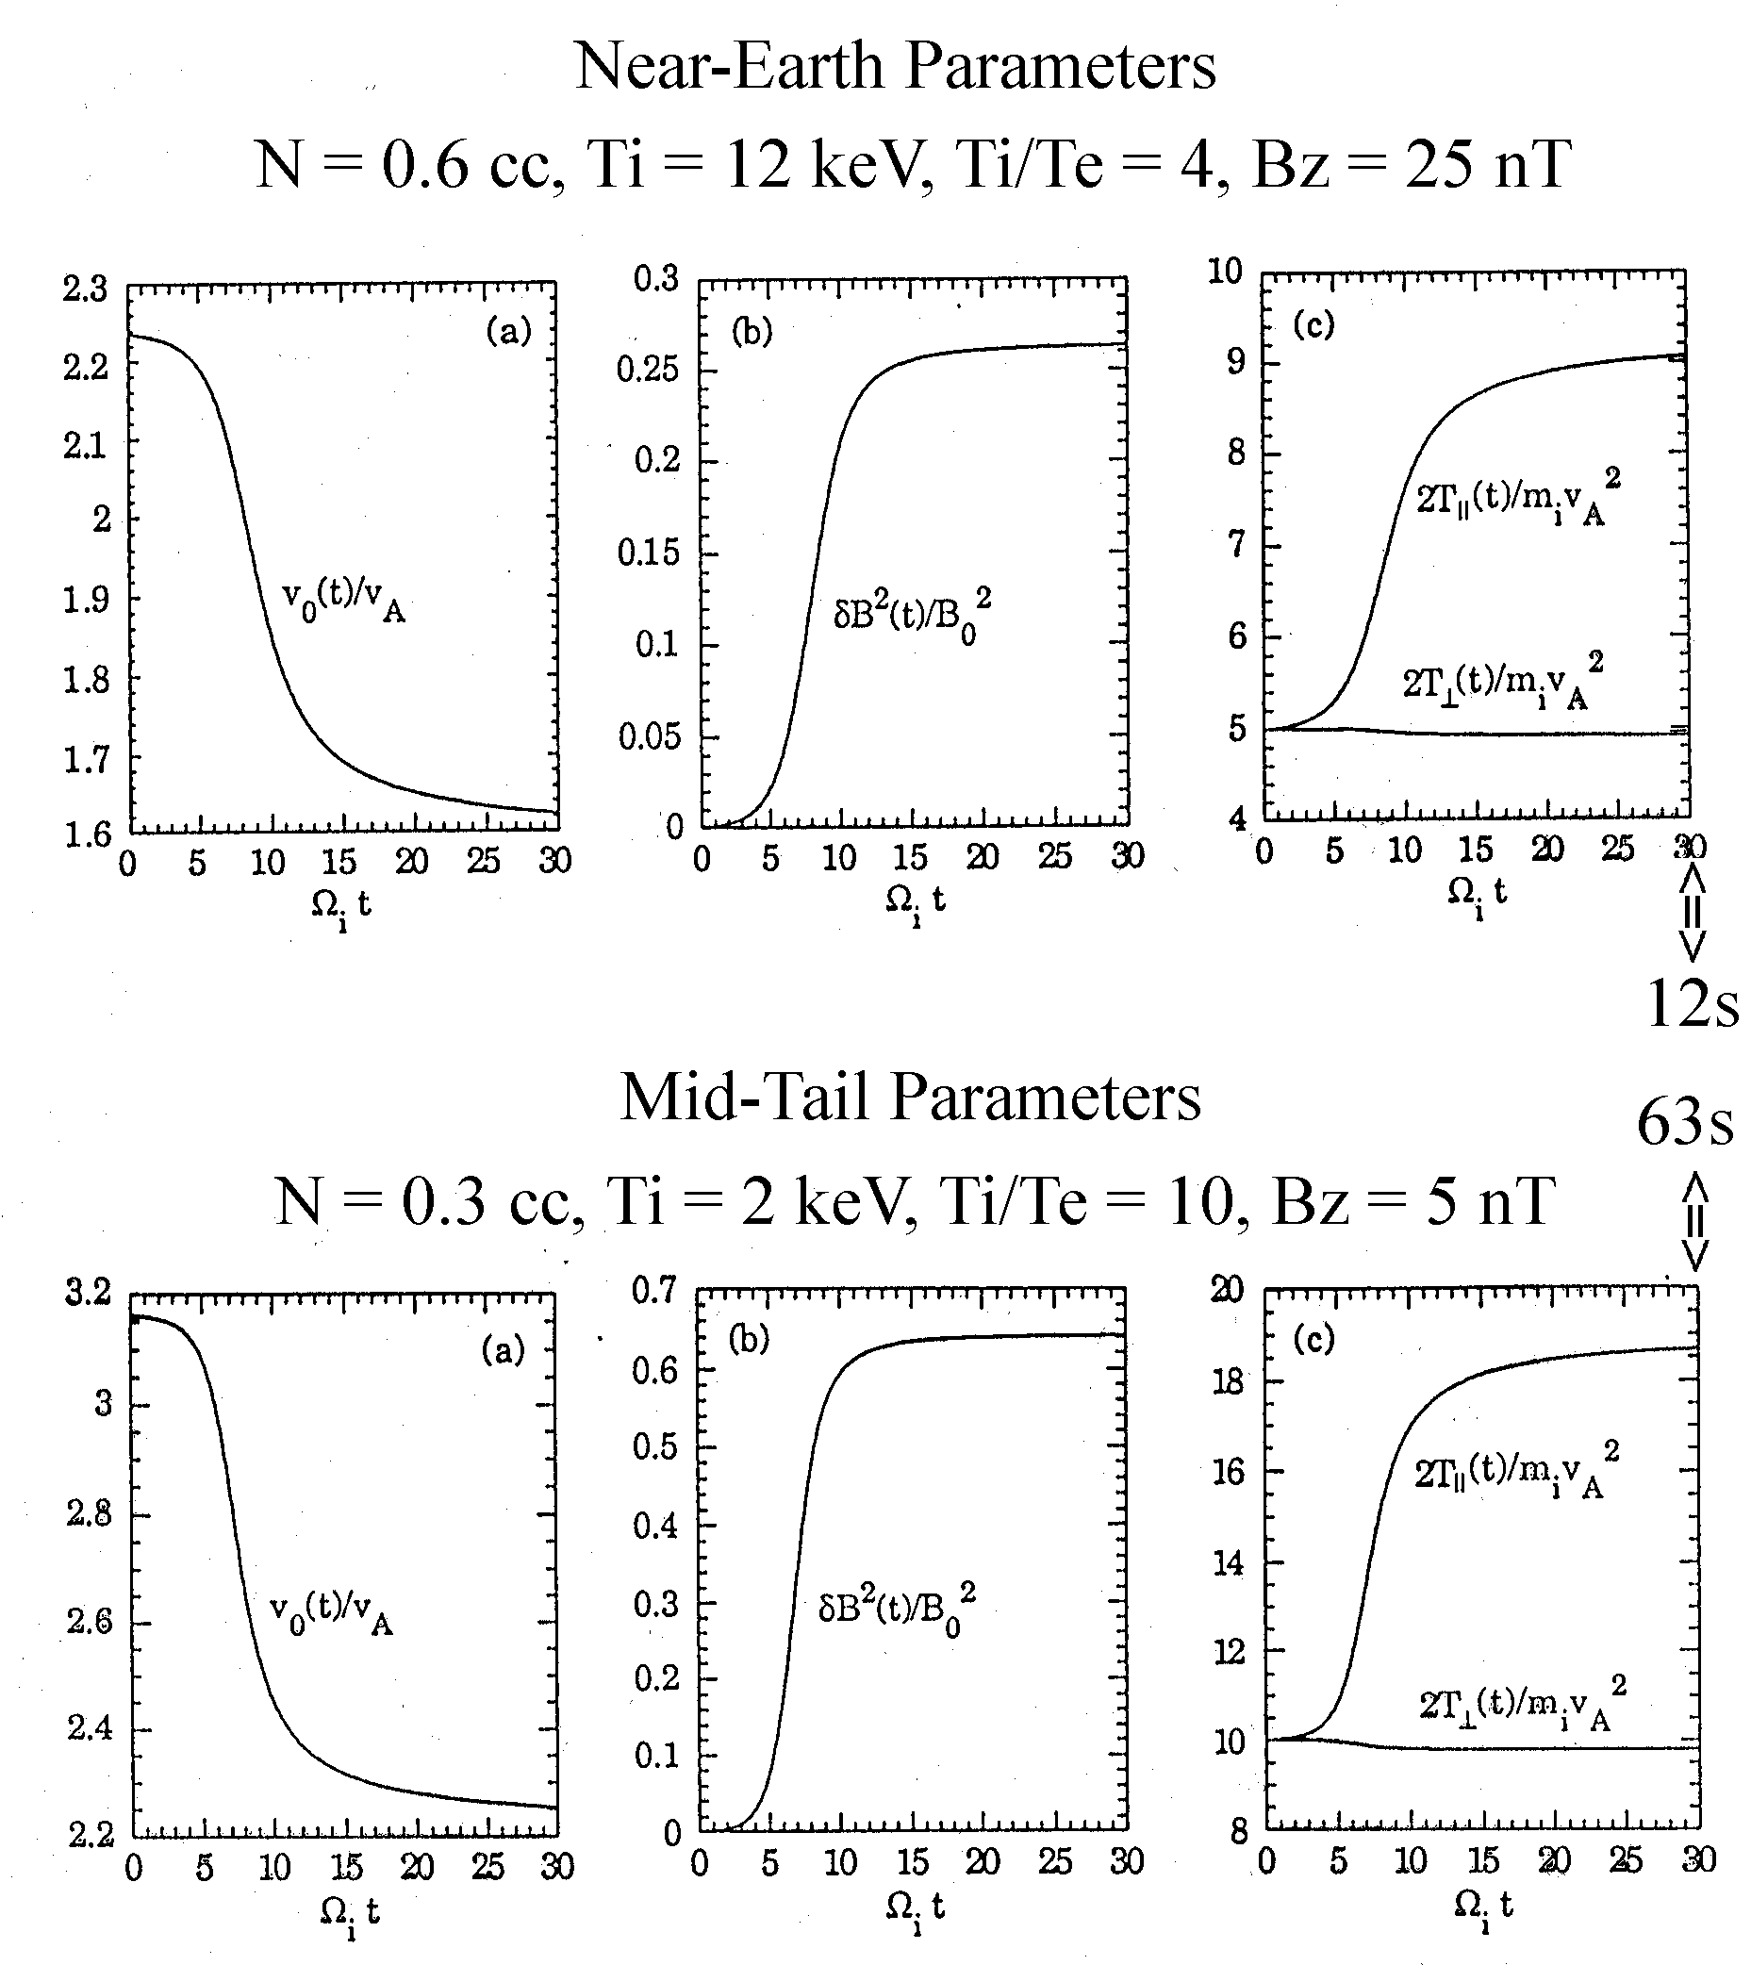
Quasi-linear Analysis of CCI
Subsequent quasi-linear calculation shows that the current can be reduced by ~15-28 % of its initial value.
Saturation is achieved when the ion drift speed is reduced and the ion parallel temperature is increased.
Lui et al. [1993]; Yoon et al. [1993]

Slide 65
Indications of Energy Transfer Between Scales in Current Disruption

Slide 66
Wavelet Analysis
CWT analysis (Gaussian Morlet) shows multiple frequency components, inverse cascade, and intermittency in CD.
f_{o}= 1, σ = 1, K=10, M=12
f_{s} = 8 (sampling frequency)
Time
Lui and Najmi [1997]

Slide 67
Inverse Cascade from FFT
Lui [2002]

Slide 68
Simulation Setup: 2D Thin Current Sheet
Lui [2004]

Slide 69
Energy Transfer in CD
Simulation shows current sheet broadening and current filamentation.
Electric field fluctuations show both kink (odd) and sausage (even) mode.
Joule dissipation (J•E>0) and electric current dynamo (J•E<0) both occur. This feature is different from the magnetic reconnection process where J•E>0 always.
Lui [2004]

Slide 70
Mode Analysis - 1
Mode 3:5 <=> kyL ~ 15:25
Lui [2002]

Slide 71
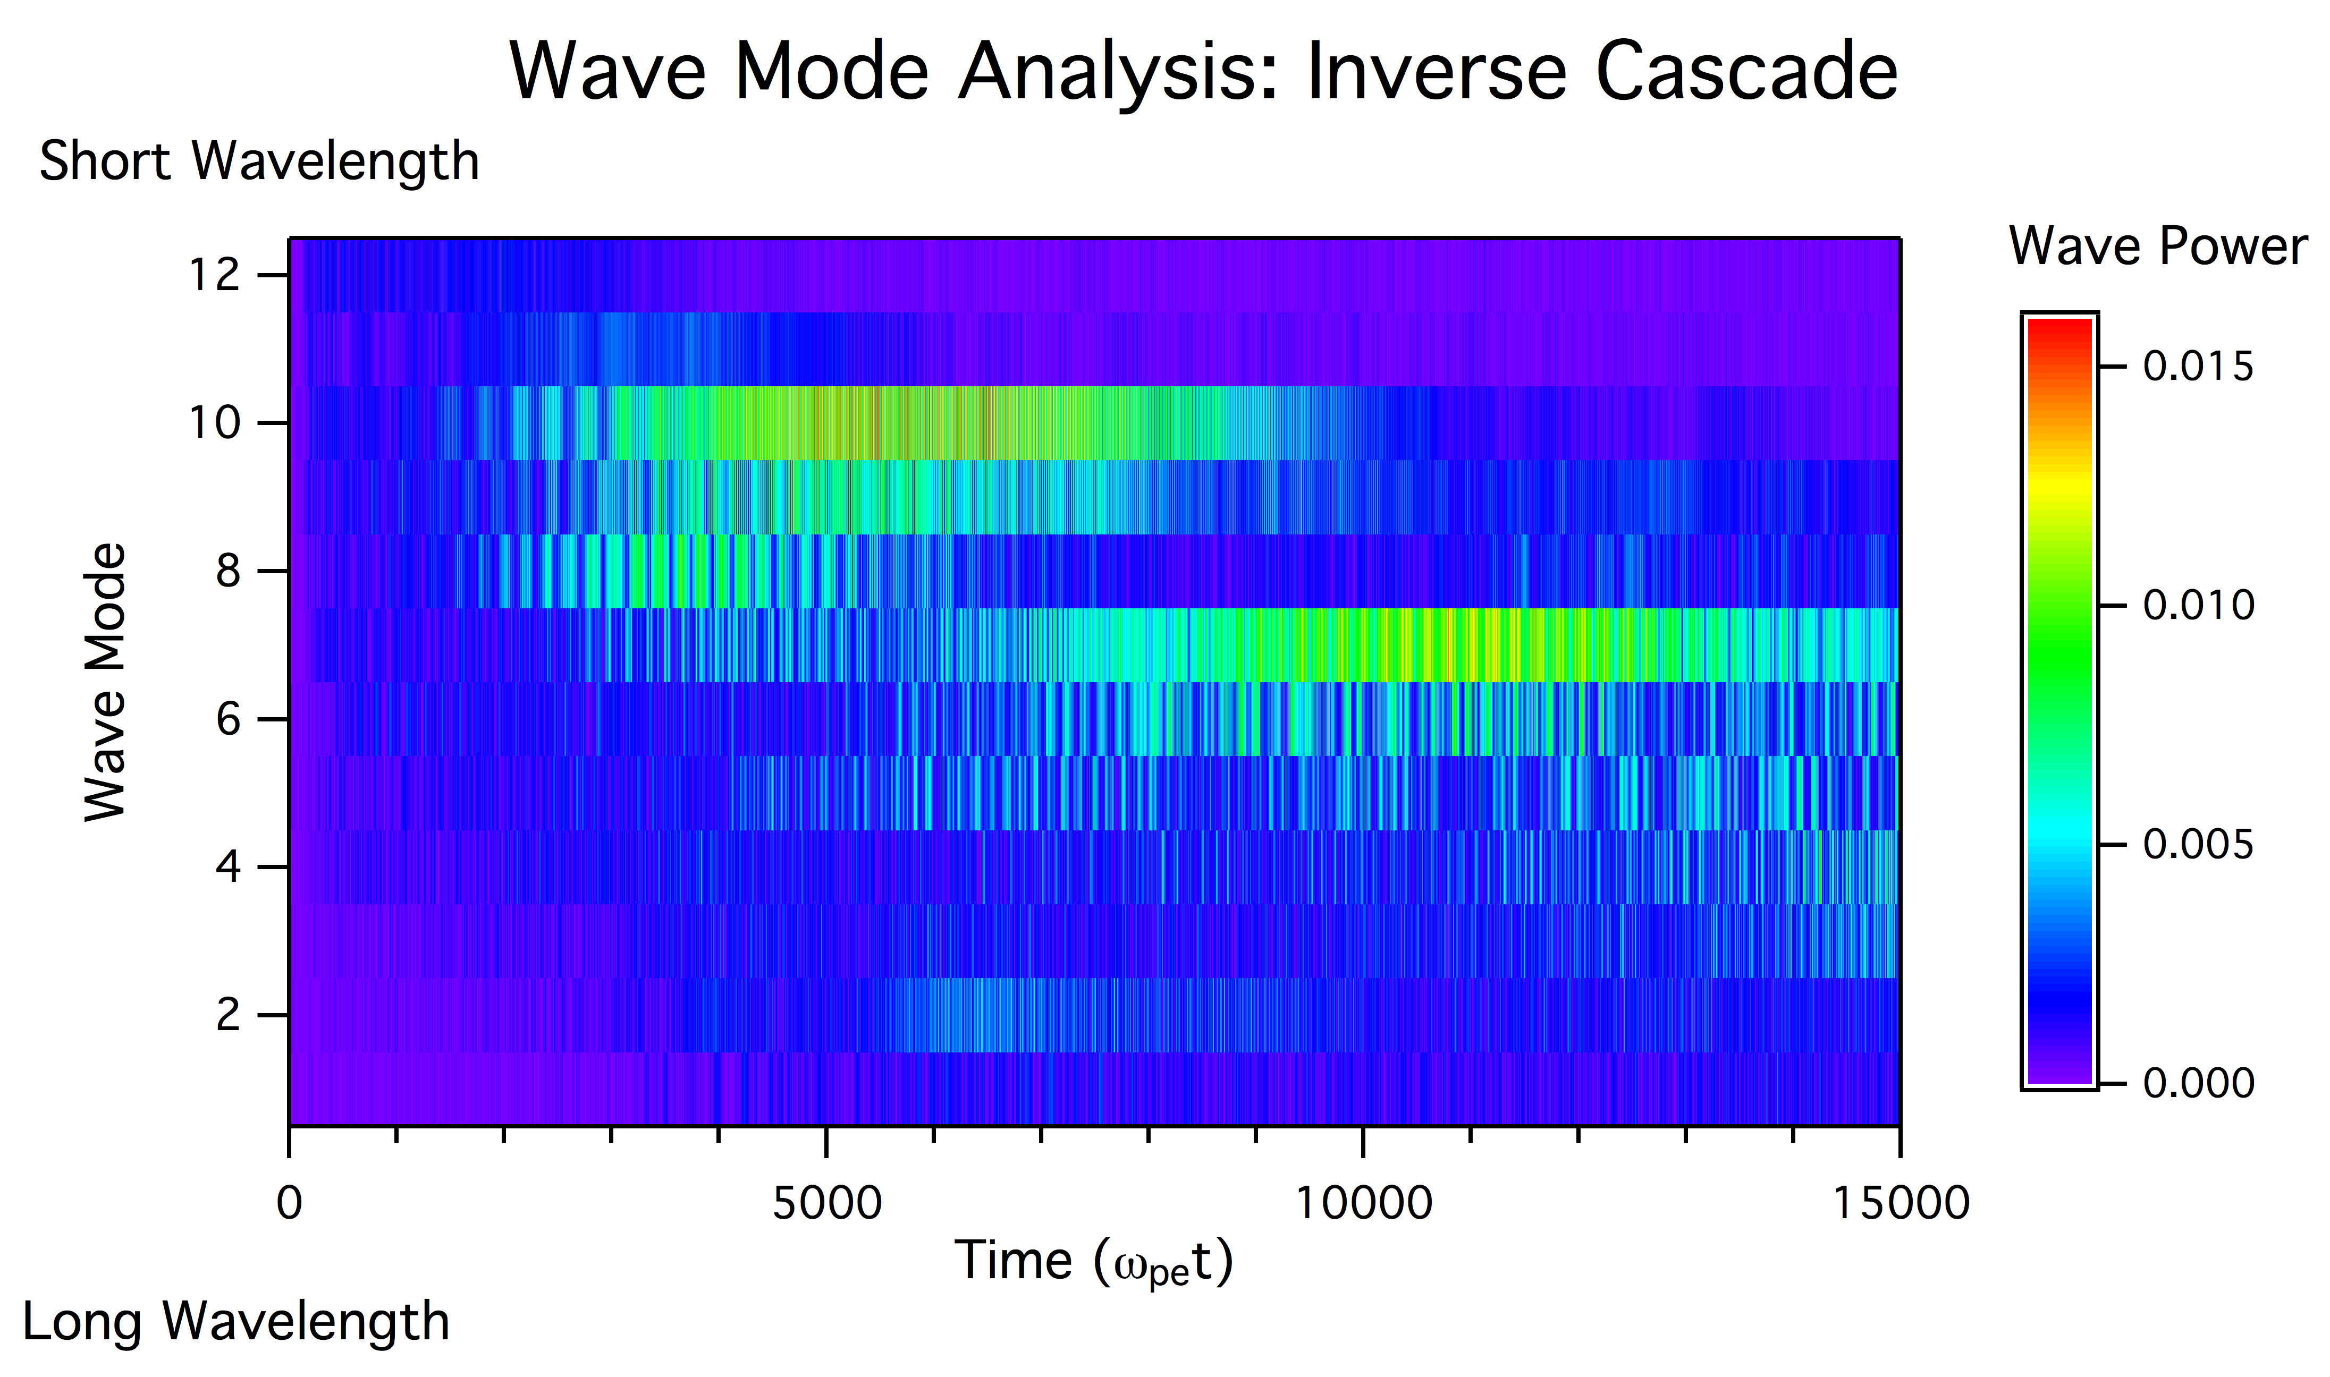
Inverse Cascade
Small λ
Large λ
Time
Free energy in the system is released progressively at larger λ.
Lui [2004]

Slide 72
Summary
Dynamic complexity analyses have offered a number of clues and provided identification of several features on the nature of the underlying physical processes.
With these insights, one can advance our understanding of the turbulent phenomena in space plasmas.
Current disruption is one example in which the intermittent turbulent nature and the inverse cascade feature can be used to test/guide proposed ideas on the observed phenomenon.
Combining analysis tools in dynamic complexity with those in traditional approach is useful to achieve a better understanding of nature in action.

Slide 73
Thank You For Your Attention

