Slide 1


Spatial and temporal monitoring of the intermittent dynamics in the terrestrial foreshock
Péter Kovács, Gergely Vadász,
András Koppán
Geological and Geophysical Institute of Hungary,
Solar system plasma turbulence, intermittency and multifractals
International Workshop and School, 06-13 September 2015, Mamaia, ROMANIA

Slide 2


Outline
Spatial and temporal monitoring of the intermittent dynamics in the terrestrial foreshock
Basic dynamics of the terrestrial foreshock (wave and turbulent properties)
Study of intermittent turbulence in the foreshock using PDF analysis
Applying high-pass filtering to enhance the properties of small amplitude fluctuations
Study of intermittency in terms of the foreshock geometry and solar wind parameters
Summary
Solar system plasma turbulence, intermittency and multifractals
International Workshop and School, 06-13 September 2015, Mamaia, ROMANIA

Slide 3
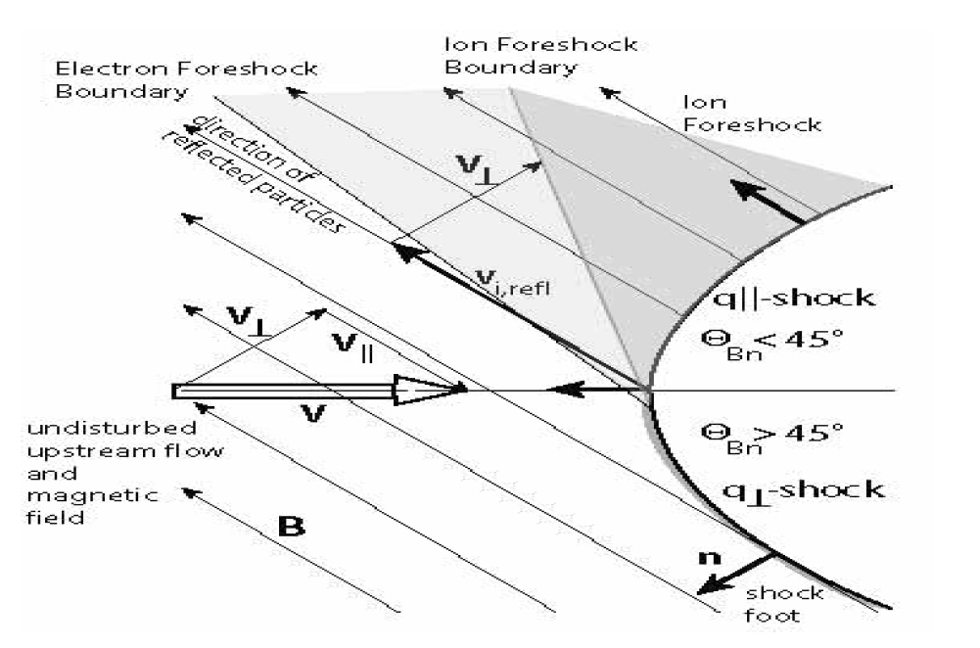
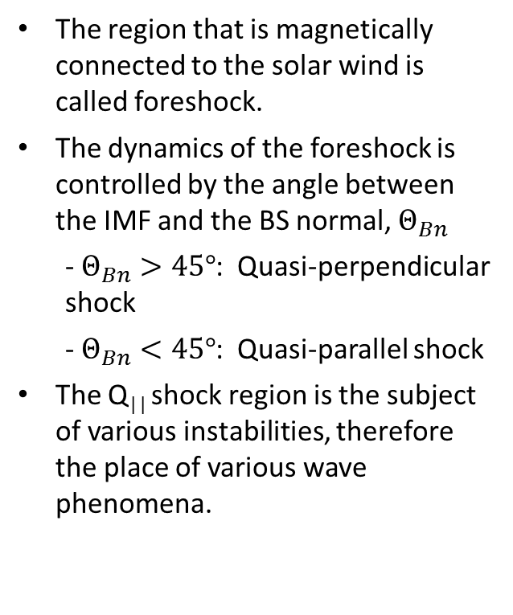
Basic dynamics of the terrestrial foreshock
The region that is magnetically connected to the solar wind is called foreshock.
The dynamics of the foreshock is controlled by the angle between the IMF and the BS normal, $Θ_{Bn}$
- $Θ_{Bn}>45°$: Quasi-perpendicular shock
- $Θ_{Bn}<45°$: Quasi-parallel shock
The Q|| shock region is the subject of various instabilities, therefore the place of various wave phenomena.
Treumann, Jaroschek, 2008
Solar system plasma turbulence, intermittency and multifractals
International Workshop and School, 06-13 September 2015, Mamaia, ROMANIA

Slide 4
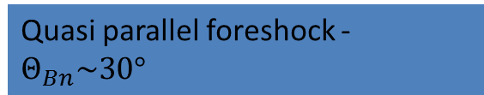
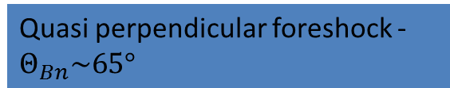
Magnetic field spectra in the foreshock
Quasi perpendicular foreshock - $Θ_{Bn}\sim 65°$
Quasi parallel foreshock - $Θ_{Bn}\sim 30°$
Solar system plasma turbulence, intermittency and multifractals
International Workshop and School, 06-13 September 2015, Mamaia, ROMANIA

Slide 5
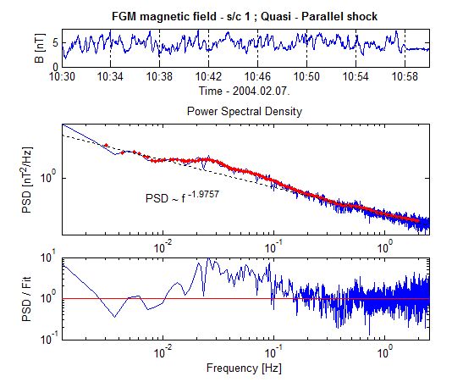
Basic properties of the waves in the Q|| foreshock
Waves are developed by the BS reflected particles
The waves frequencies are mostly in the Ultra low frequency (ULF) range (i.e. below 0.1 Hz)
Waves have usually large amplitudes
In the plasma rest frame they propagate upstream, but due to the convection they are swept back to the bow shock
Solar system plasma turbulence, intermittency and multifractals
International Workshop and School, 06-13 September 2015, Mamaia, ROMANIA

Slide 6
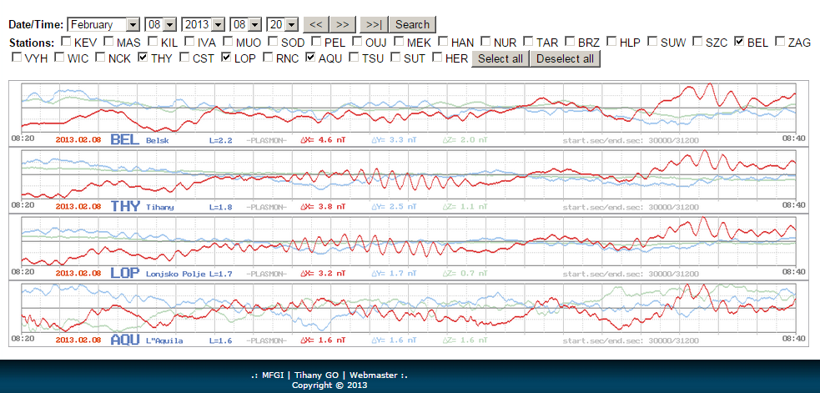
Upstream wave related geomagnetic pulsations
Solar system plasma turbulence, intermittency and multifractals
International Workshop and School, 06-13 September 2015, Mamaia, ROMANIA

Slide 7
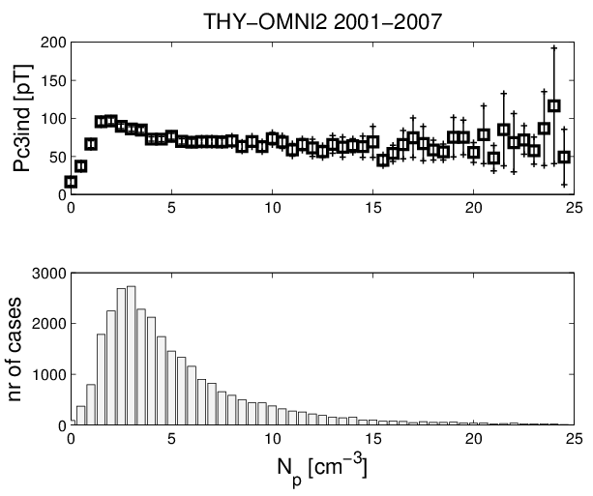
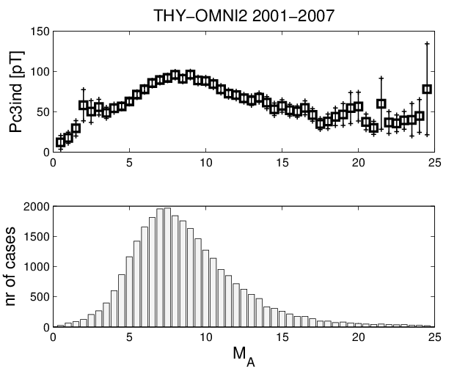
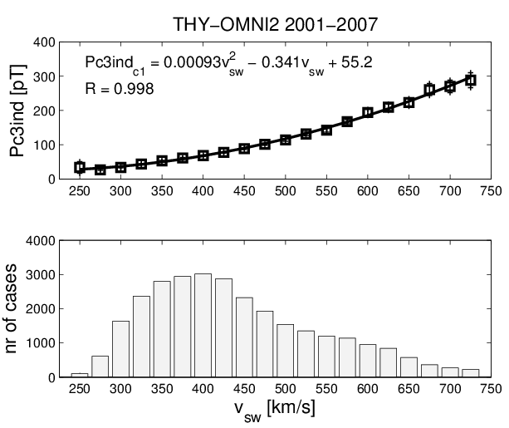
Upstream wave related geomagnetic pulsations
Heilig et al., Ann. Geophys., 2010
Solar system plasma turbulence, intermittency and multifractals
International Workshop and School, 06-13 September 2015, Mamaia, ROMANIA

Slide 8
Aims, data, methodology
Aim:
To show the turbulent properties of the foreshock in a wavy and non-stationary environment.
To study the influence of the solar wind driver to the turbulent behaviour of the foreshock.
Data:
FGM 5 Hz (5VPS) data from Cluster 1,2,3,4
Time period: January-April, 2001-2010
Method:
PDF analysis of difference time-series
__________________________________
Main sources of the non-stationarity:
The movement of the spacecraft
The change of the downstream solar wind parameters (IMF, plasma pressure, bulk velocity, …) affecting the plasma environment and the configuration of the bow shock.
Solar system plasma turbulence, intermittency and multifractals
International Workshop and School, 06-13 September 2015, Mamaia, ROMANIA

Slide 9
Data selection
Bow shock model: Farris et al., 1995
Model parameters (SW bulk velocity, proton density, MA number) have been obtained from Cluster CIS_HIA instrument records or optionally from OMNI2 database
IMF
ΘBn
d
Solar system plasma turbulence, intermittency and multifractals
International Workshop and School, 06-13 September 2015, Mamaia, ROMANIA

Slide 10

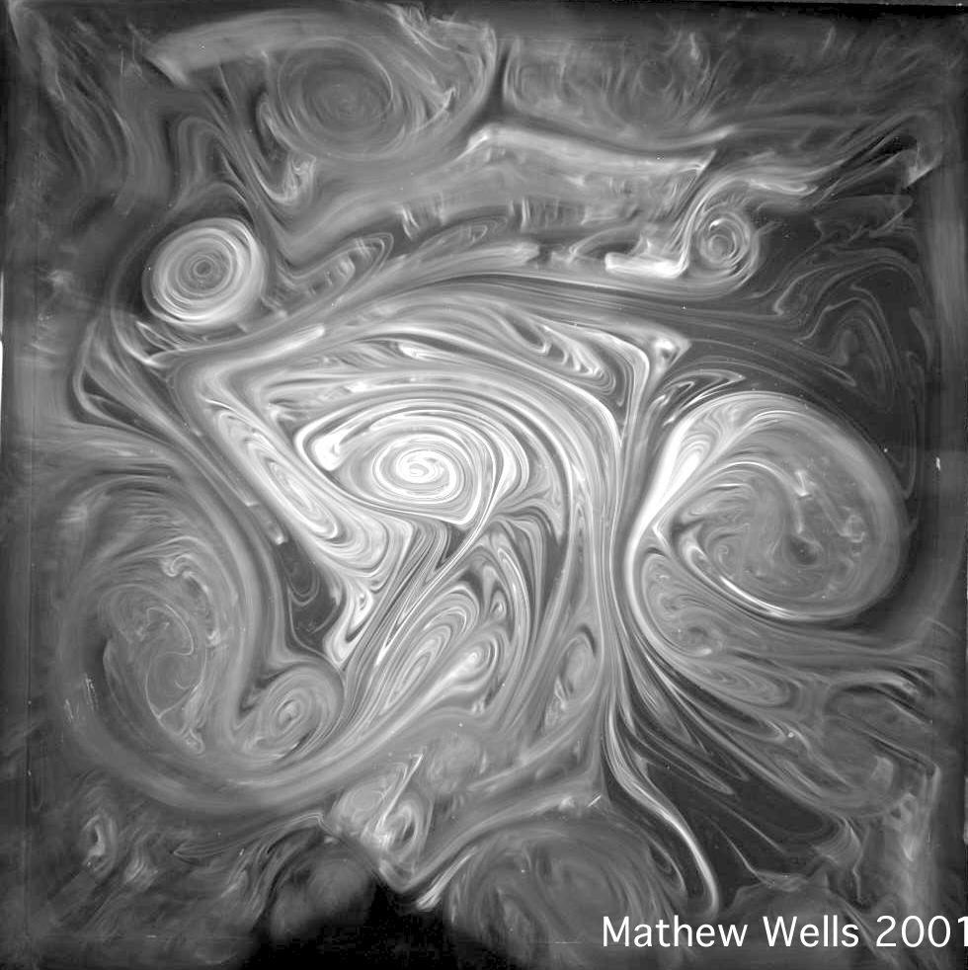




PDF analysis of temporal increments
τ₃
τ₂
$$P_{τ_{i}}\left(t\right)=P\left(t+τ_{i}\right)−P(t)$$
τ₁
$$P_{τ_{1}}\left(t\right)$$
$$P_{τ_{2}}\left(t\right)$$
$$P_{τ_{3}}\left(t\right)$$
Solar system plasma turbulence, intermittency and multifractals
International Workshop and School, 06-13 September 2015, Mamaia, ROMANIA

Slide 11
Study of intermittency in spatial scale
Cluster configuration
Solar system plasma turbulence, intermittency and multifractals
International Workshop and School, 06-13 September 2015, Mamaia, ROMANIA

Slide 12
Sliding window PDF analysis
Window length:
20 min. (6000 points)
Overlap:
5 min
Solar system plasma turbulence, intermittency and multifractals
International Workshop and School, 06-13 September 2015, Mamaia, ROMANIA

Slide 13
Mean flatness in terms of temporal and spatial scales
10 years of average, 2001-2010
Solar system plasma turbulence, intermittency and multifractals
International Workshop and School, 06-13 September 2015, Mamaia, ROMANIA

Slide 14
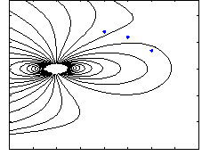
Referencing of the temporal intermittency to space
Window length:
20 min. (6000 point)
Step length:
5 min
Solar system plasma turbulence, intermittency and multifractals
International Workshop and School, 06-13 September 2015, Mamaia, ROMANIA

Slide 15
Reference frame of the observattions
Bow shock model: Farris et al., 1995
Model parameters (SW bulk velocity, proton density, MA number) have been obtained from Cluster CIS_HIA instrument (Dandouras et al., 2001) records or optionally from OMNI2 database
IMF
ΘBn
d
Condition for quasi-parallel magnetic observation:
ΘBn < 50°
Solar system plasma turbulence, intermittency and multifractals
International Workshop and School, 06-13 September 2015, Mamaia, ROMANIA

Slide 16
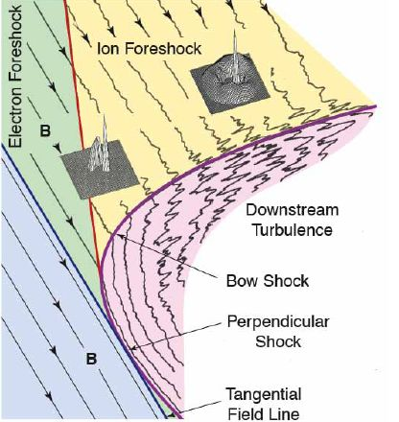
„Map” of intermittency in the foreshock
Strongest intermittency:
ΘBn ~ 35°
Solar system plasma turbulence, intermittency and multifractals
International Workshop and School, 06-13 September 2015, Mamaia, ROMANIA

Slide 17
„Map” of intermittency in the foreshock
Intermittency in temporal scale
Intermittency in spatial scale
Solar system plasma turbulence, intermittency and multifractals
International Workshop and School, 06-13 September 2015, Mamaia, ROMANIA

Slide 18
Investigation of turbulent noise in wavy environment – Synthetic analysis
Solar system plasma turbulence, intermittency and multifractals
International Workshop and School, 06-13 September 2015, Mamaia, ROMANIA

Slide 19
„Map” of intermittency in the foreshock
Strongest intermittency:
ΘBn ~ 15-25°
Solar system plasma turbulence, intermittency and multifractals
International Workshop and School, 06-13 September 2015, Mamaia, ROMANIA

Slide 20
Mean flatness vs. Solar wind parameters
10 years of average, 2001-2010
Solar system plasma turbulence, intermittency and multifractals
International Workshop and School, 06-13 September 2015, Mamaia, ROMANIA

Slide 21
Summary
Cluster FGM data have been analysed from periods in the years of 2001-2010, when the mission located in the foreshock
In 10 years of average, intermittent fluctuations were apparent in the foreshock, both in temporal and spatial scales
It is argued that PDF analysis can give misleading results regarding to turbulence, if wave activitiy is strong in the analysed signal
High-pass filtered FGM data exhibit decaying intermittency with the distance from the BS along the IMF and with angle of incidence of IMF to the BS
In 10 years of average, intermittency increases with solar wind bulk speed and Alfvén Mach number. This behaviour is similar to that related to the ULF wave activities observed in ground observatories.
Solar system plasma turbulence, intermittency and multifractals
International Workshop and School, 06-13 September 2015, Mamaia, ROMANIA

