Slide 1
Generation of turbulence in Earth’s magnetosphere
H. Hasegawa (ISAS/JAXA), T. K. M. Nakamura (IWF, Graz), M. Hoshino (U. of Tokyo), I. Shinohara (ISAS/JAXA), & T. Nagai (Tokyo Inst. Tech.)
International Workshop and School on solar system plasma turbulence, intermittency and multifractals (6-13 Sep. 2015)

Slide 2
Evolution of turbulence
Turbulence generation, or energy injection
Through existing fluctuations, instabilities, shocks, reconnection, or current disruption.
Cascading (inertial range), or energy transfer
Energy transport in wavenumber and/or configuration space, or energy partitioning
Energy dissipation
Micro-instabilities, wave damping, reconnection
Consequences: particle transport in real/velocity space (diffusion, heating, acceleration)

Slide 3
Generation of turbulence
Generation process is not fully understood!
We often observe already developed turbulence, e.g., in the solar wind.
Near-Earth space is an ideal natural laboratory for studying turbulence driving.
Foreshock, magnetosheath: turbulence associated with the bow shock.
Magnetopause, magnetotail plasma sheet: Free energy can be flow shear, electric current, density/temperature jumps, pressure anisotropy (instabilities), or magnetosheath turbulence.

Slide 4
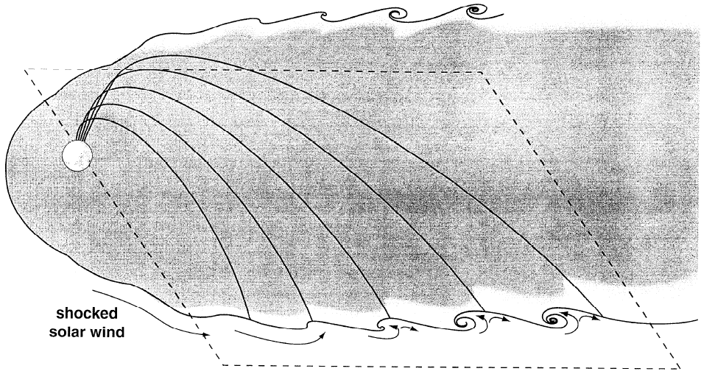
Kelvin-Helmholtz instability (KHI)
The equatorial magnetopause is subject to flow shear-driven, Kelvin-Helmholtz instability.
KHI can grow for steady northward IMF.
(Fairfield+, JGR00)
Reconnection-driven wave/instability
(Arzner+, JGR02)
Reconnection-driven turbulence can grow in the magnetotail (e.g., Voros+, SSR06), e.g., for southward IMF.

Slide 5
Conditions for KHI growth
① Super-Alfvénic flow
Chandrasekhar (1961)
$V_{0}>2V_{A}$: bulk flow energy > magnetic energy
$V_{0}=\left|V_{1}−V_{2}\right|$: Total velocity jump
② Sub-(magneto)sonic flow
Miura & Pritchett (JGR82)
$V_{0}<2C_{s}$ for $V_{0}∥B_{0}$ case
$V_{0}<2C_{ms}=2\sqrt{{C_{s}}^{2}+{V_{A}}^{2}}$ for $V_{0}⊥B_{0}$ case
KHI cannot grow when the velocity jump is too large!
Note: in finite-thickness shear layer, KHI can grow even for super-(magneto)sonic flow conditions (e.g, Miura+, JGR92).

Slide 6
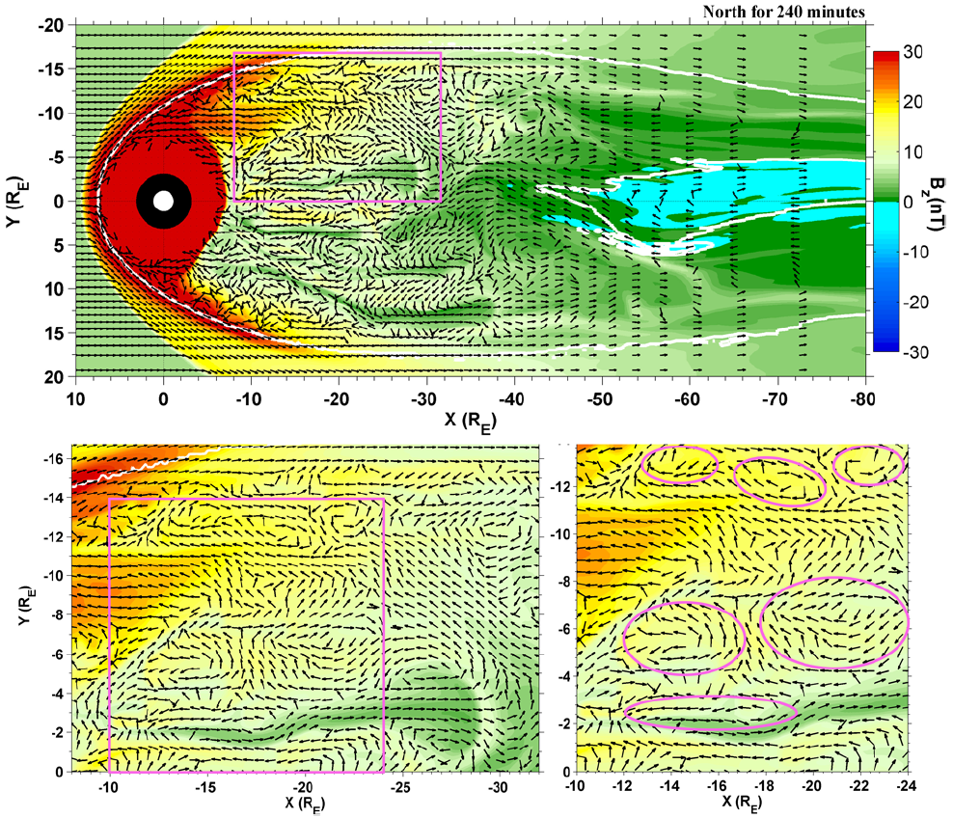
Magnetotail flow for northward IMF
El-Alaoui+
(NPG12)
Equatorial cut of the magnetotail from a global MHD simulation for northward IMF.
KHI may induce turbulence in the tail plasma sheet.

Slide 7
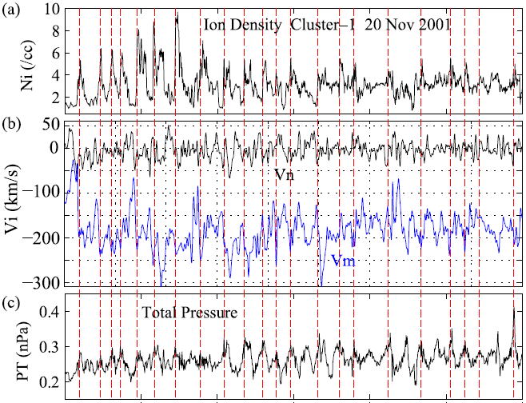
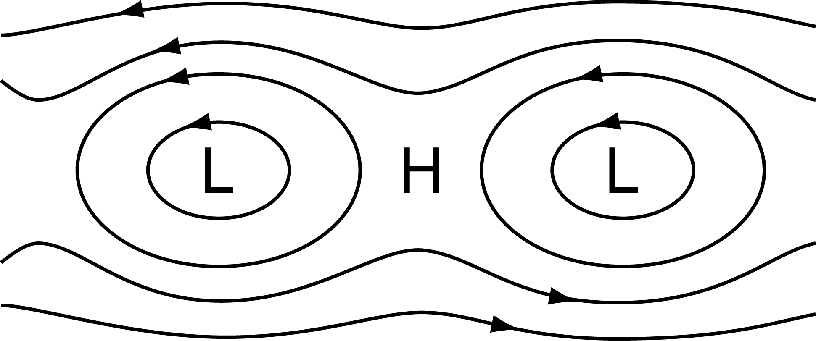
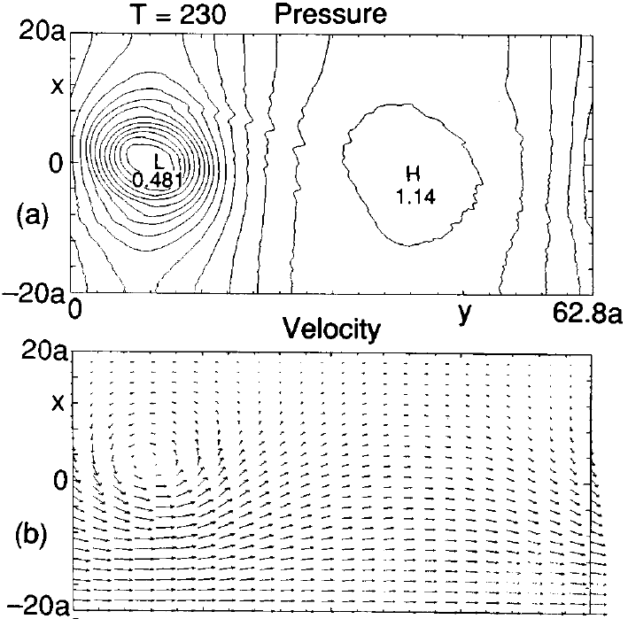
P_{T} variation as a signature of vortex
Vortices (streamlines)
$$−∇P_{T}$$
F_{centrifugal}
1.5 hour
KH vortex from 2-D MHD simulation (Miura, PoP97)
KH vortices seen by Cluster at the magnetopause (Hasegawa, MEEP12)

Slide 8
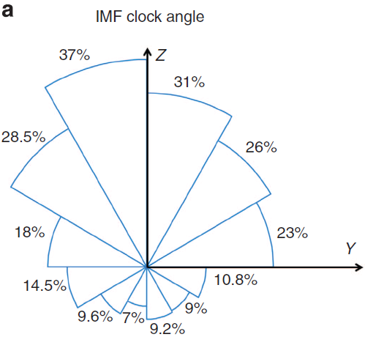
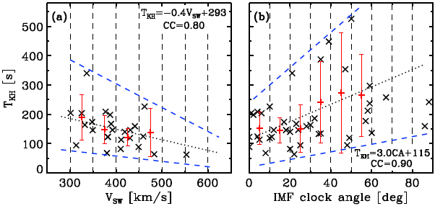
Kelvin-Helmholtz wave & its properties
Kavosi & Raeder (Nat. Commun.15)
Ubiquitous KH waves even for southward IMF
Role in ULF excitation???
Nakamura & Daughton (GRL14)
Lin+ (JGR14)
Higher propagation speed for faster SW.
Puzzling longer T_{KH} or wavelengths for larger IMF clock angles.

Slide 9
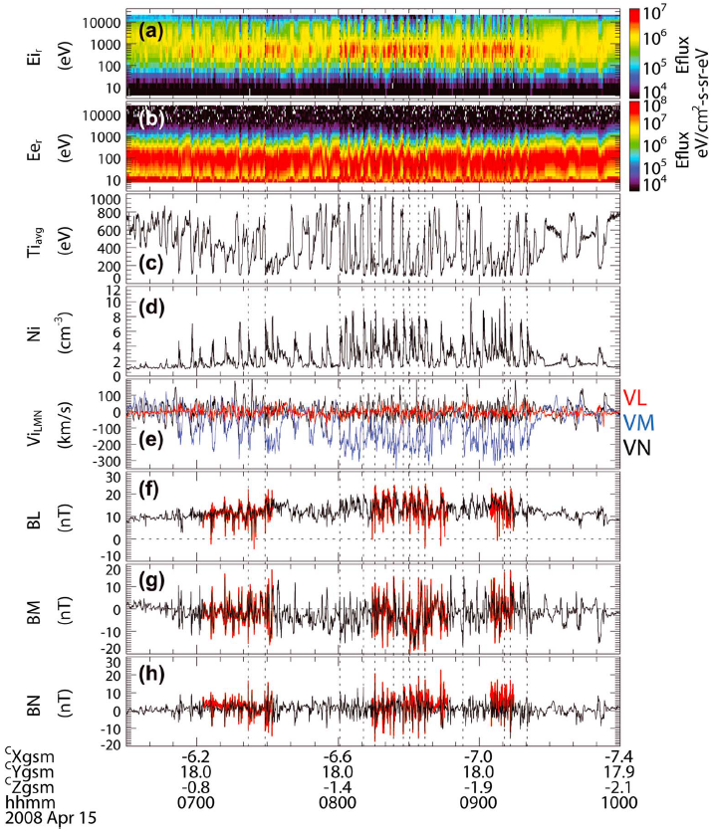
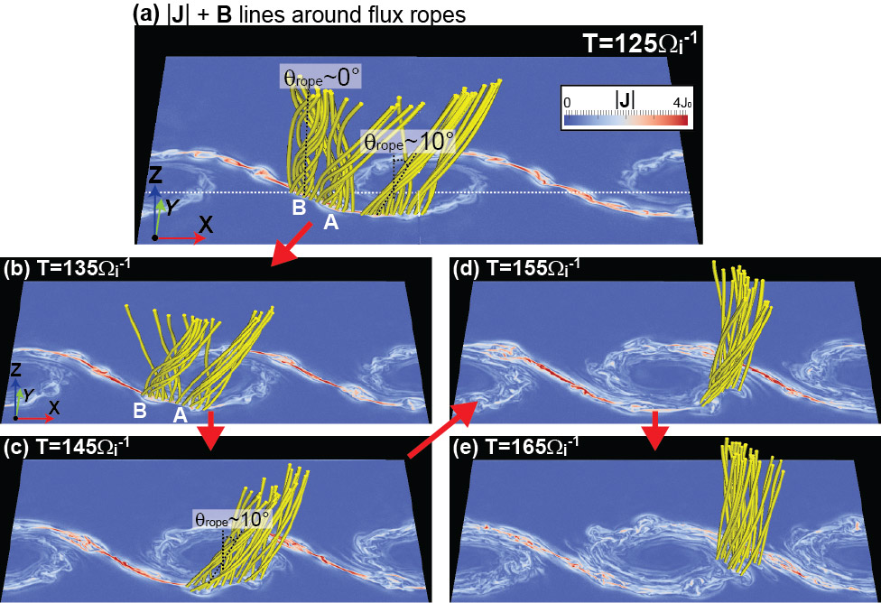
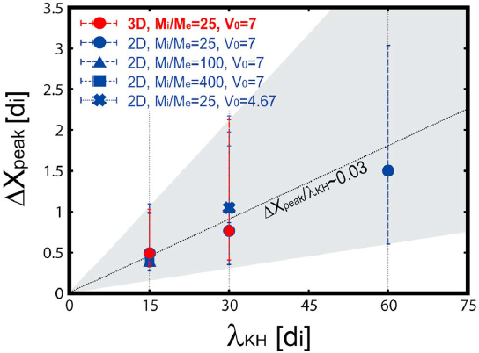
KH vortex-induced magnetic flux ropes
3D PIC simulation of symmetric shear layer (V shear + B shear)
Nakamura+ (JGR13)
Vortex induced reconnection & oblique flux rope formation
Rapid plasma mixing within vortex
Size of KH-induced flux rope scaled by KH-wavelength

Slide 10
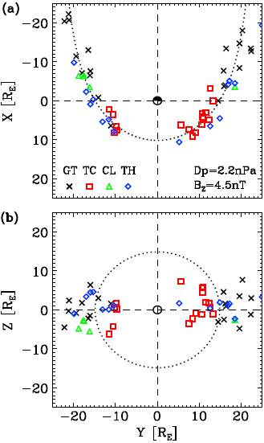
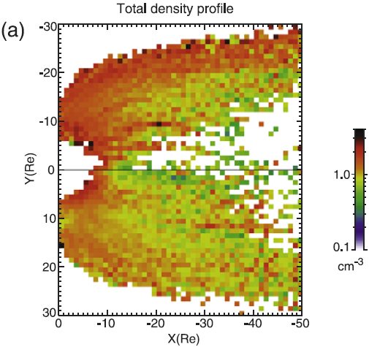
Dawn-dusk asymmetry
Occurrence of KH vortices:
No clear dawn-dusk asymmetry behind the terminator.
Dayside events occur more frequently at dusk. (Taylor+, AG12).
But, the PS density is higher at dawn.
Weak role of KHI in the SW entry?
Lin+ (JGR14)
Northward IMF plasma sheet (Wing+, JGR05)

Slide 11
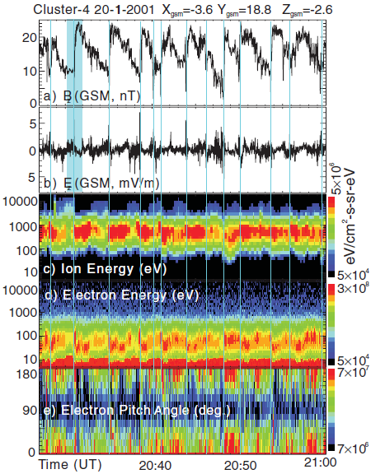
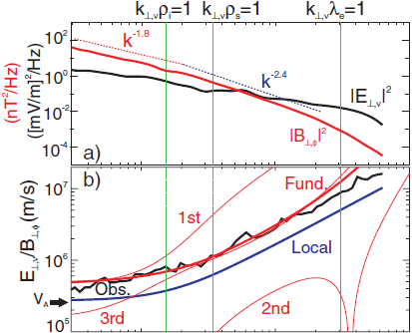
Kinetic Alfven wave turbulence in KHI
←Electron parallel heating by KAWs?
(Chaston+, PRL07)

Slide 12
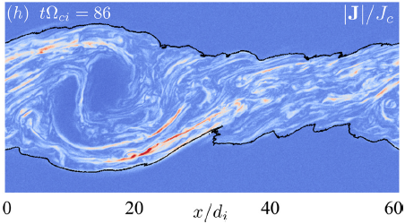
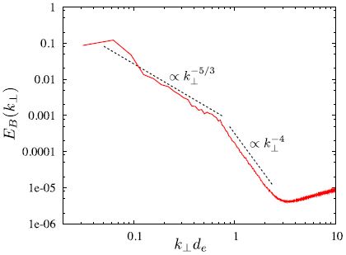
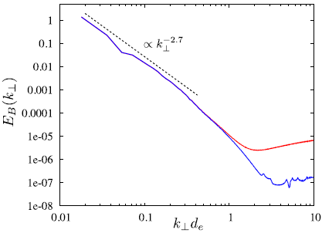
Vortex induced reconnection
Spectral index is different from Chaston’s result.
But why?
KAWs vs reconnection, or
observation (asymmetric) vs simulation (symmetric)???
PIC simulation of 3-D vortex induced reconnection for m_{i}/m_{e} = 25
Daughton+, PoP14
PIC simulation of 3-D reconnection for m_{i}/m_{e} = 100

Slide 13
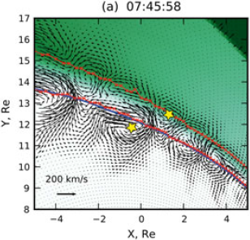
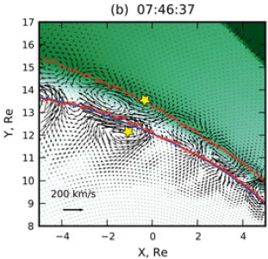
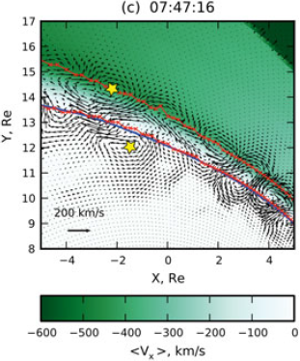
KH vortices in the inner & outer layers
Merkin+, JGR13
Not clear if double-layered KH vortices exist in reality.
If present, what role does the interaction between the two layers play in turbulence evolution?

Slide 14
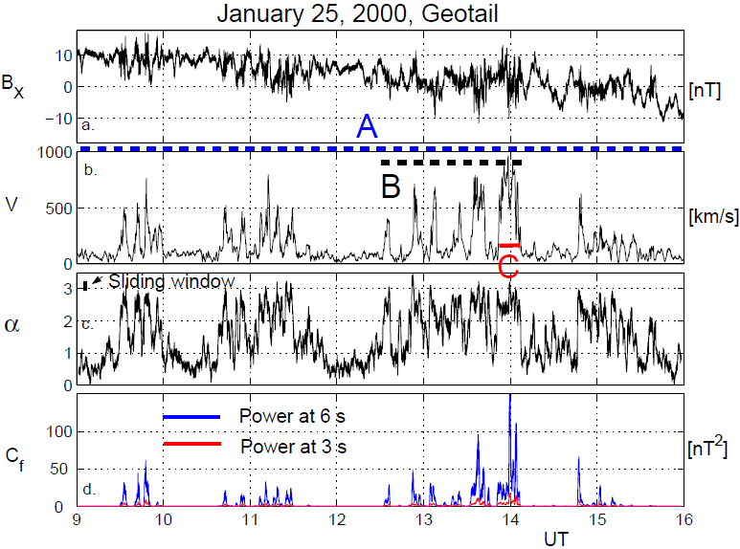
Bursty Bulk Flows (BBFs)
(Voros+, NPG07)
Complexities
Transient
Finite dawn-dusk extent of fast flows (2-3 Re: Nakamura+, GRL04), so turbulence may be excited at BBF flanks too.
Finite thickness of the plasma sheet/fast flows (order 1 Re).

Slide 15
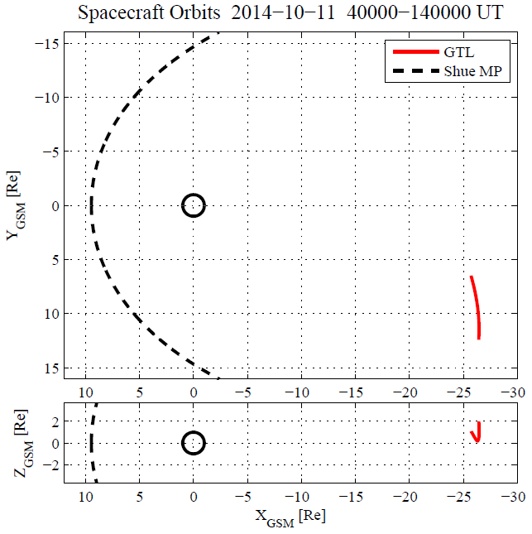
Geotail observations of quasi-continuous reconnection jet in the tail
Geotail@X~ -26 R_{E} pre-midnight

Slide 16
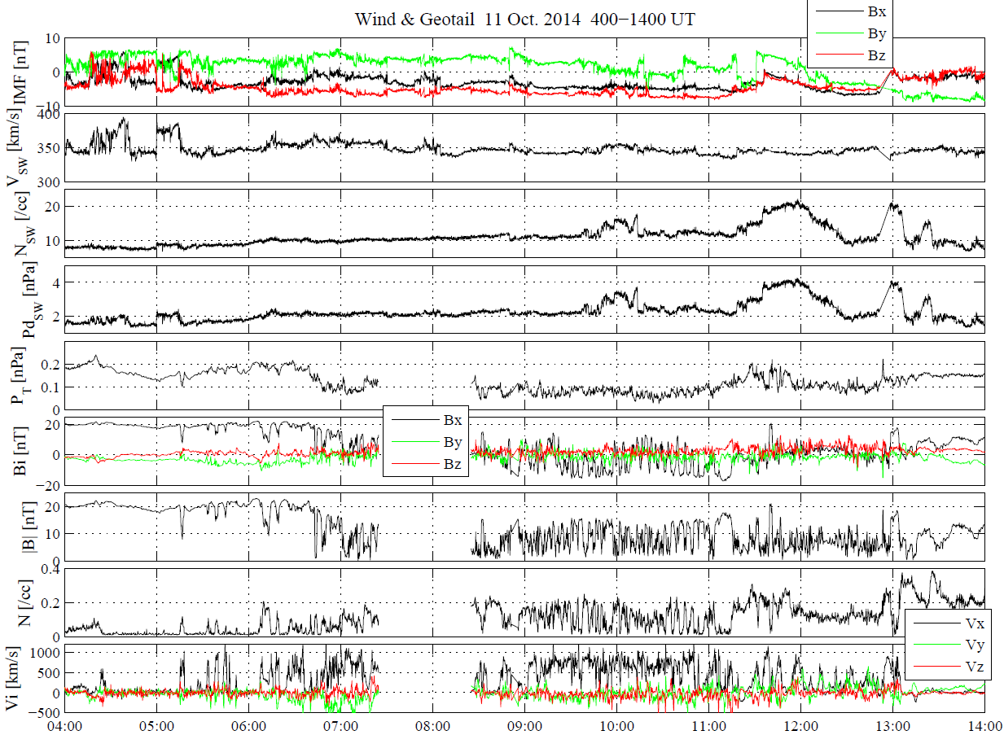
IMF Bz = -5 nT
Vsw ~ 350 km/s
Solar Wind (Wind) data
Quasi-steady, moderate driving
SW dynamic pressure ~2 nPa
Geotail data
4 hours
Quasi-continuous earthward jet with dawn-dusk extent >3 R_{E}.

Slide 17
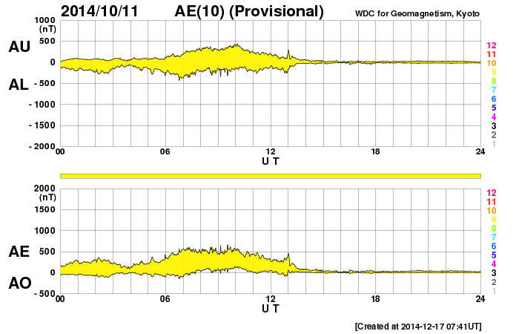
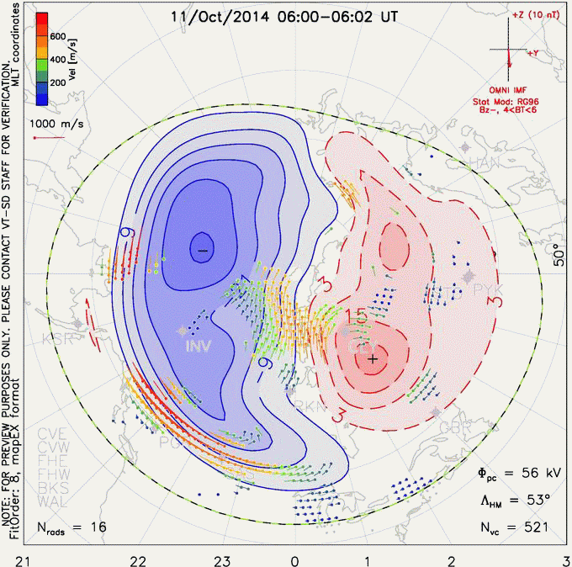
Steady magnetospheric convection (SMC)
AE roughly constant, with no (or only weak) substorm activities.
Quasi-steady two cell ionospheric convection.
SuperDARN convection map from VirginiaTech (http://vt.superdarn.org)
“Globally” quasi-steady magnetospheric conditions: Ideal for studying fundamental dynamics of the tail current sheet.

Slide 18
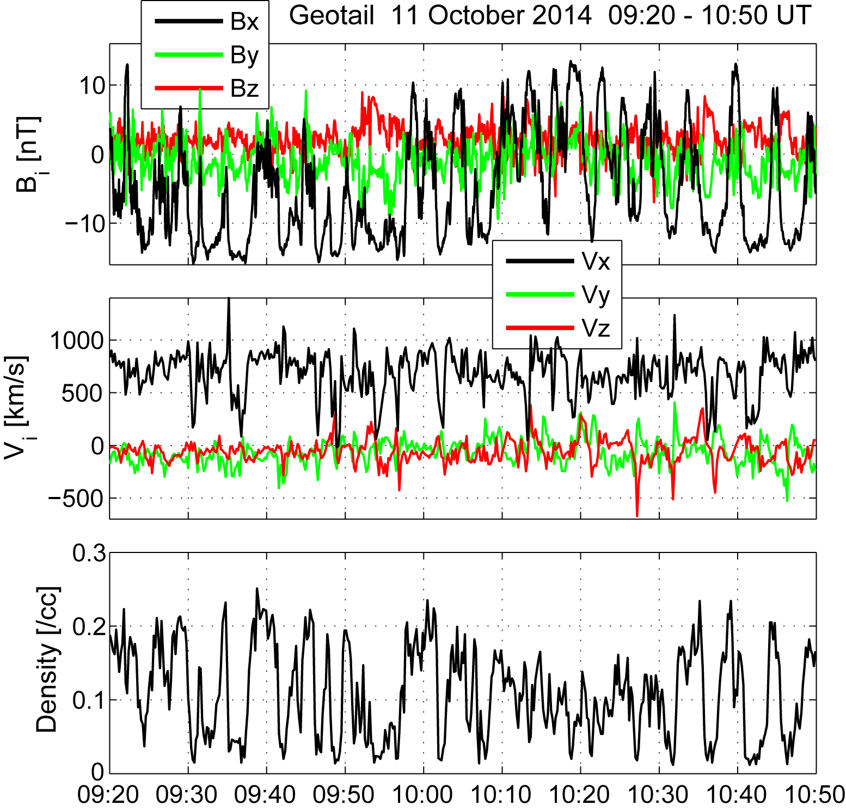
Flapping of the tail current sheet
Quasi-periodic Bx oscillations
Period ~3 min.
Embedded in fast earthward flow
Questions to constrain mechanism:
Is the propagation flankward or earthward?
Wave length/amplitude?
What is the free energy?
Reconnection jet
1.5 hours
Geotail@X~ -26 R_{E} pre-midnight

Slide 19
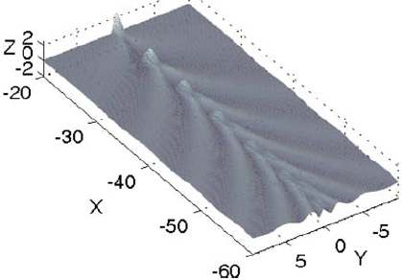
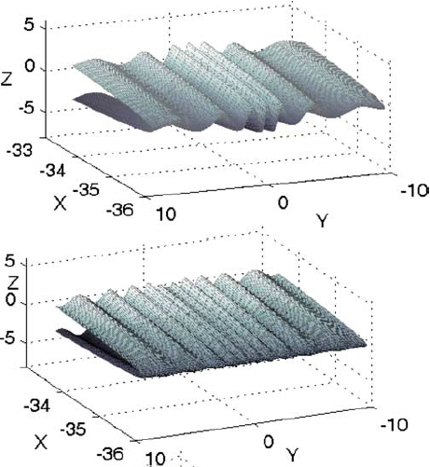
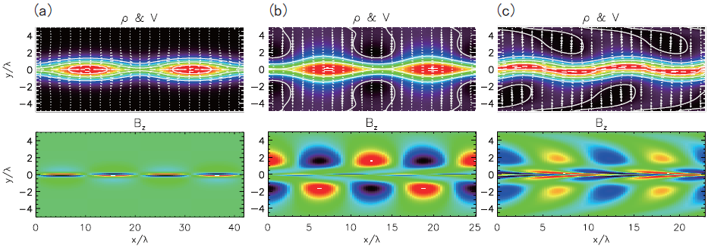
Generation mechanism of CS flapping
Structure in dawn-dusk dir.?
kink-mode
Wave source propagating earthward?
sausage-mode
Structure in Sun-Earth dir.?
tearing-mode
Streaming sausage-mode
Streaming kink-mode
Erkaev+, JGR09
Hoshino & Higashimori, JGR15

Slide 20
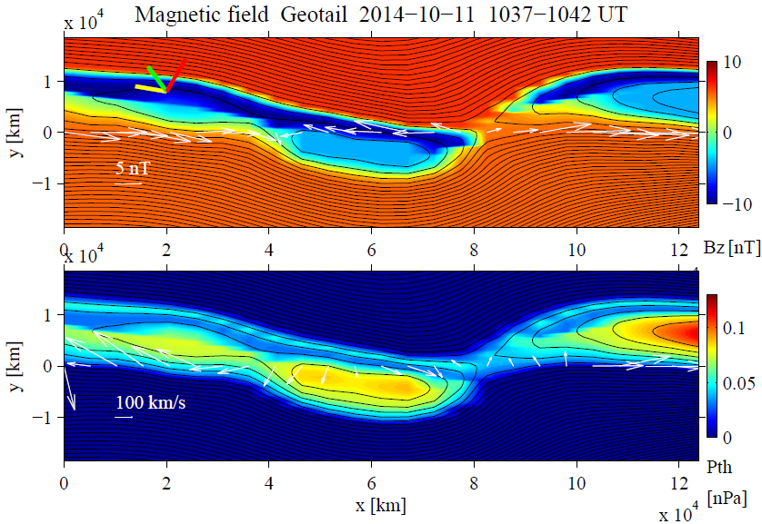
Grad-Shafranov (GS) reconstruction
GS equation (e.g., Sturrock, 1994)
Hau & Sonnerup, JGR99
Y_{GSM}
Z_{GSM}
X_{GSM}
Out-of-plane B comp.
V_{HT} = (560, -46, -54) km/s
X_{GS} = (-0.762, -0.451, 0.465): Earthward & duskward propagation
Y_{GS} = (0.126, 0.601, 0.789)
Z_{GS} = (-0.635, 0.660, -0.401)
pressure
“Kink-mode” waves
Roughly “earthward” propagation
Wavelength: 10-15 R_{E}, Amplitude: 1-2 R_{E}
~15 R_{E}

Slide 21
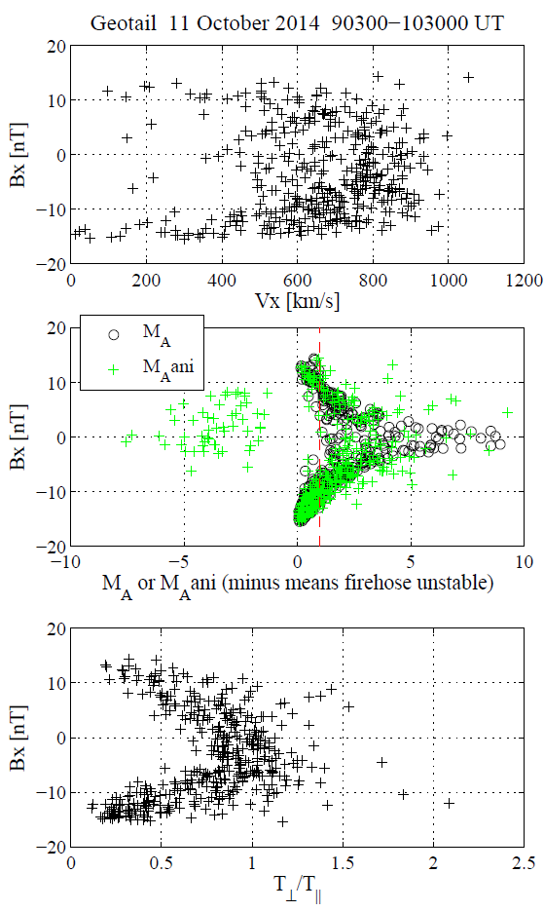
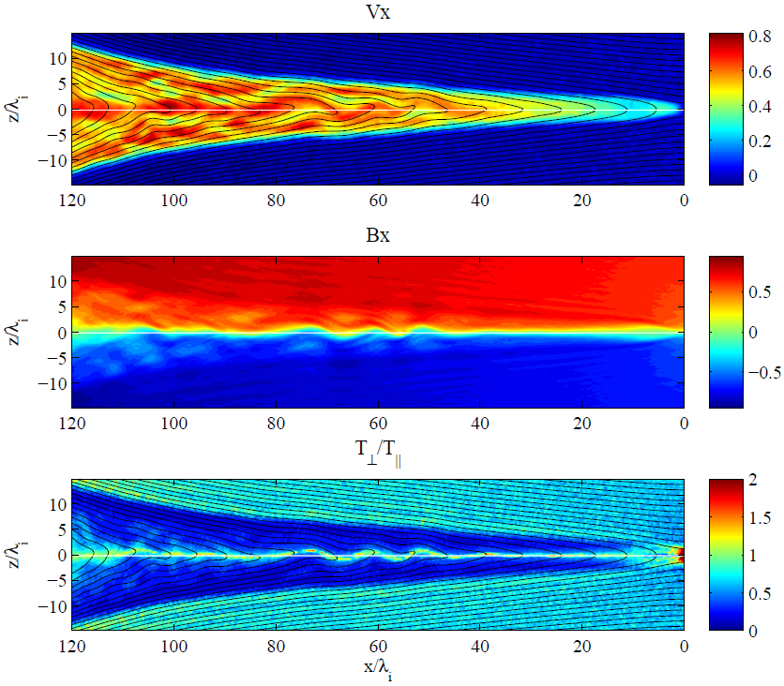
Kink mode driven by flow & pressure anisotropy
Bx [nT]
2D hybrid simulation of reconnection (lobe β=0.18)
Reconnection jet
Firehose unstable
Super-Alfvenic flow
Kink-mode waves
T|| > Tperp
Higashimori & Hoshino (JGR15)
T|| > Tperp

Slide 22
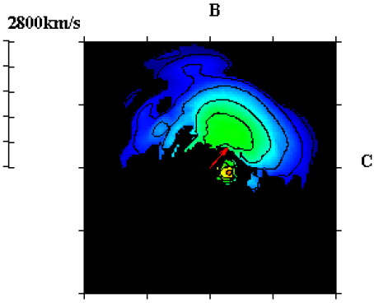
Origin of pressure anisotropy & its effect
Geotail 2-D ion velocity distribution in PSBL
PSBL ion beam (emanating from X-line)
+
Lobe cold ions convected toward CS center
|| to B
convection
MHD Eq. with anisotropy effect:
$$ρ\frac{∂V}{∂t}=−∇\left(p_{⊥}+\frac{B^{2}}{2μ_{0}}\right)−ρV∙∇V+∇∙\left(ε_{ani}\frac{BB}{μ_{0}}\right)$$
Inertia or V shear effect
Total pressure gradient force
Magnetic tension
$$ε_{ani}=1−\frac{(p_{∥}−p_{⊥})μ_{0}}{B^{2}}$$
< 0 ⇒ Firehose unstable
Weaker magnetic tension (stabilizing force) when T|| > Tperp.

Slide 23
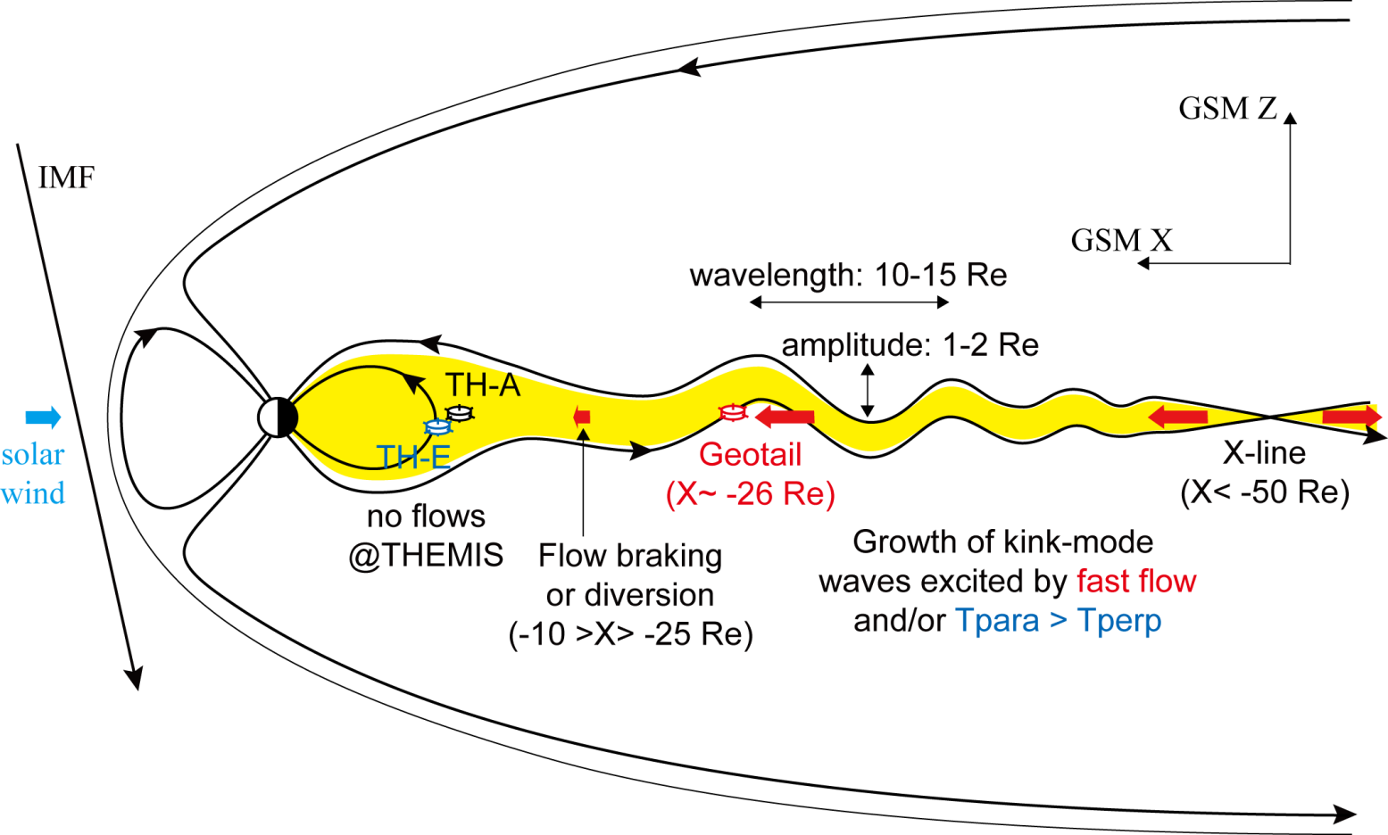
Interpretation: Streaming Kink Instability
SKI driven by a continuous reconnection jet originating from the distant tail (X-line possibly at x~ -100 Re)
“Dynamic” tail current sheet even under “globally steady” magnetospheric (SMC) condition (turbulence driver).

Slide 24
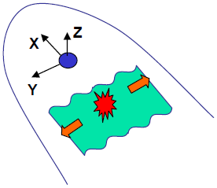
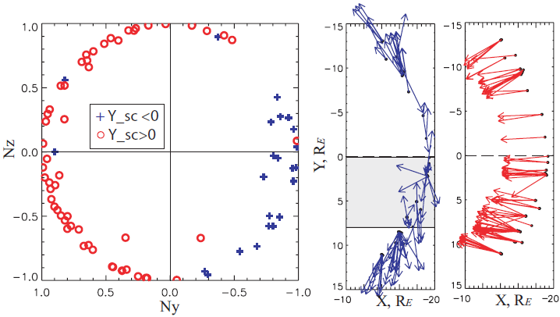
Question: could flankward-propagating waves result from earthward kink waves?
Zhang+, AG05
Sergeev+, AG06
@R = 10–30 Re, the waves tend to propagate from center toward flanks.
Often observed along with fast flow, or substorm activities. But not always.
Interval between neighboring CS crossings: 30 sec–10 min.
Runov+, AG05

Slide 25
Possible consequences of the tail SKI
2-D hybrid simulation of reconnection
: a measure of Alfvenicity
Erkaev+ (JGR09)
Higashimori & Hoshino (JGR15)
Generation of Alfvenic wave/turbulence.
Flow braking and/or plasma heating by converting the flow energy into thermal energy (via waves/turbulence).
Possibility that part of flankward-propagating current sheet flappings in the near-Earth tail results from the SKI waves propagating from the mid-tail?

Slide 26
Possible roles
Role | Kelvin-Helmholtz instability | Streaming Kink Instability
Mass transport | Plasma transport via vortex-induced turbulence/reconnection (secondary processes!) | ???
Momentum transport | Viscous or turbulent convection | Braking of reconnection jet
Energy transfer | ULF (Pc4-5) wave excitation in the inner magnetosphere | Excitation of Alfven waves, possibly leading to auroral acceleration
Structure formation | Spatially periodic auroral forms | Plasma sheet flapping propagating flankward

Slide 27
Summary
The KHI at the flank magnetopause can drive turbulence (eddy/Alfven) in the low-latitude boundary layer and/or plasma sheet for northward IMF, but details remain unclear.
First identification of earthward propagating kink-mode waves in the magnetotail current sheet, possibly from the SKI, for southward IMF.
This may drive Alfven wave/turbulence in plasma sheet.
Understanding turbulence in highly inhomogeneous magnetospheric plasmas is challenging, but it would be worth to study and we may need some smart approach to investigate it.

Slide 28
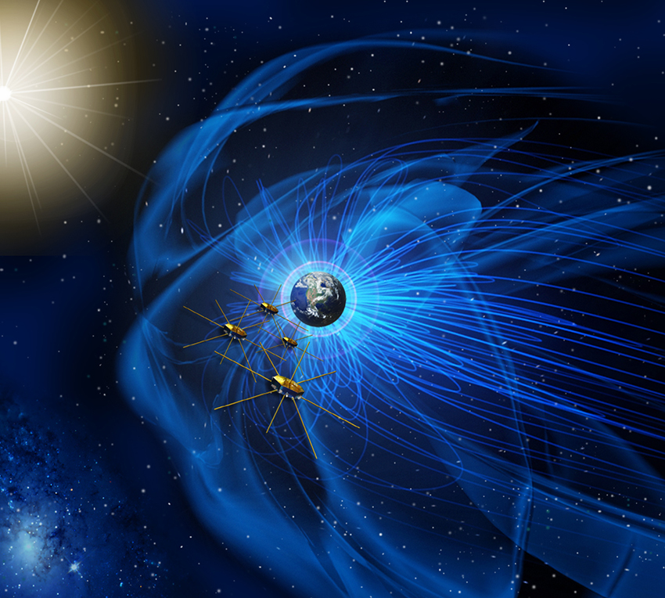
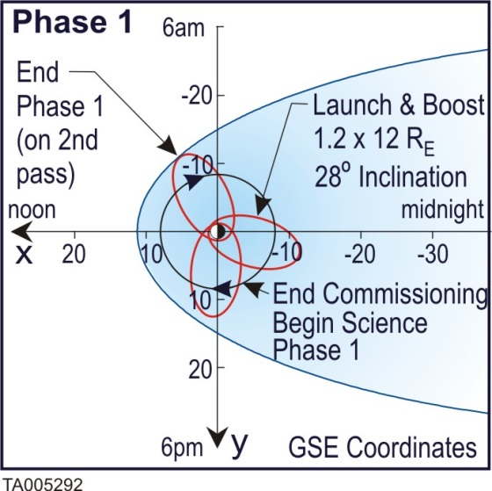
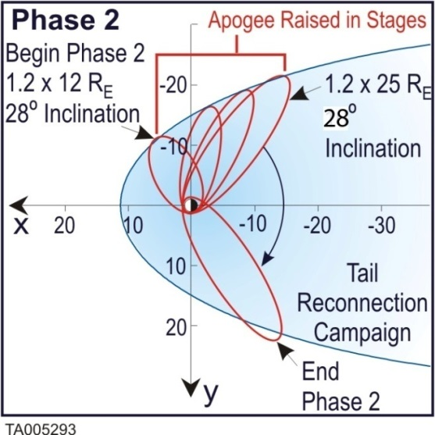
New discoveries will come from Magnetospheric Multiscale (MMS) mission with high-resolution 4-SC measurements
Successful launch on 12 March 2015!
http://mms.space.swri.edu/
Image credit: NASA
Phase 1a from September 1
30 ms electron measurements
~10 km spacecraft separation

Slide 29
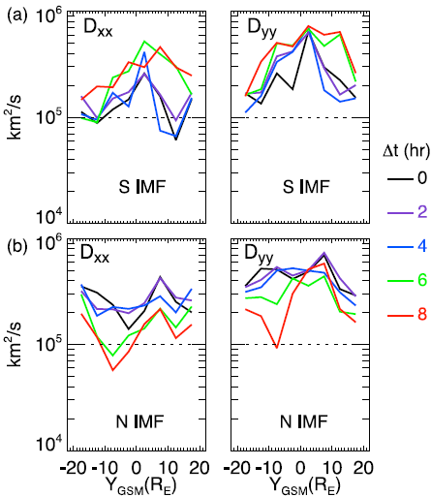
Eddy diffusion coefficient for southward & northward IMF
Dawn
Dusk
Wang+ (JGR10)

Slide 31
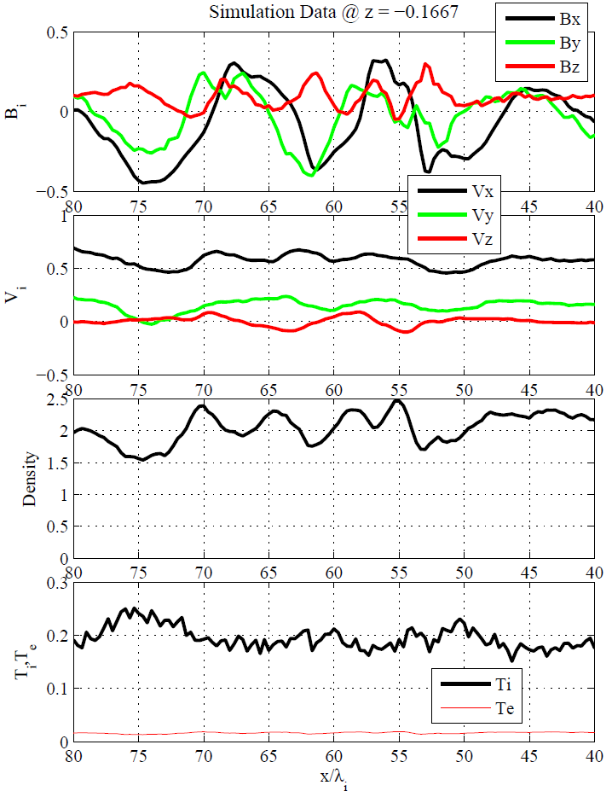
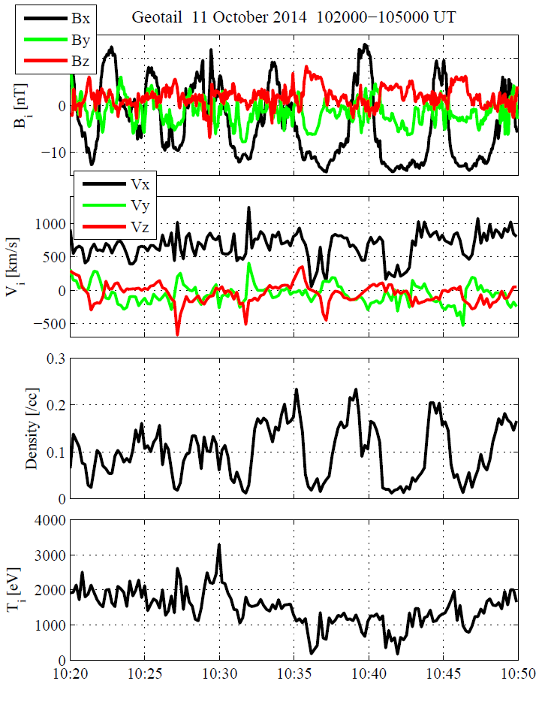
Simulation vs Observation
Virtual spacecraft observations
Geotail observations
Bz peaks right after CS crossings
Changes larger than in simulation suggest a larger amplitude.
Ni [/cc]
Grad-Shafranov Reconstruction interval
Ti [eV]
30 min

Slide 32
Current sheet flapping in the tail is common, but not well understood
Zhang+, AG05
Sergeev+, AG06
@R = 10–30 Re, the waves tend to propagate from center toward flanks.
Often observed along with fast flow, or substorm activities. But not always.
Interval between neighboring CS crossings: 30 sec–10 min.
Runov+, AG05

Slide 33
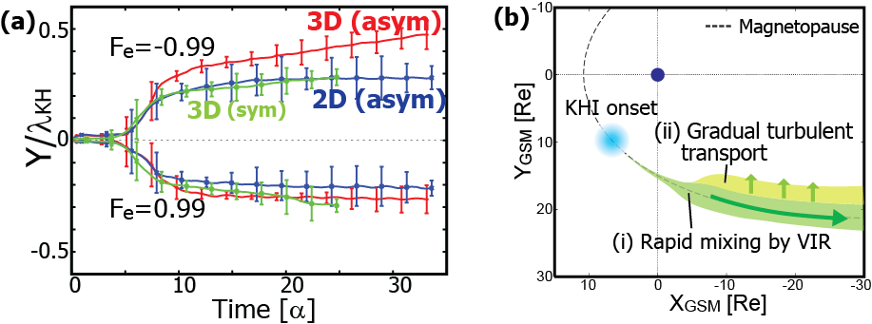
Mixing and transport rates
[Nakamura & Daughton, GRL, 2014]
Mixing boundary
Rapid mixing by the VIR
Additional gradual transport
by the 2ndary turbulence
Producing ~R_{E} thickness of mixing layer while the KH waves propagate ~20R_{E}.
Enough to form the tail CDPS observed during periods of prolonged northward IMF.
Enough to form the observed thickness of the flank-to-tail LLBL during northward IMF.

Slide 34
Why KHI grows?
Flow line
$$V_{0}/2$$
Interface
$$V_{0}/2$$
Bernoulli’s principle
(in incompressible case)
$$\frac{1}{2}v^{2}+\frac{p}{ρ}=const.$$

Slide 35
Why KHI grows?
Flow line
$$V_{0}/2$$
Interface
$$V_{0}/2$$
Bernoulli’s principle
(in incompressible case)
$$\frac{1}{2}v^{2}+\frac{p}{ρ}=const.$$

Slide 36
Why KHI grows?
$V_{0}/2<C_{s}$
Subsonic flow case
(KH-unstable)
Flow line
$$V_{0}/2$$
$$−∇p$$
$$−∇p$$
Interface
$$V_{0}/2$$
Bernoulli’s principle
(in incompressible case)
$$\frac{1}{2}v^{2}+\frac{p}{ρ}=const.$$
Positive feedback occurs, i.e., Perturbations grow.

Slide 37
Why KHI grows?
$V_{0}/2>C_{s}$
Supersonic flow case (KH-stable)
Flow line
$$V_{0}/2$$
$$−∇p$$
$$−∇p$$
Interface
$$V_{0}/2$$
Bernoulli’s principle
(in incompressible case)
$$\frac{1}{2}v^{2}+\frac{p}{ρ}=const.$$
Negative feedback occurs, i.e., Perturbations suppressed.
Note: in finite-thickness shear layer, KHI can grow even for super-(magneto)sonic flow conditions (e.g., Miura+, JGR92).

Slide 38
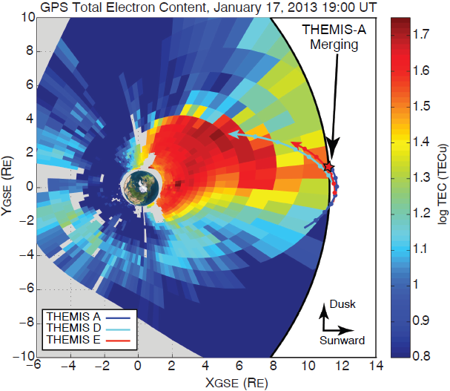
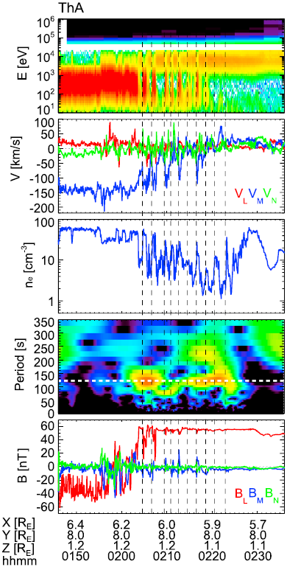
Walsh+ (Science14; JGR15)
Plume mostly for southward IMF. So contribution to northward IMF KHI could be negligible.

Slide 39
Why important? Mechanisms?
Manifestation of energy conversion (excitation)
Candidate mechanisms & free energy of tail CS flapping:
Solar wind perturbations [e.g., Speiser & Ness, JGR67]
Ballooning instability (pressure gradient) [Golovchanskaya & Maltsev, GRL05]
Kelvin-Helmholtz instability (velocity shear) [e.g., Nakagawa & Nishida, GRL89]
Firehose instability (temperature anisotropy)
Drift or kink instability (electric current, non-Maxwellian distribution) [e.g., Karimabadi+, JGR03]
Transport energy (propagation)
Heat plasma or accelerate particles (dissipation)

