Slide 1
Introduction to
Space Plasma Complexity
Tom Chang
Kavli Institute for Astrophysics and Space Research
Massachusetts Institute of Technology
Cambridge, MA USA

Slide 5
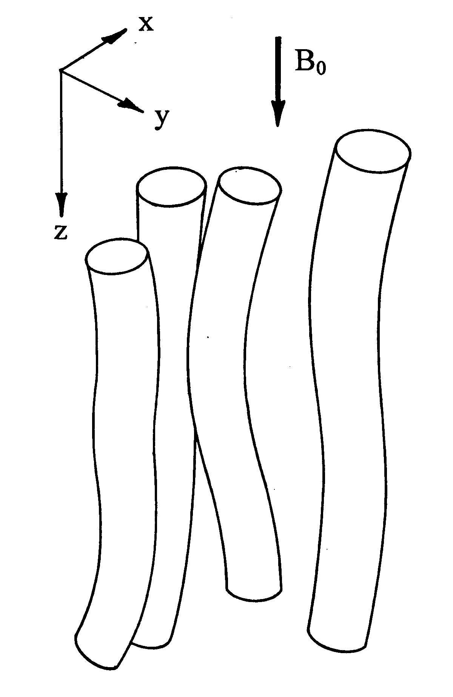
SOLAR WIND
CHANG (1998)
BRUNO ET AL. (2001)

Slide 7
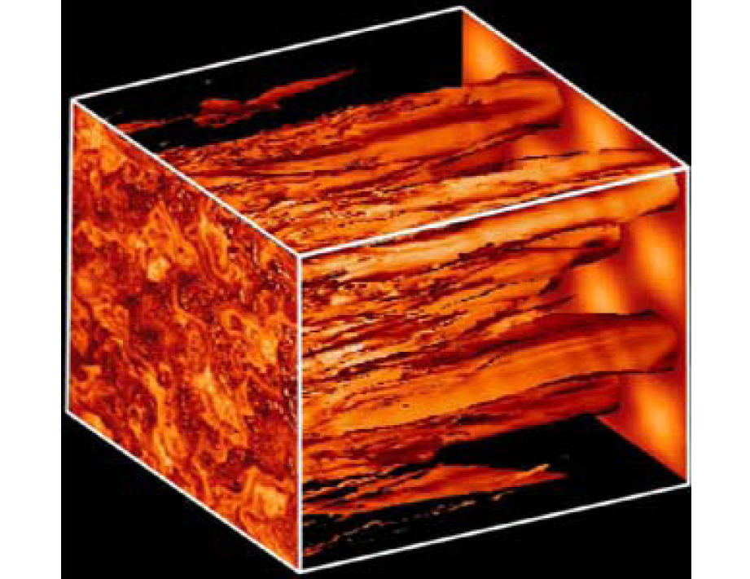
Matthaeus, Qin, Bieber, and Zank, Astrophys. J. Lett. 2003

Slide 8
CHANG, 1998

Slide 9
ALEXANDROVA 2008

Slide 10
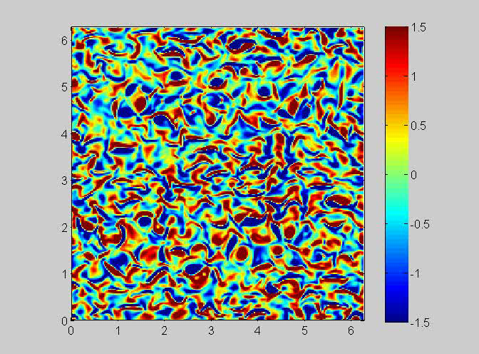
WU & CHANG, 2006

Slide 11
WU & CHANG, 2001

Slide 12
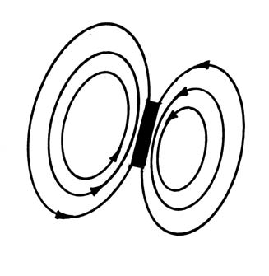

Slide 13
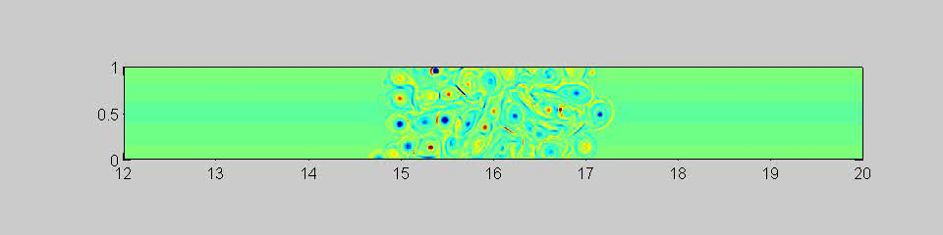
COARSE-GRAINED DISSIPATION

Slide 14
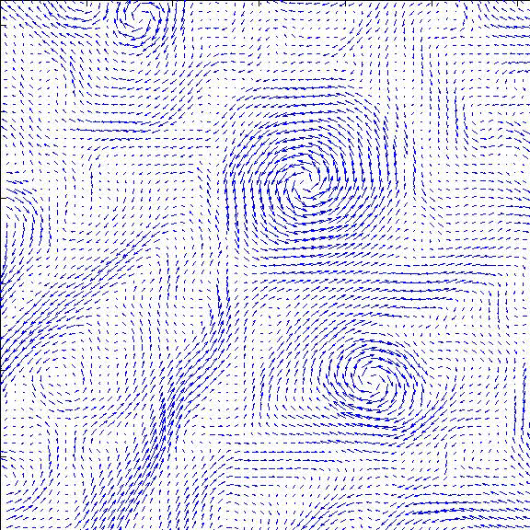

Slide 15
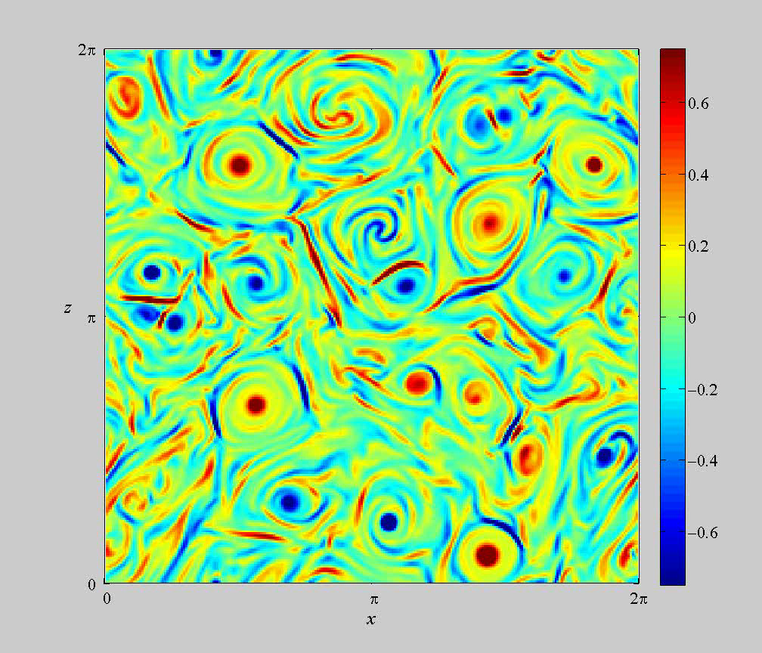

Slide 19
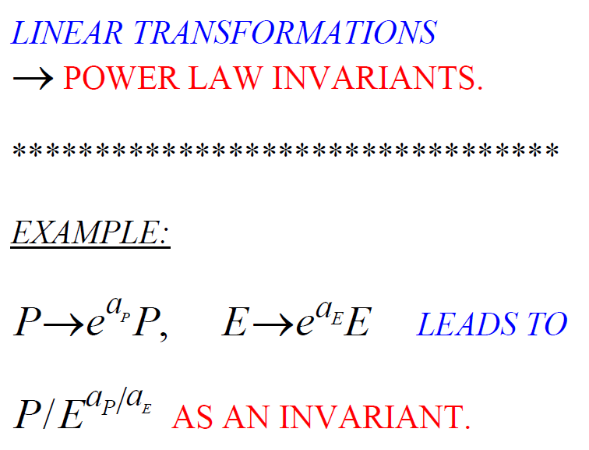

Slide 20
HOW DO WE DEFINE
DIMENSIONS?

Slide 21
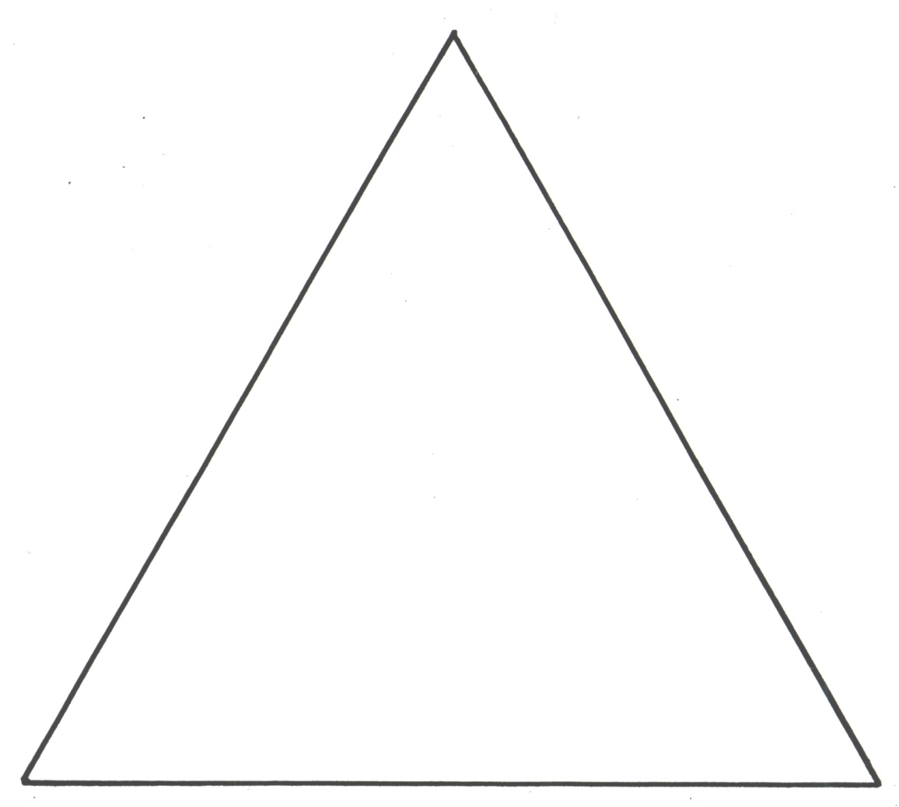

Slide 22
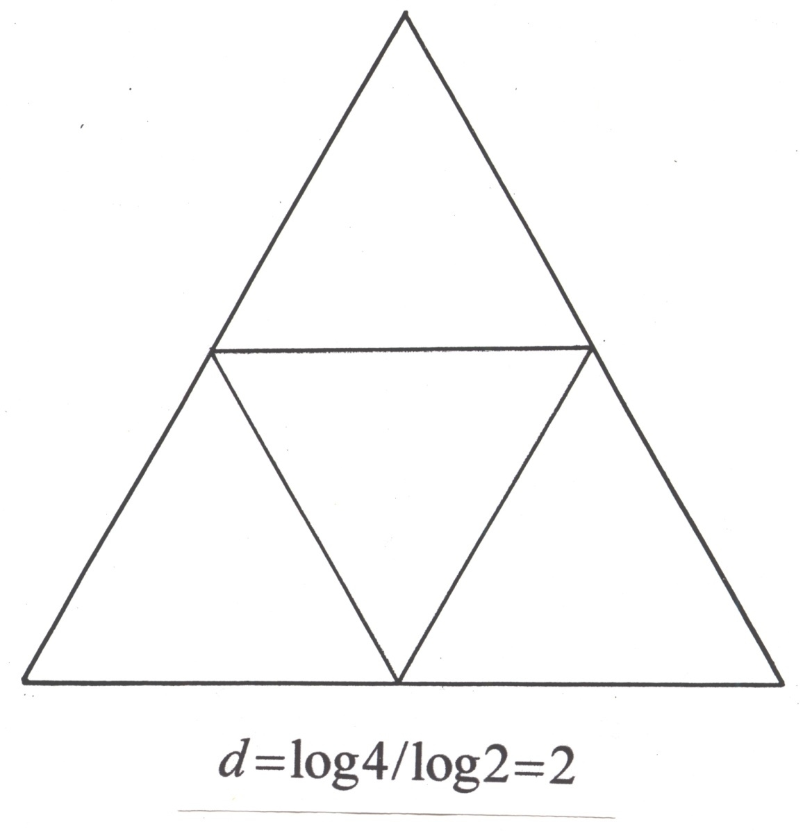

Slide 23


Slide 24
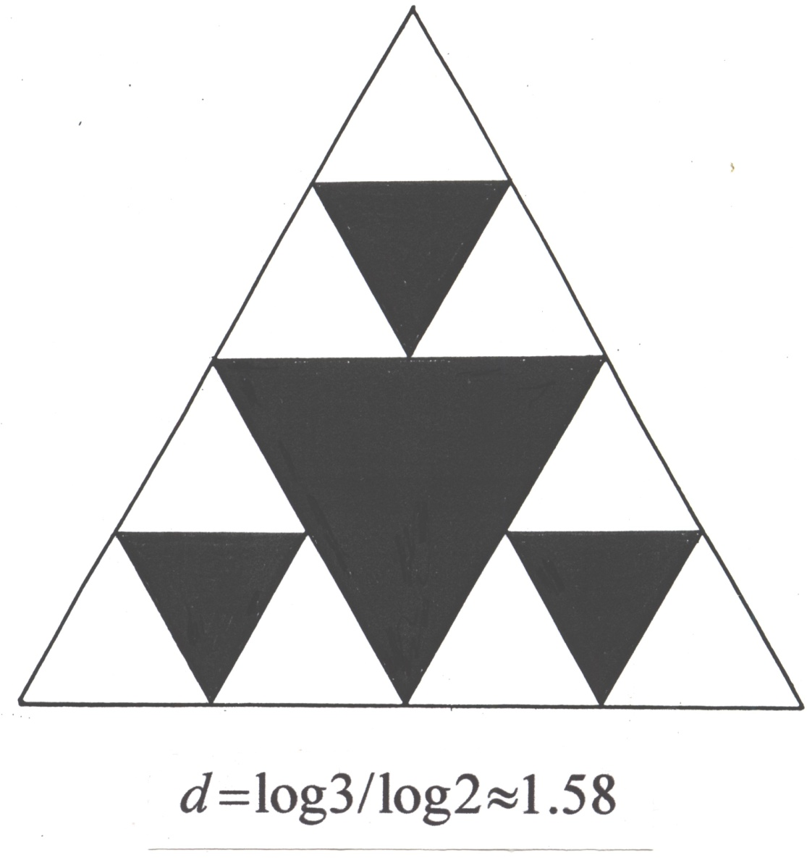

Slide 25
Dennis, 1985

Slide 26
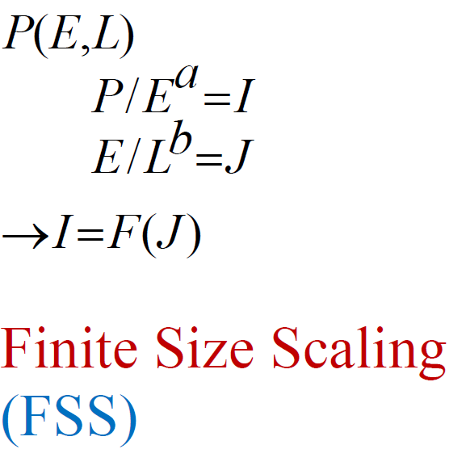

Slide 27
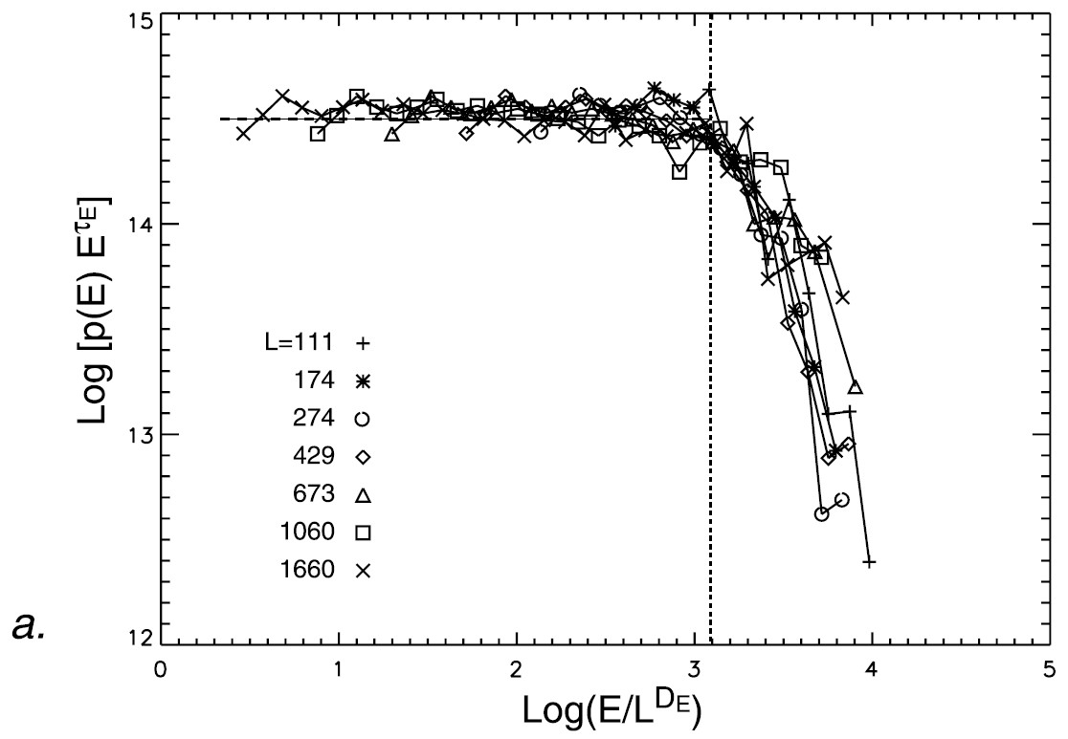

Slide 28
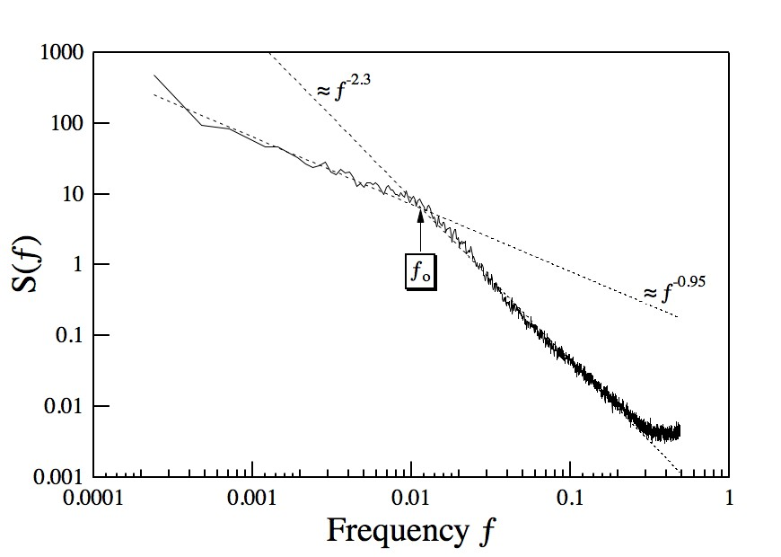

Slide 31
MULTI-FRACTALS

Slide 32
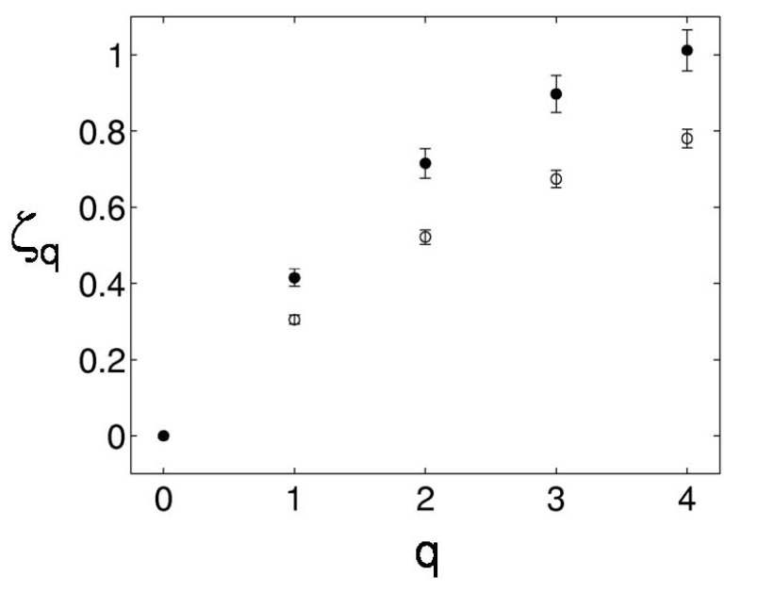
Bruno et al. 2007, Magnetic field strength fluctuations

Slide 35
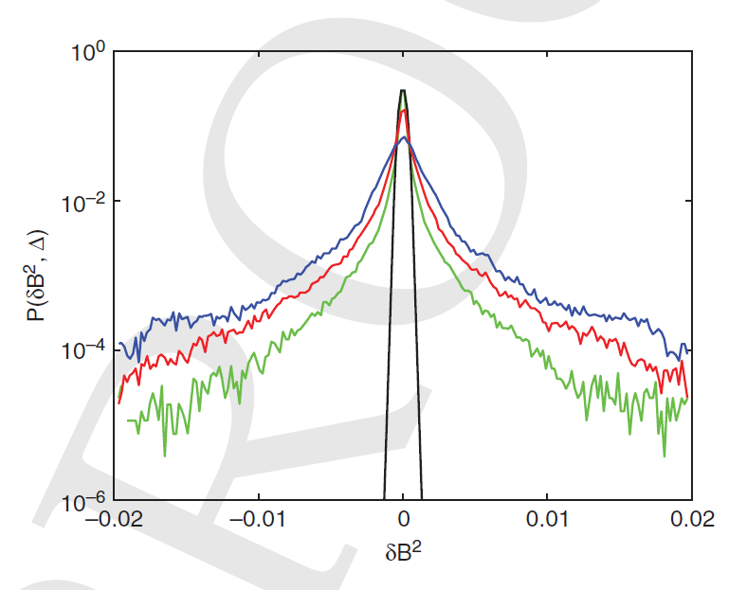

Slide 36
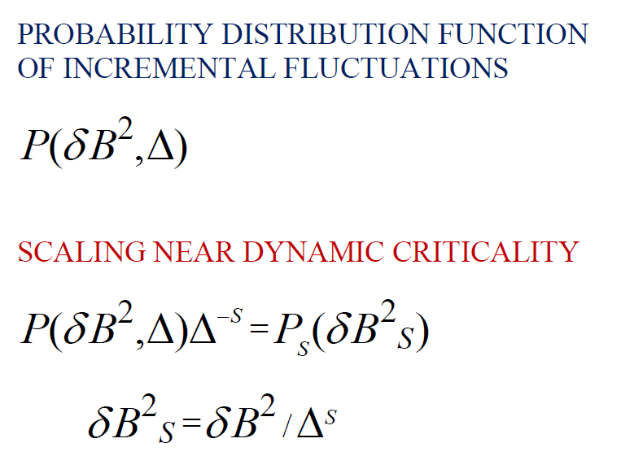

Slide 37
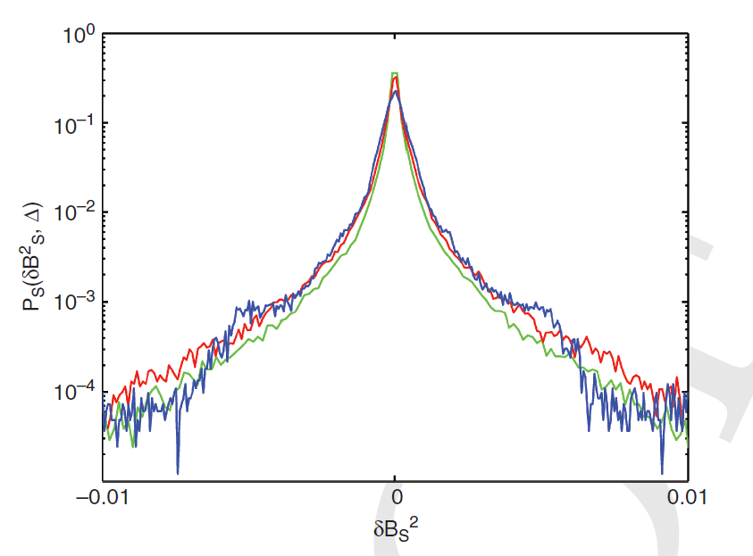
Hnat et al., 2002 (Solar Wind) Chang et al., 2004

Slide 38
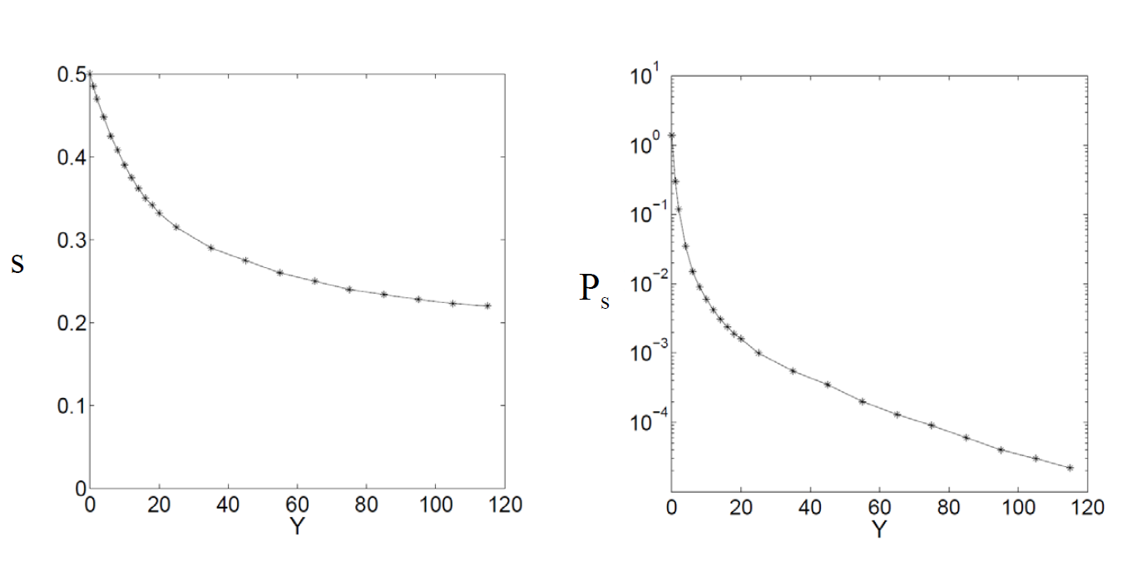
Y=
S=S(Y)

Slide 39
ROMA
(Rank Ordered Multifractal Analyses)
Chang and Wu, 2008

Slide 40
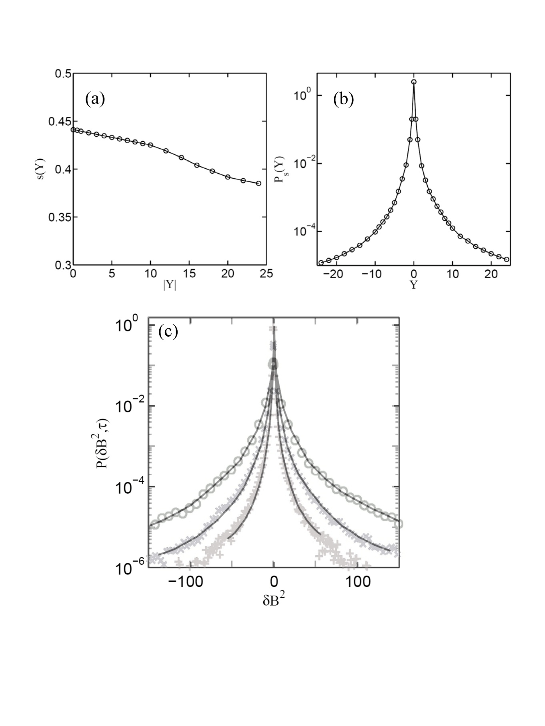

Slide 41
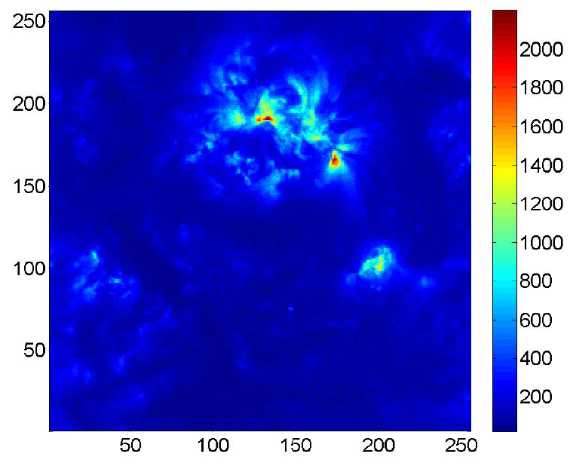
Corona EUV Emissions – SOHO (Wu et al., 2011)
Wu, Chang, Uritsky; 2011

Slide 42
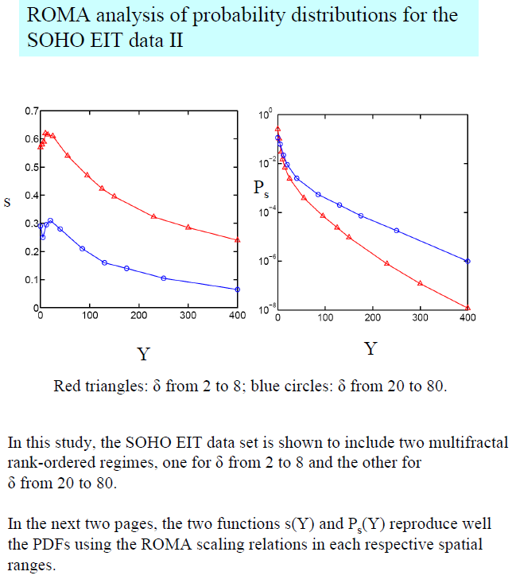

Slide 43
APPLICATIONS TO SPACE PLASMAS
Auroral electric field fluctuations (Tam et al.)
Cusp and magnetosheath magnetic field fluctuations (Echim and Lamy)
AE index (Consolini and De Michelis)
EUV solar emissions (Wu and Uritsky)
Solar wind (Podesta)
Isotropic hydrodynamic turbulence (Wu)
Cosmic Web (Chang et al.)

Slide 44
CUSP-Cluster data (Echim et al., 2007 and Lamy et al., 2008)

Slide 45
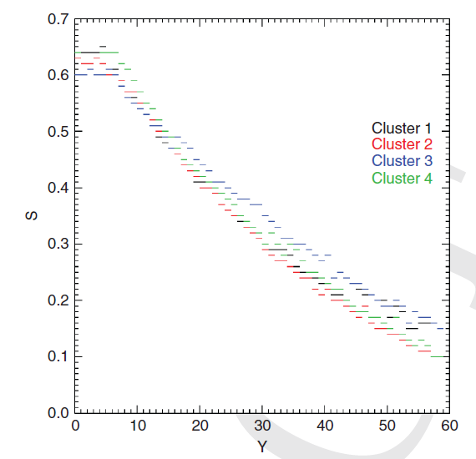

Slide 46
MODIFIED FOREST FIRE MODEL
Drossel and Schwabl, 1994
Loreto et al., 1995
Tam, Chang, Consolini, De Michelis, 2000

Slide 47
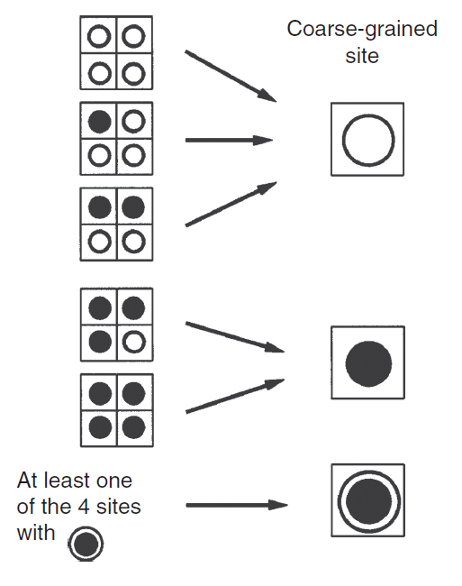
Rules of RG Transformation

Slide 48
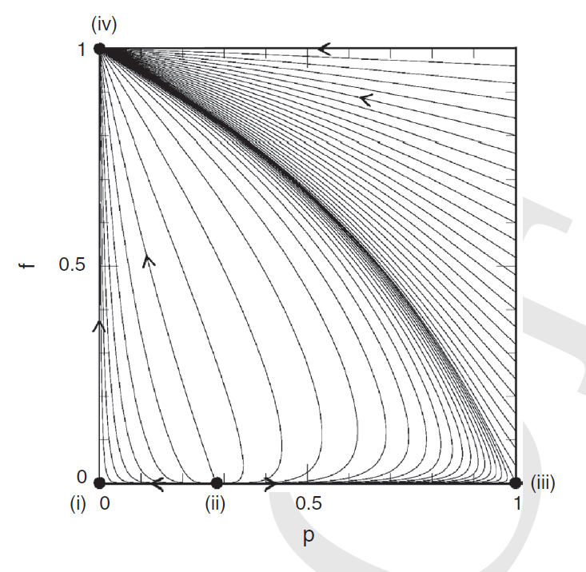
Phase Space Global RG Trajectories

