Slide 1


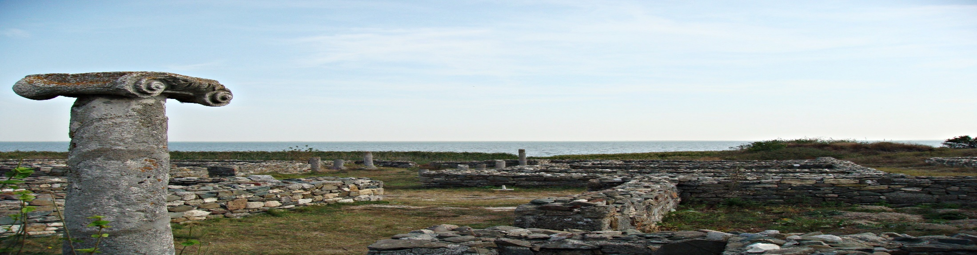
STORM FP7
Solar system plasma turbulence, intermittency and multifractals
International Workshop and School
06-13 September 2015
Mamaia, ROMANIA
Observing MHD turbulence phenomenology in 3D heliosphere
Roberto Bruno
INAF-IAPS, Roma, Italy
roberto.bruno@iaps.inaf.it
Roman-Greek ruins at Tomis-Constanta

Slide 2
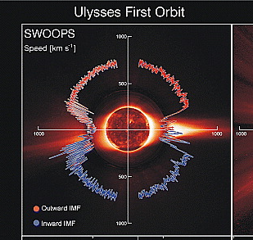
Solar wind large scale structure
Solar minimum:
fast steady wind at high latitudes
Fast and slow streams in the ecliptic.
McComas et al, GRL, 2003

Slide 3
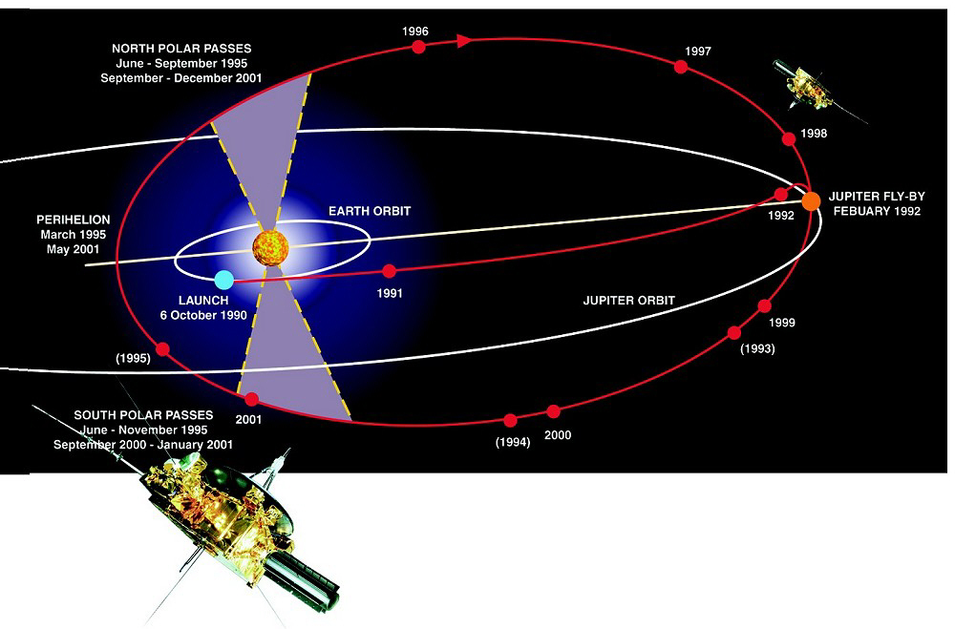
Ulysses
Launched in 1990 and still operating
perihelion : 1.3AU
aphelion: 5.4 AU
Latitudinal excursion: ±82°

Slide 4
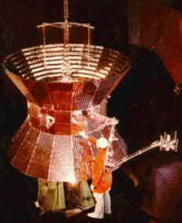
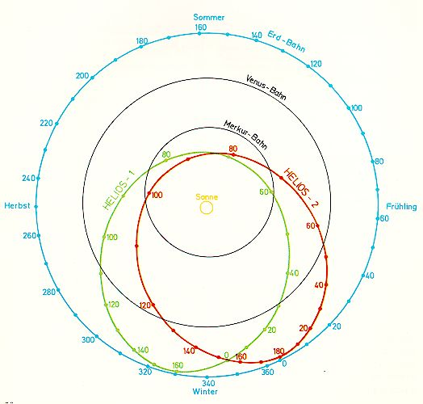
Most of our knowledge about solar wind plasma and magnetic field in the inner heliosphere is due to Helios 1-2 s/c developed by the Federal Republic of Germany (FRG) in a cooperative program with NASA
Two spacecraft, launched in 1974(10 Dec) & 1976(15 Jan)
ecliptic orbit, perihelium @ 0.29AU
Plasma measurements: protons(+alphas) and electrons
No composition
Slow plasma sampling, VDF in 40.5 sec
Low phase space resolution
NO imaging
Programme realized in only 5 years!
1969: contract between FRG and NASA approved
10 December 1974: Helios 1 launched

Slide 5
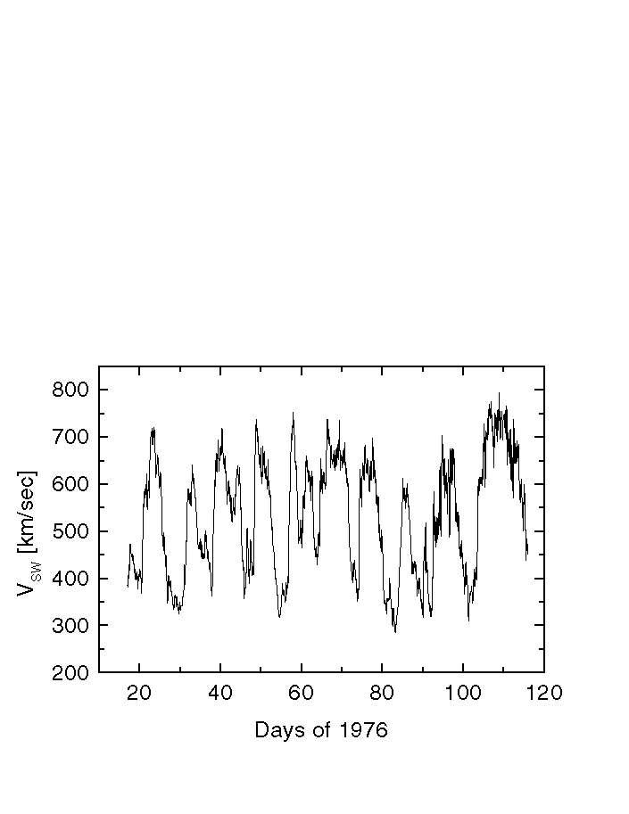
A sample of interplanetary data observed in the ecliptic

Slide 6
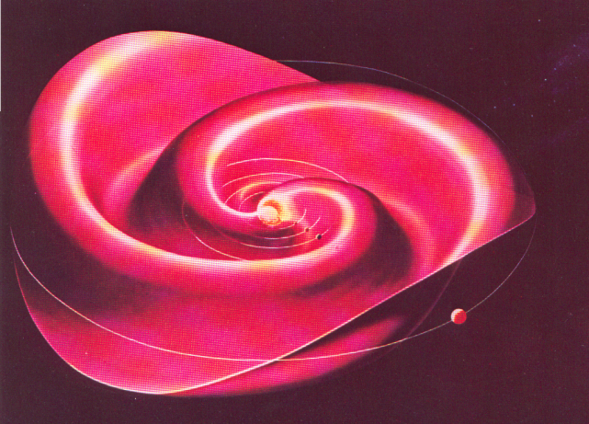
A sample of interplanetary data observed in the ecliptic

Slide 7
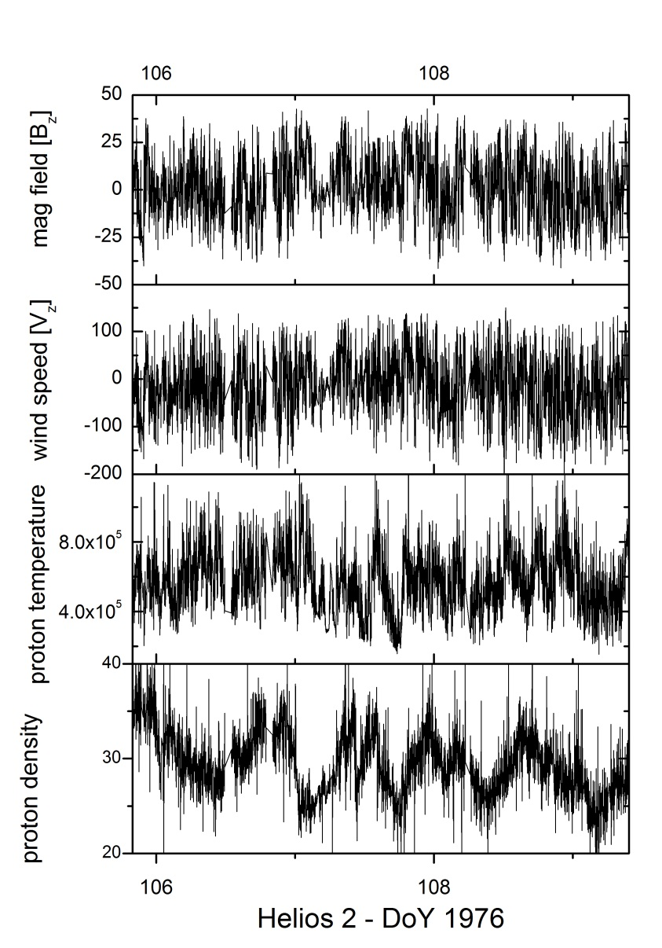
A sample of interplanetary data observed in the ecliptic
As we will see in the following,
the Solar Wind is a turbulent medium

Slide 8
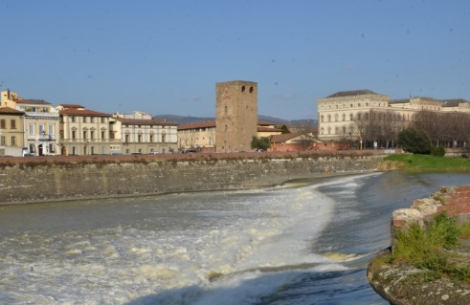
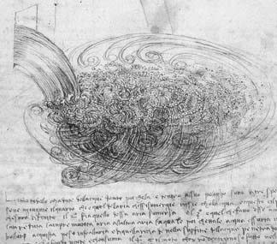
Turbulence is an old problem…
Arno river in Florence
Study by Leonardo da Vinci (1452-1519)
Related to the problem of reducing the rapids in the river Arno

Slide 9
Turbulence is an old problem…
Arno river in Florence
Study by Leonardo da Vinci (1452-1519)
Related to the problem of reducing the rapids in the river Arno
“Turbulence still remains the last major unsolved problem in classical physics.” Feynman et al. (1977)

Slide 10
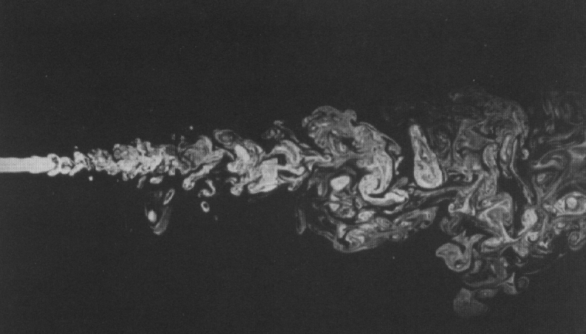
TURBULENCE
The study of the chaotic behavior of a fluid flow in space and time

Slide 11
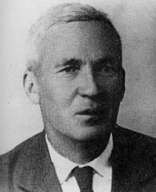
TURBULENCE
The legacy of
Kolmogorov, Andrei Nikolaevich (1903-1987)
The study of the chaotic behavior of a fluid flow in space and time

Slide 12
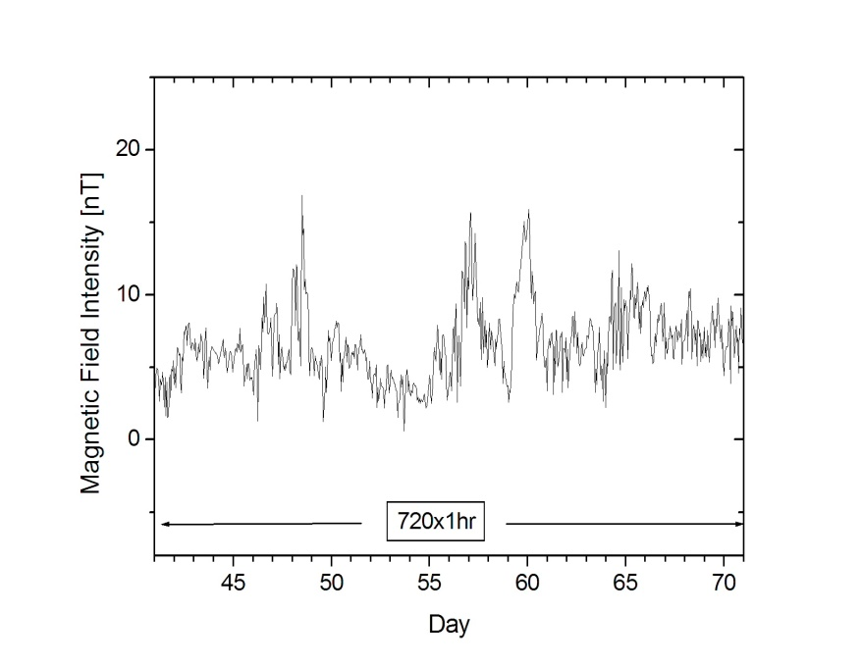
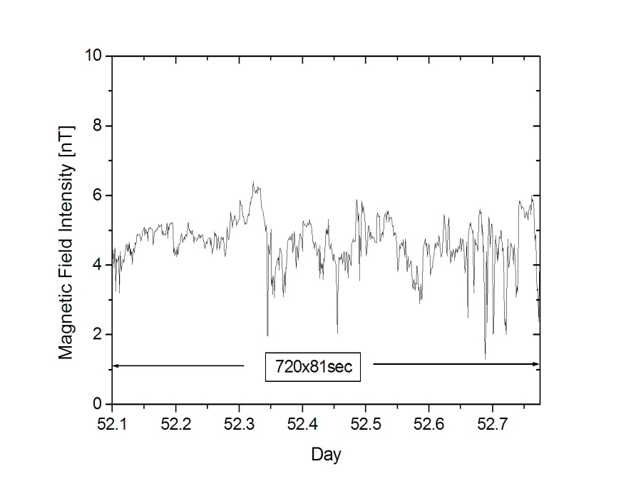
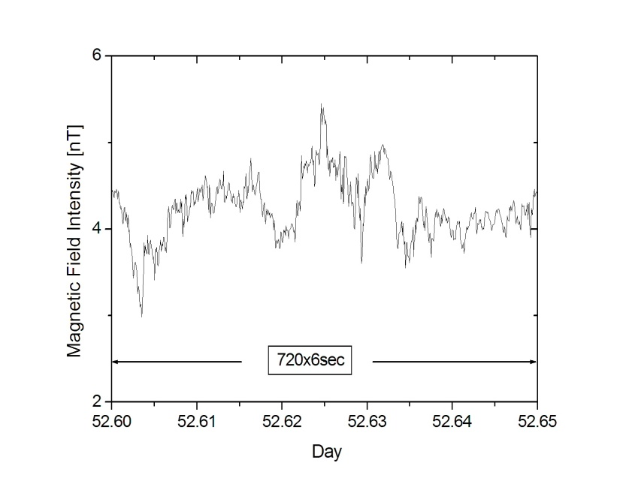
The first feature we notice in interplanetary fluctuations is an approximate self-similarity when we look at different scales
Scales of days
Scales of hours and minutes
Scales of seconds
Three panels with the same amount of datapoints
Similar profiles

Slide 13
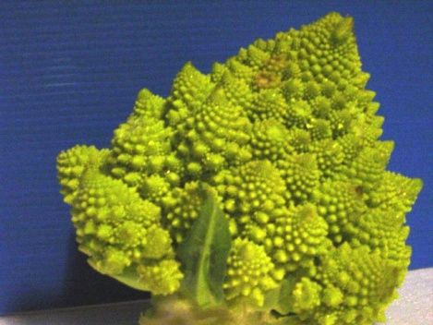
self-similarity implies power-laws
The field v(λ) is said to be “invariant for scale transformation” λ→rλ or “self-similar” if there exists a parameter μ(r) such that:
Romanesco broccoli
The solution of this relation is a power law: v(λ)=Cλ^{h} where h=-log_{r}μ(r)

Slide 14
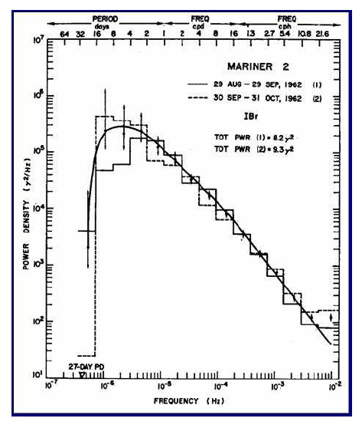
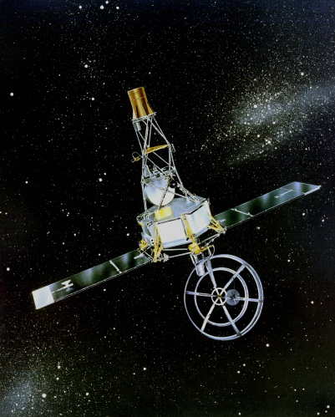
As a matter of fact, interplanetary fluctuations do show power laws
The first evidence of the existence of a power law in solar wind fluctuations
MARINER 2
Launch: 1962
Destination: Venus
First magnetic energy spectrum
(Coleman, 1968)

Slide 15
As a matter of fact, interplanetary fluctuations do show power laws
Scales of fractions of AUs
f^{-5/3}
f_{c}
A typical IMF power spectrum in interplanetary space at 1 AU
[Low frequency from Bruno et al., 1985, high freq. tail from Leamon et al, 1999]

Slide 16
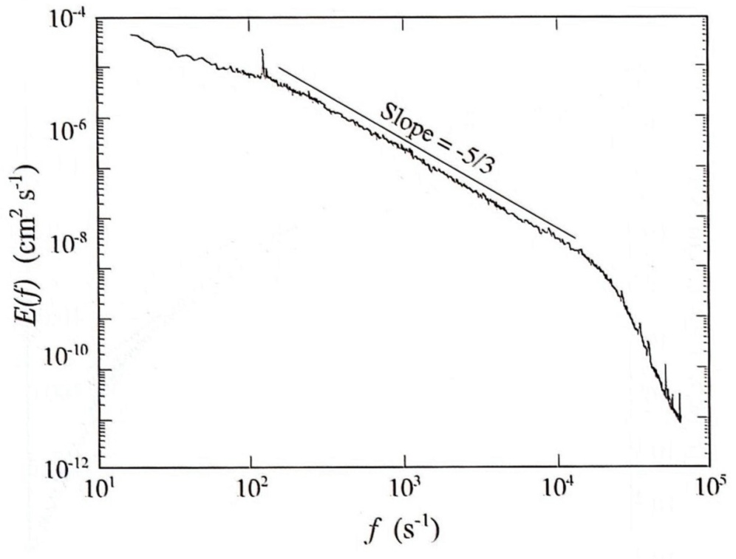
Spectral index of turbulent phenomena is universal
Scales of fractions of AUs
Scales of cms
f^{-5/3}
f_{c}
A typical IMF power spectrum in interplanetary space at 1 AU
[Low frequency from Bruno et al., 1985, high freq. tail from Leamon et al, 1999]
Laboratory experiment on turbulence with low temperature helium gas flow [Maurer et al., 1994]

Slide 17
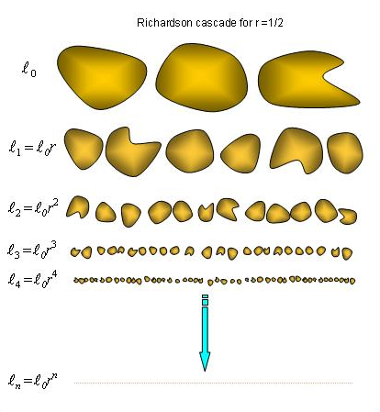
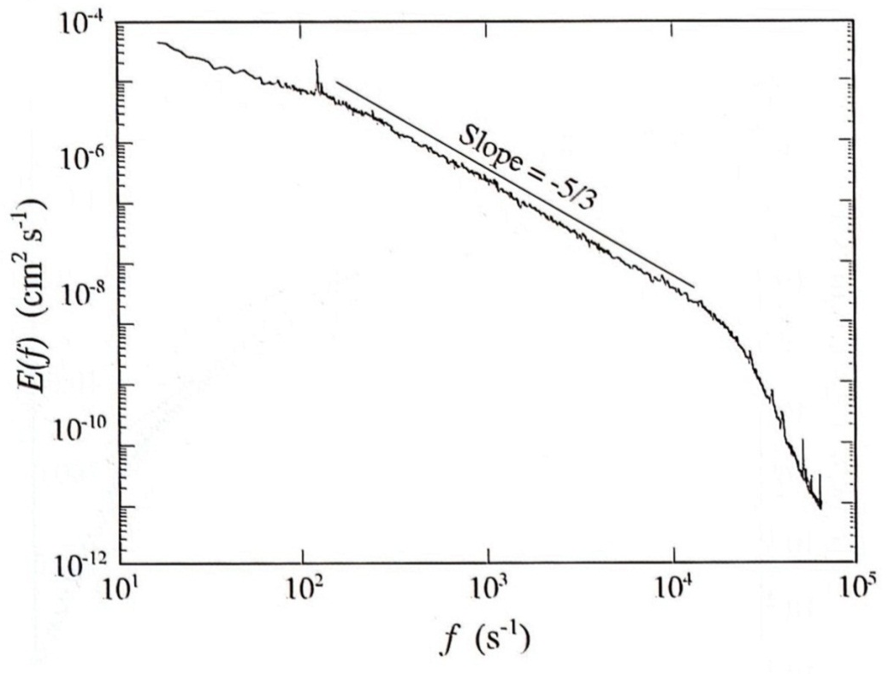
The phenomenology at the basis of these observations follows the energy cascade á la Richardson in the hypothesis of homogeneous and isotropic turbulence
integral scales
ε
ε = energy transfer rate
~k⁻¹
inertial range
ε
dissipation scales
ε
homogeneous=statistically invariant under space translation
isotropic=statistically invariant under simultaneous rotation of δv and

Slide 18
K41 theory and k^{-5/3} scaling (A.N. Kolmogorov,1941) based on dimensional analysis
1
1
v₁
3
4
3
4
eddy turnover time (generation of new scales)
2
v₂
2
Scaling of power density spectrum
if ε doesn’t depend on scale

Slide 19
Turbulence is the result of nonlinear dynamics and is described by the NS eq.
Incompressible
Navier-Stokes equation
u → velocity field
P → pressure
ν → kinematic viscosity
non-linear
dissipative
for large R_{e} → non-linear regime

Slide 20
Characteristic scales in turbulence
Correlative Scale/Integral Scale:
  the largest separation distance over which eddies are still correlated. i.e. the largest turb. eddy size.
Taylor scale:
  The scale size at which viscous dissipation begins to affect the eddies.
  Several times larger than Kolmogorov scale
  it marks the transition from the inertial range to the dissipation range.
Kolmogorov scale:
  The scale size that characterizes the smallest dissipation-scale eddies
typical IMF power spectrum in at 1 AU
[Low frequency from Bruno et al., 1985, high freq. tail from Leamon et al, 1999]
(Batchelor, 1970)

Slide 21
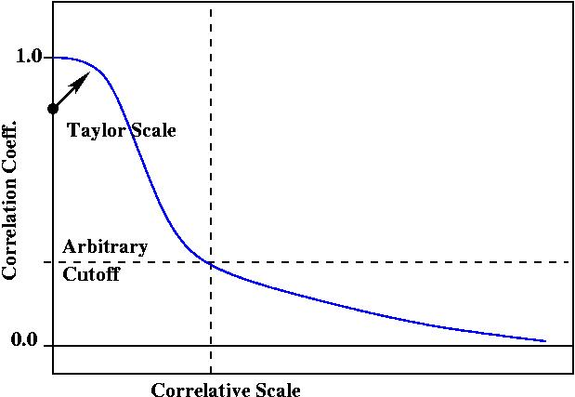
The Taylor Scale and Correlative Scale can be obtained from the two point correlation function
Taylor scale:
  Radius of curvature of the Correlation function at the origin.
Correlative/Integral scale:
  Scale at which turbulent fluctuation are no longer correlated.
Main features of the correlation function R(r)
Correlation function R(r)
(adapted from Weygand et al., 2007)

Slide 22
We can determine:
the Taylor Scale from Taylor expansion of the two-point correlation function for r→0:
(Tennekes, and Lumley , 1972)
where r is the spacecraft separation and R(r) is the two-point correlation function.
the Correlative Scale from:
the effective magnetic Reynolds number from:
(Batchelor, 1970)
(Batchelor, 1970)

Slide 23
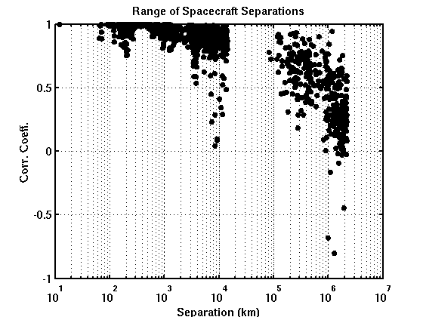
First experimental estimate of the effective Reynolds number in the solar wind (previous estimates obtained only from single spacecraft observations using theTaylor hypothesis)
First evaluation the two-point correlation functions using simultaneous measurements from Wind, ACE, Geotail, IMP8 and Cluster spacecraft (Matthaeus et al., 2005).
Cluster in the SW
Geotail+IMP 8
ACE+Wind
Separations (km)
(Matthaeus et al., 2005, Weygand et al., 2007)

Slide 24
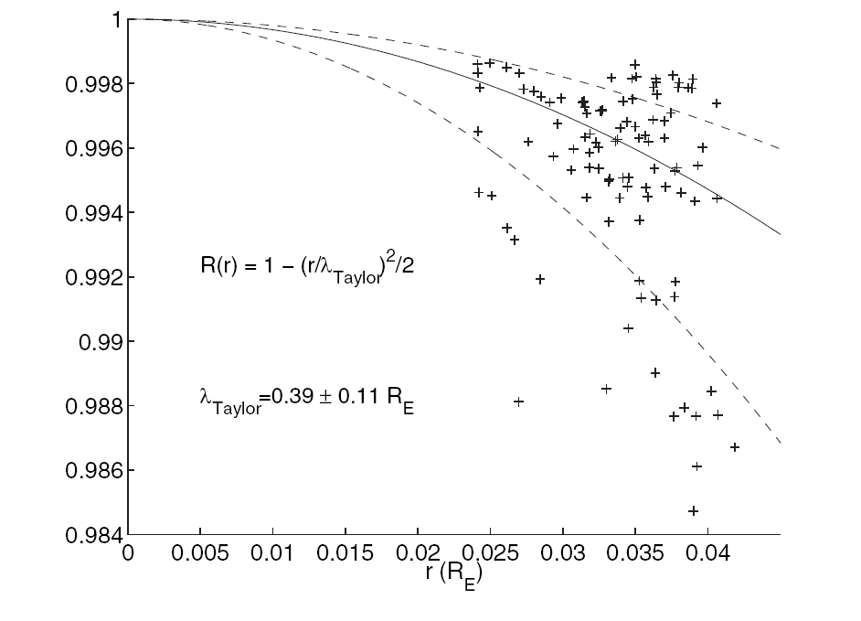
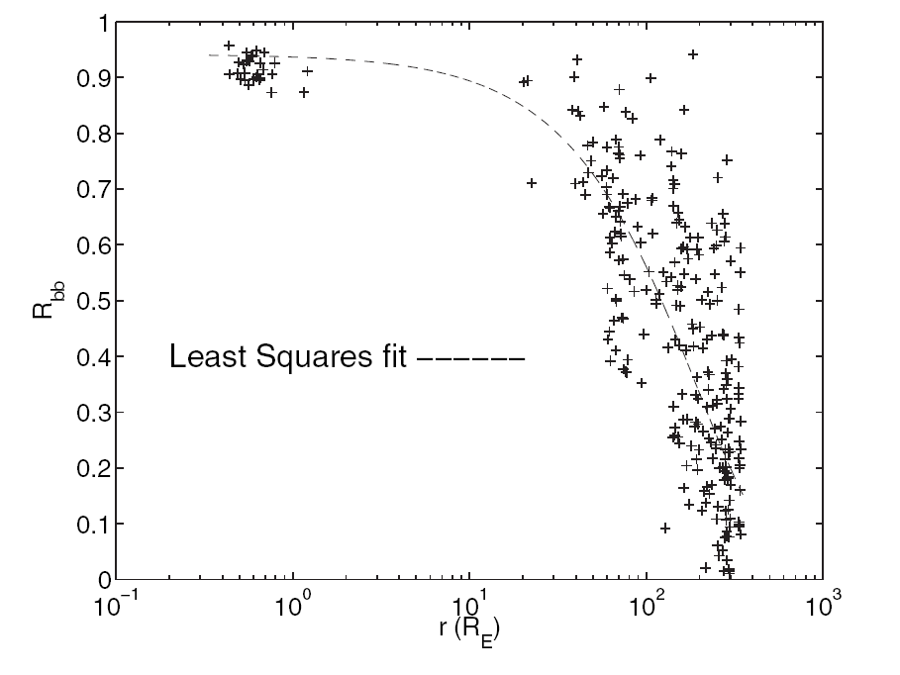
Experimental evaluation of λ_{C} and λ_{T} in the solar wind at 1 AU
Cluster
Wind & ACE
(parabolic fit)
Cluster
(exponential fit)
  λ_{T} ∼ 2.4∙10³ km
  λ_{C} ∼ 1.3∙10⁶ km
(Matthaeus et al., 2005
Weygand et al., 2007)
high Reynolds number → turbulent fluid → non-linear interactions expected

Slide 25
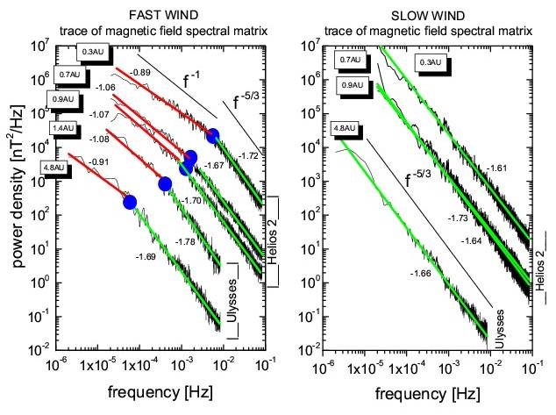
Solar wind turbulence: first experimental evidence for the existence of a spectral radial evolution
[Bruno and Carbone, 2013]

Slide 26
Solar wind turbulence: first experimental evidence for the existence of a spectral radial evolution
Non linear interactions are still active
[Bruno and Carbone, 2013]

Slide 27
Turbulence is the result of nonlinear dynamics and is described by the NS eq.
NS equations for the hydromagnetic case
Incompressible
Navier-Stokes equation
u → velocity field
P → pressure
ν → kinematic viscosity
non-linear
nonlinear
dissipative
dissipative
Hydromagnetic flows: same
“structure” of NS equations
Elsässer variables
z⁺
z⁻
<B>

Slide 28
NS equations for the hydromagnetic case
Incompressible
Navier-Stokes equation
u → velocity field
P → pressure
ν → kinematic viscosity
non-linear
nonlinear
dissipative
dissipative
Hydromagnetic flows: same
“structure” of NS equations
Nonlinear interactions and the consequent energy cascade need both Z⁺ and Z⁻

Slide 29
Definition of the Elsässer variables
outward propagating wave
B₀
k
B₀
inward propagating wave
k

Slide 30
Definition of the Elsässer variables
outward propagating wave
B₀
k
B₀
inward propagating wave
k

Slide 31
Solar wind turbulence is studied by means of the ideal MHD invariants (E, H_{c}, H_{m})

Slide 32
Statistical approach to turbulence
The statistical description of MHD turbulence relies on the evaluation of the three quadratic invariants of the ideal system (no dissipation)
where b is in Alfvén units
1) total energy per unit density
2) cross helicity
3) magnetic helicity
where b is defined via
In the following we will use a combination of these invariants to describe the phenomenology of turbulent fluctuations in the solar wind and to understand their nature

Slide 33
Sometimes it is more convenient to use the normalized expressions for cross-helicity and magnetic helicity
σ_{c} and σ_{m} can vary between +1 and -1
the sign of σ_{c} indicates correlation or anticorrelation between δv and δb
the sign of σ_{m} indicates left or right hand polarization

Slide 34
The 2 quadratic invariants E_{t} and H_{c} can be expressed in terms of the Elsässer variables
Fields:
Second order moments:
e⁺ and e⁻ energy
Kinetic energy
Magnetic energy
Cross-helicity

Slide 35
The 2 quadratic invariants E_{t} and H_{c} can be expressed in terms of the Elsässer variables
Fields:
Normalized parameters:
Normalized cross-helicity
Normalized residual energy
for an Alfvén wave:
r_{A}=e^{V}/e^{B}=1
σ_{C}=(e⁺-e⁻)/(e⁺+e⁻) =±1
σ_{R}=(e^{V}-e^{B})/(e^{V}+e^{B})=0
Alfvén ratio

Slide 36
observations in the ecliptic

Slide 37

An overview on the main features of solar wind fluctuations at MHD scales in fast and slow wind and their evolution during radial expansion
Fast and slow wind features should never be averaged together.
«Asking for the average solar wind might appear as silly as asking for the taste af an average drink. What is the average between wine and beer? Obviously a mere mixing – and averaging means mixing – does not lead to a meaningful result.
Better taste and judge separately and then compare, if you wish.»
[Rainer Schwenn, Solar Wind 5, 1982]

Slide 38
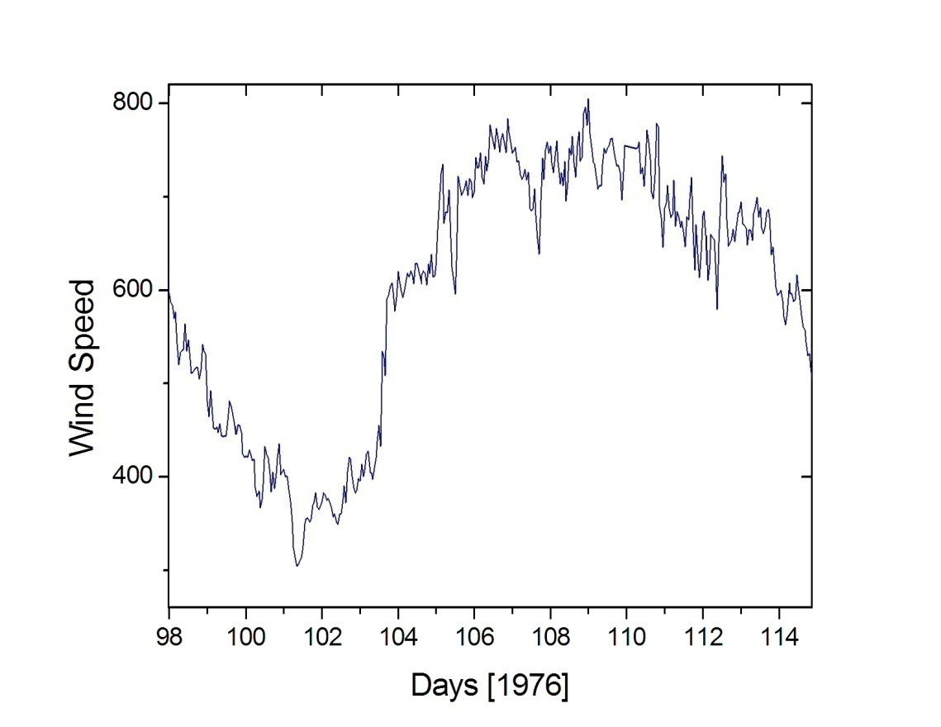
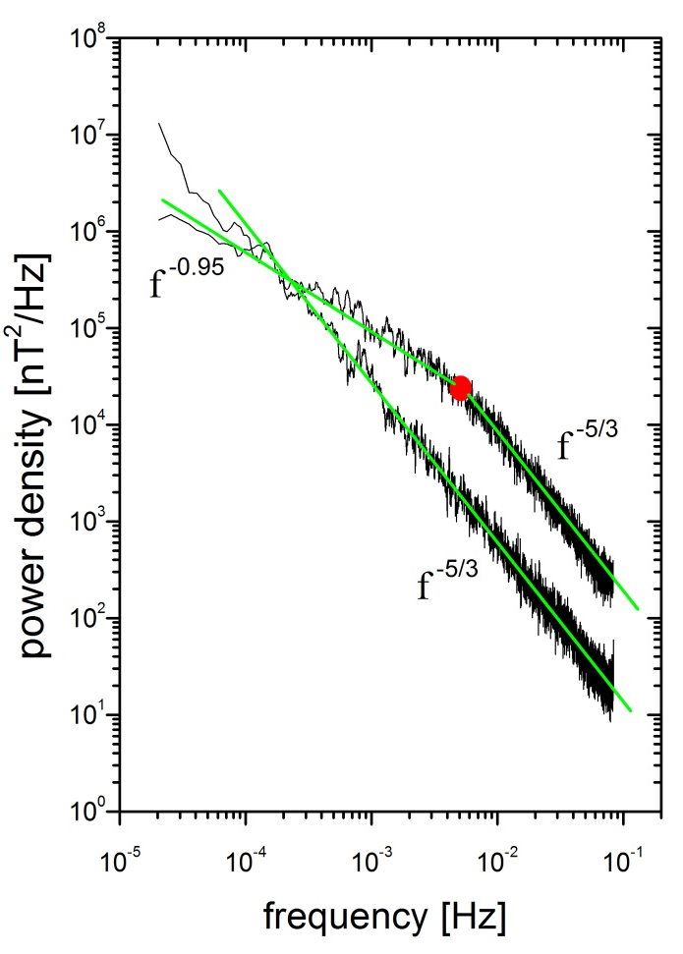
Differences in the spectral signature of fast and slow wind
Magnetic field spectral trace
Helios 2 @ 0.29 AU
fast
slow
The spectral break in the fast wind spectrum suggests shorter correlation lengths

Slide 39
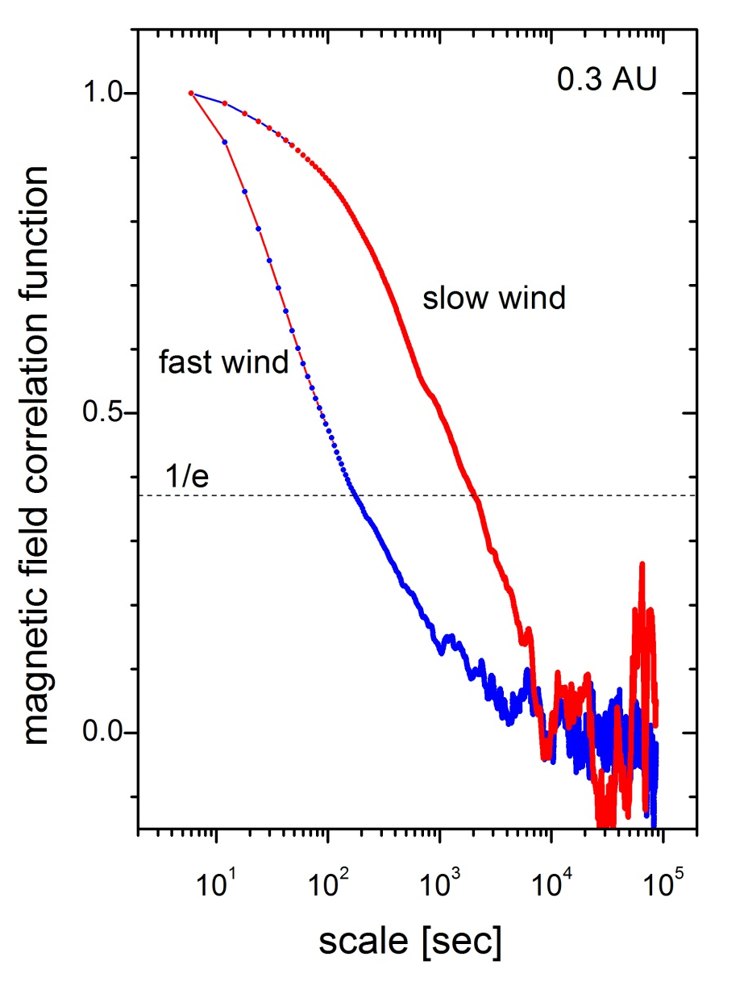
The spectral break in the fast wind spectrum suggests shorter correlation lengths
Helios 2 @ 0.29 AU

Slide 40
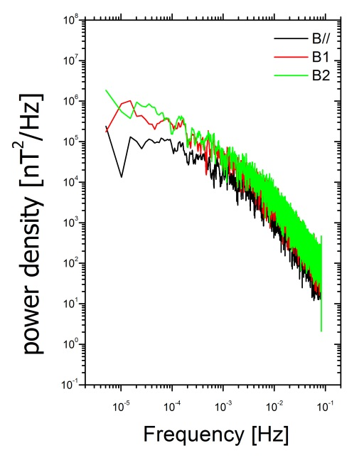
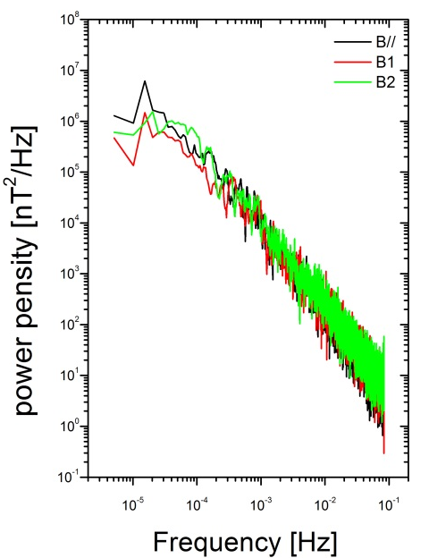
Differences also in the variance anisotropy of the fluctuations
wrt Parker’s spiral
Helios 2 @ 0.29 AU
mean field ref. sys.

Slide 41
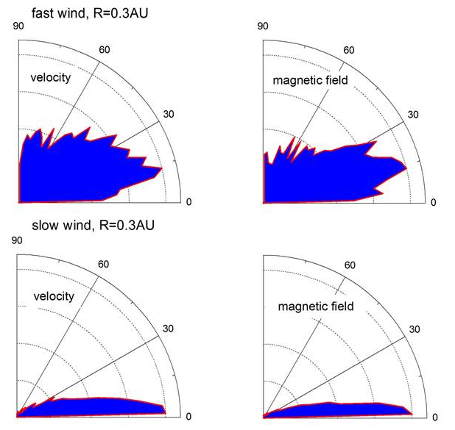
Differences also in the amplitude of directional fluctuations of velocity and magnetic field vectors
Angular histograms
[scale 81 s]
Helios 2 @ 0.29 AU
fast
slow
Distributions of the angle formed between two successive vectors
time resolution=81sec
R. Bruno, International Workshop and School Mamaia, Romania 6-13 September 2015

Slide 42
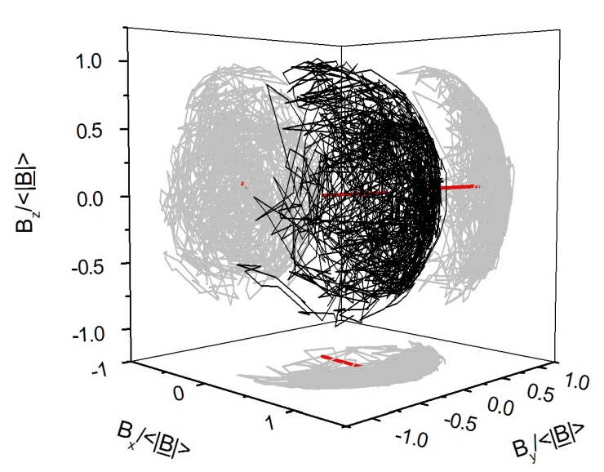
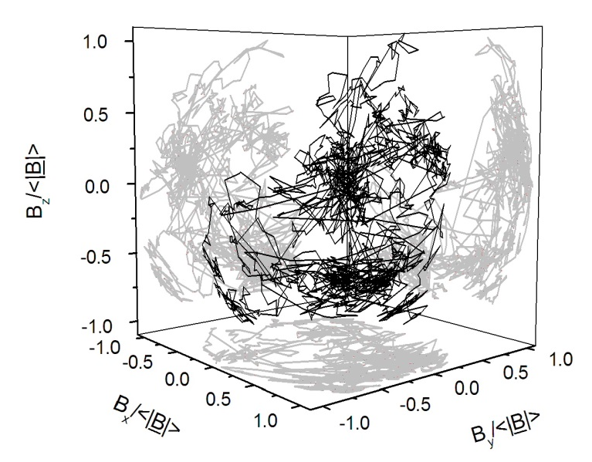
Differences also in the spatial distribution of the fluctuations
Helios 2 @ 0.29 AU
B_{Z}/|B|
B_{X}/|B|
B_{Y}/|B|
B_{Z}/|B|
B_{X}/|B|
B_{Y}/|B|
R. Bruno, International Workshop and School Mamaia, Romania 6-13 September 2015

Slide 43
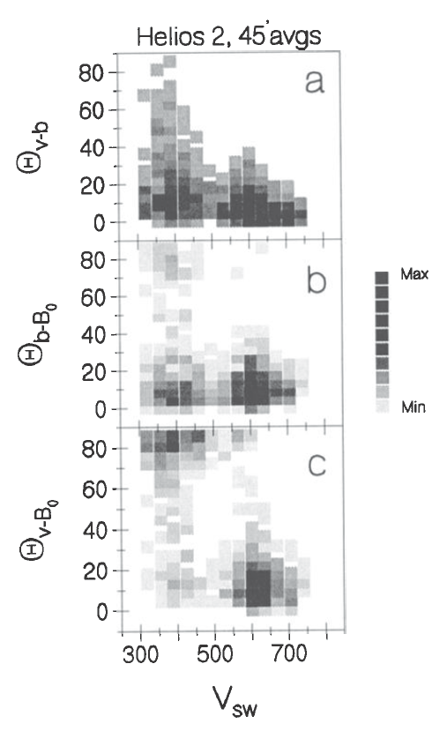
Differences in the orientation of the minimum variance direction
Helios 2 @ 0.29 AU
θ_{v-b} : angle between MVD of δb and δv
θ_{b-B0}: angle between MVD of δb and B₀
θ_{v-B0}: angle between MVD of δv and B₀
fast wind: the local field orders the behaviour of the fluctuations
[Klein et al., 1993]

Slide 44
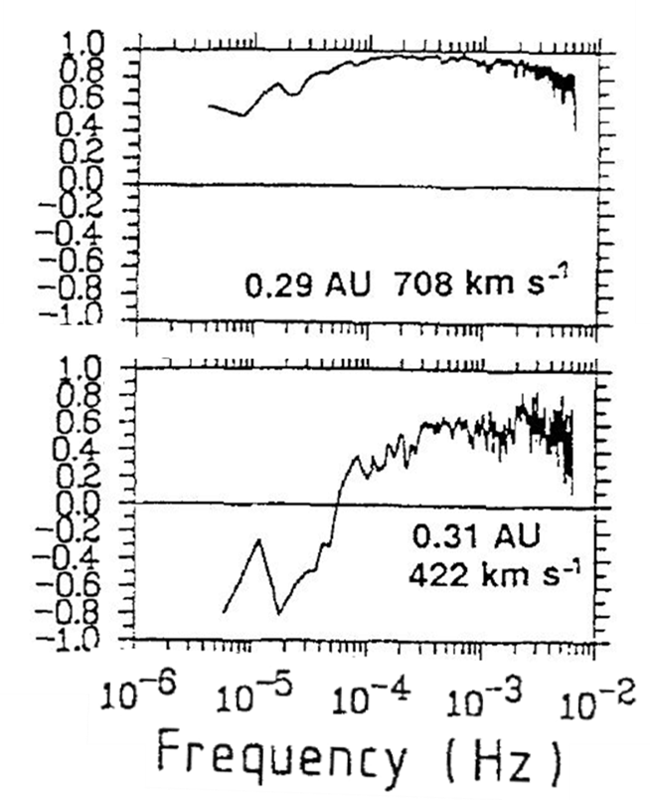
Differences in the level of normalized crosshelicity
Helios 2 @ 0.29 AU
σ_{c}
[adapted from Marsch and Tu, 1990]

Slide 45
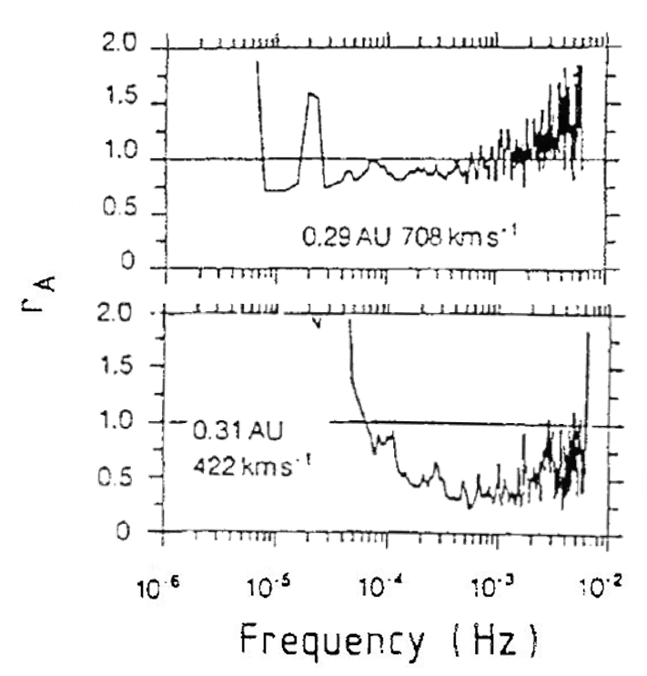

Differences in the level of magnetic and kinetic energy content
Helios 2 @ 0.29 AU
[adapted from Marsch and Tu, 1990]

Slide 46
Differences in Intermittency along the velocity profile
a measure of the non-Gaussianity of the fluctuations
Helios 2 @ 0.9 AU
Intermittency strongly depends on the location within the stream
Magnetic field flatness
stream IF
[Bruno et al., 2007]

Slide 47
Differences in Intermittency along the velocity profile
a measure of the non-Gaussianity of the fluctuations
Helios 2 @ 0.9 AU
Intermittency strongly depends on the location within the stream
Magnetic field flatness
stream IF
slow
[Bruno et al., 2007]

Slide 48
Differences in Intermittency along the velocity profile
a measure of the non-Gaussianity of the fluctuations
Helios 2 @ 0.9 AU
Intermittency strongly depends on the location within the stream
Magnetic field flatness
stream IF
slow
fast
[Bruno et al., 2007]

Slide 49
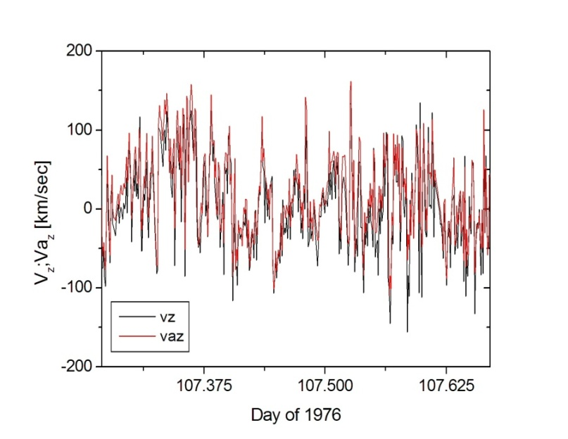
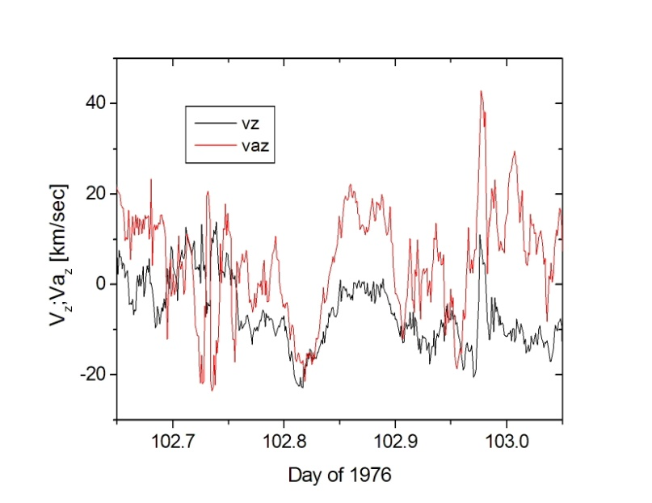

Differences in the Alfvénic character of the fluctuations in fast and slow wind
$$v_{az}=sign[−\vec{k}∙{\vec{B}}_{0}]\frac{b_{z}}{\sqrt{4πρ}}$$
Helios 2 @ 0.29 AU

Slide 50
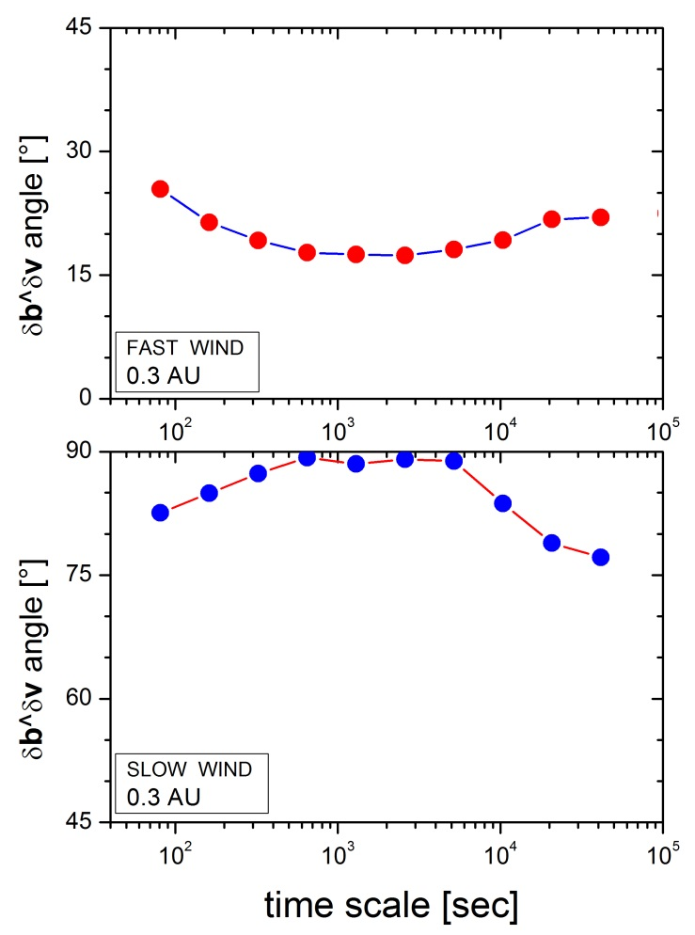
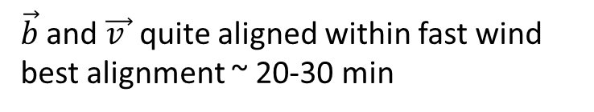
Differences in the δB-δV alignment
Helios 2 @ 0.29 AU
$\vec{b}$ and $\vec{v }$ quite aligned within fast wind
best alignment ~ 20-30 min

Slide 51
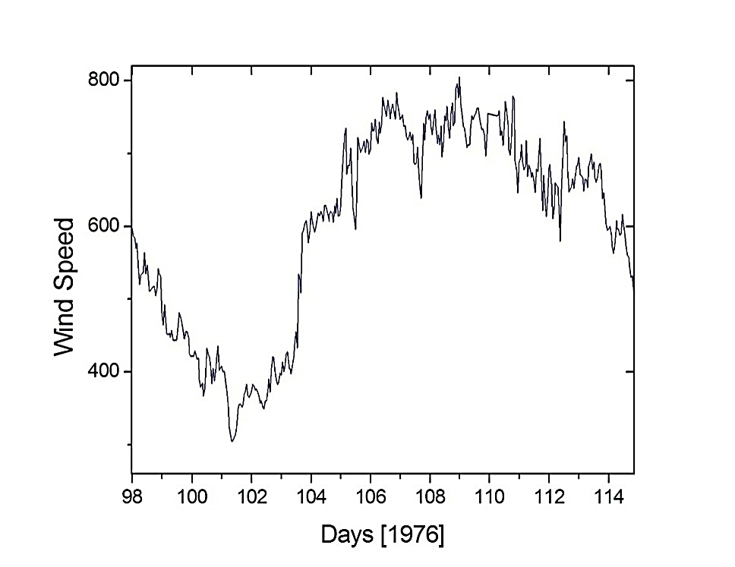

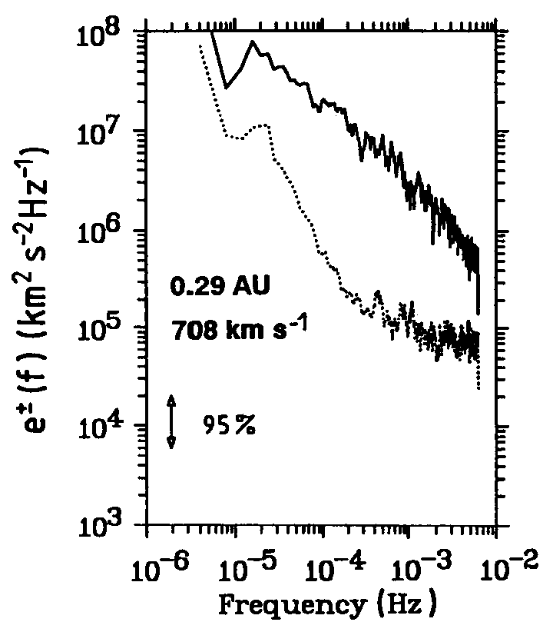
Alfvénic correlations: fast vs slow wind
0.3 AU
Fast wind:
fluctuations strongly Alfvénic
FFT(Z±)→e±
e⁺
Outward modes largely dominate
e⁻
Marsch and Tu, JGR, 95, 8211, 1990

Slide 52
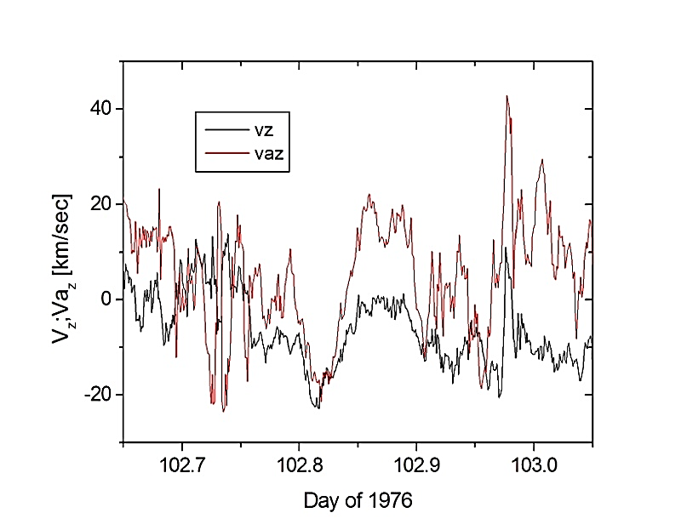
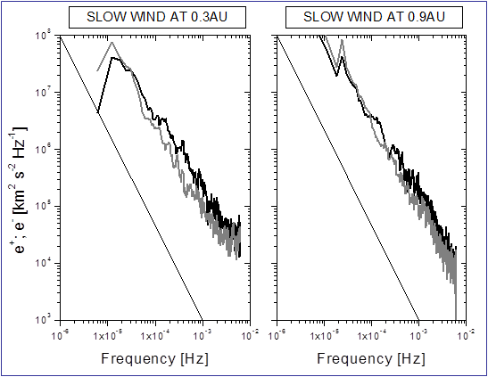
Alfvénic correlations: fast vs slow wind
0.3 AU
Slow wind: fluctuations scarcely Alfvénic
FFT(Z±)→e±
e⁺
outward modes ≅ inward modes
e⁻

Slide 53
All these features evolve with the radial distance from the Sun
[Fast wind tends to resemble slow wind as the distance increase]

Slide 54
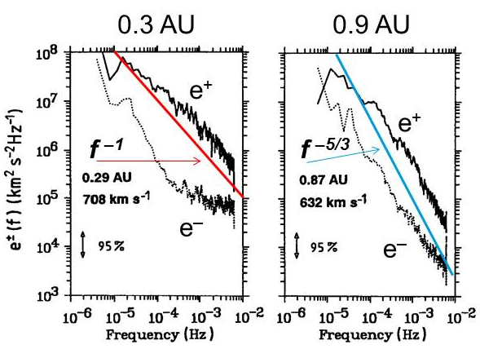
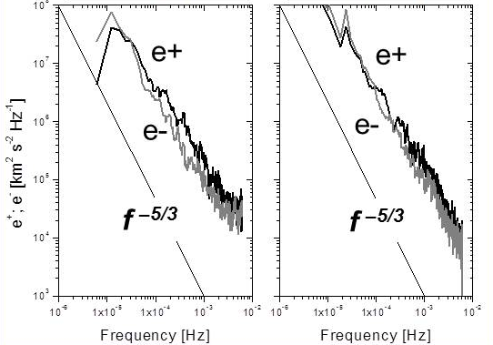
0.3AU
0.9AU
For increasing distance:
e⁺ decreases towards e–
spectral slope evolves towards -5/3
FAST
[Marsch and Tu, 1990]
0.3AU
0.9AU
No much radial evolution
spectral slopes always close to -5/3
SLOW
[Bruno]

Slide 55
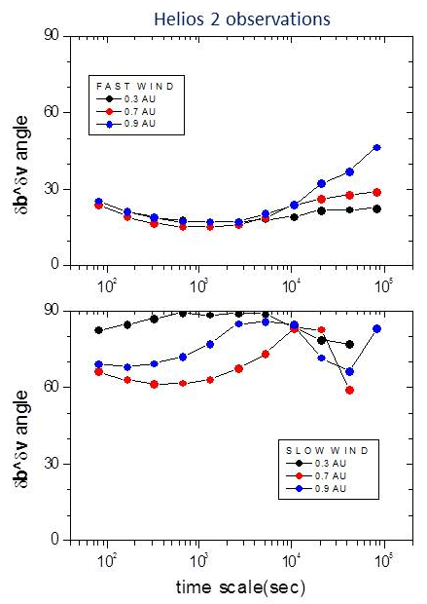
Since e⁺→e⁻, δB-δV alignment decreases during expansion
Best alignment for younger turbulence (0.3AU)
No alignment for slow wind, as expected from fully developed turbulence (|δZ⁺|=|δZ⁻|)

Slide 56
FAST WIND
Radial evolution of MHD turbulence in terms of σ_{R} and σ_{C} (scale of 1hr)
0.3 AU
Alfvénic population

Slide 57
FAST WIND
Radial evolution of MHD turbulence in terms of σ_{R} and σ_{C} (scale of 1hr)
0.3 AU
0.7 AU
Alfvénic population

Slide 58
FAST WIND
Radial evolution of MHD turbulence in terms of σ_{R} and σ_{C} (scale of 1hr)
0.3 AU
0.7 AU
Alfvénic population
0.9 AU
A new population appears, characterized by magnetic energy excess and low Alfvénicity
(Bruno et al., 2007)

Slide 59
FAST WIND
Radial evolution of MHD turbulence in terms of σ_{R} and σ_{C} (scale of 1hr)
0.3 AU
0.7 AU
Alfvénic population
0.9 AU
this might be a result of turbulence evolution or the signature of underlying advected structure
(Bruno et al., 2007)

Slide 60
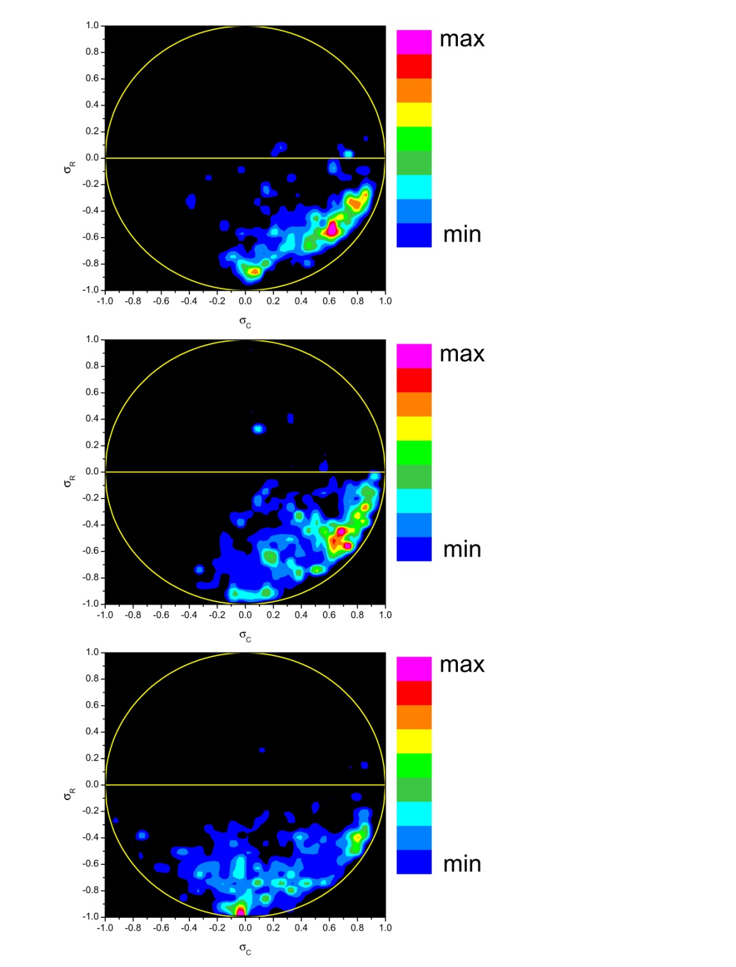
FAST WIND
SLOW WIND
Helios 2 observations
0.3 AU
0.3 AU
Different situation in Slow-Wind:
no evolution
second population already present at 0.3 AU
0.7 AU
0.7 AU
0.9 AU
0.9 AU

Slide 61
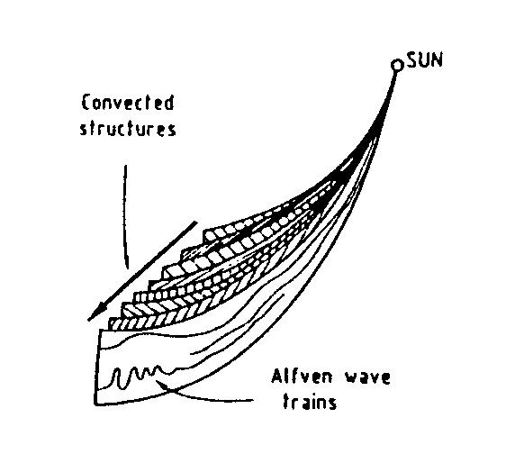



Several contributions suggested that incompressible turbulence is not purely slab (Alfvénic)
(Thieme et al., 1988, 1989; Tu et al., 1989, 1997; Tu and Marsch, 1990, 1993; Bieber and Matthaeus, 1996; Crooker et al., 1996; Bruno et al., 2001, 2003, 2004; Chang and Wu, 2002; Chang, 2003; Chang et al., 2004; Tu and Marsch, 1992, Chang et al., 2002, Borovsky, 2006, 2008, 2009, Li, 2007, 2008)
Similar pictures
2D+SLAB
[Tu and Marsch, 1992]
[Bieber et al., 1996]
[Bruno et al., 2001]
(Chang et al., 2002)

Slide 62


k// and k⊥ are the ingredients of Slab and 2D turbulence model
2D+SLAB
[Bieber et al., 1996]
Axisimmetry assumed

Slide 63

Dominance of k⊥ or k// has implications in the correlation lengths anisotropy
observations at 1AU [ISEE3 data]
Numerical model
[Bieber et al., 1996]

Slide 64



Shebalin et al., (1983) proposed the anisotropy development due to 3-wave resonant interaction
2D incompressible MHD simulation
Initial isotropic spectrum
magnetic field:
  B₀=B₀e_{x} mean field
  B= (B_{x},B_{y},0) turbulent field
  non-zero couplings between right and left travelling waves
k₁, ω(k₁)
k₂, -ω(k₂)
Condition for 3-wave resonant interaction:
k₃=k₁+k₂
±ω(k₃)=ω(k₁)-ω(k₂)
Since ω(k)=k⋅B₀ possible solutions: ω(k₁)=0 or ω(k₂)=0
⇒ either k₁ or k₂ ⊥ B₀
Result: excitation of a wave with larger k⊥ but never with larger k// . Turbulence evolves towards a dominance of k⊥

Slide 65
Shebalin et al., (1983) proposed the anisotropy development due to 3-wave resonant interaction
2D incompressible MHD simulation
Initial isotropic spectrum
magnetic field:
  B₀=B₀e_{x} mean field
  B= (B_{x},B_{y},0) turbulent field
  non-zero couplings between right and left travelling waves
k₁, ω(k₁)
k₂, -ω(k₂)
Condition for 3-wave resonant interaction:
k₃=k₁+k₂
±ω(k₃)=ω(k₁)-ω(k₂)
Since ω(k)=k⋅B₀ possible solutions: ω(k₁)=0 or ω(k₂)=0
⇒ either k₁ or k₂ ⊥ B₀
Result: excitation of a wave with larger k⊥ but never with larger k// . Turbulence evolves towards a dominance of k⊥

Slide 66
Goldreich and Sridhar [1995] (GS95) proposed a new mechanism characterized by the so called “Critical Balance” conjecture
Alfvénic turbulence reaches a state for which there is a balance between non-linear time and Alfvén time:
[“L” is the initial scale of excitation]
Parallel and perpendicular spatial scales of eddies are correlated
As the cascade proceeds to larger k⊥, the eddies become more elongated along B₀
3D spectrum
If only slab and 2D turbulence are present →
[Horbury et al., 2008]

Slide 67
θ_{B} is the angle between sampling direction and mean field direction
The possibility to observe a different scaling Introduces the problem of defining what the “mean field” is
R. Bruno, International Workshop and School Mamaia, Romania 6-13 September 2015

Slide 68


About the problem of defining the “mean field”
Fluctuations at a given scale are sensitive to the local magnetic field, but the definition of “local” varies with the spatial scales of interest.
[Bruno et al., 2001]
About 3 hrs of 6s averages of Helios 2, fast wind at 0.9AU

Slide 69

Anisotropy test by Bieber et al. [1996] in the solar wind
Data rotated into the mean field ref.sys.
r
Sampling direction
P_{yy} ≡ P⊥ [perpendicular spectrum]
P_{xx} ≡ P_{(//)} [quasi parallel spectrum]
x
z
ψ
P⊥ [fluctuations ⊥ to the sampling direction]
P_{(//)} [fluctuations with one component // to the sampling direction]
B₀
y
mean field ref.sys.
C_{S} and C₂ are the amplitude of slab and 2D components
q is the spectral index around a certain frequency within inertial range
2D gives a different contribution to P⊥ and P_{(//)}

Slide 70

Helios data for the anisotropy test by Bieber et al. [1996]
fast and slow(dominating) wind mixed together
Ratio of perpendicular to parallel power fitted by a composite geometry with 74% 2D and 26% slab
Dataset: Helios 1&2 between 0.3 and 1AU, 454 spectra of 34 min each taken during SEP events
P⊥ [fluctuations ⊥ to the sampling direction]
P_{(//)} [fluctuations quasi // to the sampling direction]
Dramatically different results are expected selecting only Alfvénic high velocity streams (time res. in Helios data not sufficient)

Slide 71


Dasso et al., (2005): Ecliptic turbulence with Ulysses data
SLOW WIND:
mainly 2D turbulence
FAST WIND:
mainly Slab turbulence
Fluctuations decorrelate faster in the perpendicular direction in the slow wind while the opposite occurs in the fast wind

Slide 72
Which mechanism does generate turbulence
in the ecliptic?

Slide 73

Different origin for Z⁺ and Z⁻ modes in interplanetary space
Outside the Alfvén radius we need Z⁻ modes in order to have
Need for a mechanisms able to generate locally Z⁻ modes
Z⁺
Z⁺
Z⁻
Z⁻
V_{sw}< V_{A}
Z⁺
Z⁺
V_{sw} > V_{A}
Alfvén radius
∼20 R_{S}

Slide 74

Radial evolution of σ_{C} in the ecliptic
Normalized cross-helicity
Helios 1*
Voyager*
σ_{C} → 0
[Adopted from Matthaeus et al., 2004]
*mixing fast and slow wind

Slide 75

Radial evolution of σ_{C} in the ecliptic
Normalized cross-helicity
Helios 1*
Voyager*
Combining dynamic alignment and velocity shear mechanism
[Adopted from Matthaeus et al., 2004]
Dynamic alignment ⇒ |σ_{C}| increases
(Dobrowolny et al., 1980)
velocity shear ⇒ |σ_{C}| decreases
(Coleman, 1968)
*mixing fast and slow wind

Slide 76
Dynamic alignment
(Dobrowolny et al., 1980)
This model was stimulated by apparently contradictory observations recorded close to the sun by Helios:
absence of non-linear interactions
1. observation of σ_{C} ∼ 1 means correlations of only one type (δZ⁺)
2. turbulent spectrum clearly observed
presence of non-linear interactions
?

Slide 77
Dynamic alignment
(Dobrowolny et al., 1980)
Interactions between Alfvénic fluctuations are local in k-space
We can define 2 different time-scales for these interactions
The Alfvén effect increases the non-linear interaction time
We can define an energy transfer rate
The energy transfer rate is the same for dZ⁺ and dZ⁻
An initial unbalance between dZ⁺ and dZ⁻ , as observed close to the Sun, would end up in the disappearance of the minority modes dZ⁻ towards a total alignment between dB and dV as the wind expands

Slide 78
Radial evolution of σ_{C} in the ecliptic
Normalized cross-helicity
Helios 1*
Voyager*
Combining dynamic alignment and velocity shear mechanism
[Adopted from Matthaeus et al., 2004]
Dynamic alignment ⇒ |σ_{C}| increases
(Dobrowolny et al., 1980)
velocity shear ⇒ |σ_{C}| decreases
(Coleman, 1968)
*mixing fast and slow wind

Slide 79

Typical velocity shear region

Slide 80

Turbulence generation in the ecliptic: velocity shear mechanism
(Coleman 1968)
The 6 lowest Fourier modes of B and V define the shear profile
The z⁺ spectrum evolves slowly
Alfvén modes added
Solar wind turbulence may be locally generated by non-linear MHD processes at velocity-shear layers.
Magnetic field reversals speed up the spectral evolution.
T=3 ~ 1 AU
This process might have a relevant role in driving turbulence evolution in low-latitude solar wind, where a fast-slow stream structure and reversals of magnetic polarity are common features.
A z– spectrum is quickly developed at high k
2D Incompressible simulations by Roberts et al., Phys. Rev. Lett., 67, 3741, 1991

Slide 81
In-situ observations at high latitude

Slide 82

Polar wind features
At LOW activity the polar wind fills a large fraction of the heliosphere.
In contrast, polar wind almost disappears at HIGH activity.
L
O
W
HIGH
The polar wind, a relatively homogeneous environment, offers the opportunity of studying how the Alfvénic turbulence evolves under almost undisturbed conditions.
McComas et al., GRL, 29 (9), 2002

Slide 83

Polar wind: spectral evolution
Power spectra of z⁺ and z– at 2 and 4 AU in polar wind clearly indicate a spectral evolution qualitatively similar to that observed in ecliptic wind.
The development of a turbulent cascade with increasing distance moves the breakpoint between the f ^{–1} and f ^{–5/3} regimes to larger scales.
z⁺
f ^{–1}
polar wind
2 AU
z–
polar wind
4 AU
f ^{–5/3}
Goldstein et al., GRL, 22, 3393, 1995

Slide 84

Polar wind:
Spectral breakpoint, a comparison with ecliptic wind
polar wind
In the polar wind the breakpoint is at smaller scale than at similar distances in the ecliptic wind.
Thus, spectral evolution in the polar wind is slower than in the ecliptic wind.
(data from: Helios, IMP, Pioneer, Voyager, Ulysses)
Horbury et al., Astron. Astrophys., 316, 333, 1996

Slide 85
Polar wind: radial dependence of e⁺ and e–
Ulysses polar wind observations show that e⁺ exhibits the same radial gradient over all the investigated range of distances. In contrast, e– shows a change of slope at ~2.5 AU.
Perhaps, e– generated by some mechanism acting on e⁺ which saturates for a given ratio of e– / e⁺
Ulysses
Helios
Bavassano et al., JGR, 105, 15959, 2000

Slide 86
Turbulence generation in the polar wind: parametric decay
  The absence of strong velocity shears plays in favour of the parametric decay mechanism
This instability develops
in a compressible plasma and, in its simplest form, involves
the decay of a large amplitude Alfvén wave (called “pump wave”, or “mother wave”) in a magnetosonic fluctuation
and a backscattered Alfvén wave.
K₀, ω₀
Z⁺
K₁, ω₁
K₂, ω₂
Z⁻
energy & momentum conservation
ω₀= ω₁+ ω₂ k₀= k₁+k₂

Slide 87

Test for parametric instability for β∼1
MHD compressible simulation by L. Primavera (2003)
e⁺
e⁺
e⁻
non-monochromatic, large amplitude Alfvén wave experiencing parametric instability creates backscattered fluctuations (e⁻) and compressive modes (e^{ρ}).
e^{ρ}
e⁻
e⁺
e^{ρ}
( Malara et al., 2001 Nl.Proc in Geophys.)
(Simulation details in: Malara et al., JGR, 101, 21597, 1996, Malara et al., Phys. Plasmas, 7, 2866, 2000,
Primavera et al. in Solar Wind 10, 2003)

Slide 88

The parametric instability for β∼1
Malara et al., Phys. Plasmas, 7, 2866, 2000
The decay ends in a state in which the initial Alfvénic correlation is partially preserved.
The predicted cross-helicity behaviour qualitatively agrees with that observed by Ulysses.
Ulysses
Bavassano et al., JGR, 105, 15959, 2000

Slide 89
Summary
Solar wind is a turbulent medium (Re∼10⁵ @1AU)
Fast wind: radially evolving Alfvénic turbulence (predominance of outward correlations)
Slow wind: developed turbulence, no radial evolution (equal amount of outward and inward correlations)
We have a comprehensive, phenomenological view of the Alfvénic turbulence evolution in the 3-D heliosphere.
The dominant character of outward fluctuations in the polar wind extends to larger distances from the Sun compared to the ecliptic
polar turbulence evolution is slower than ecliptic turbulence.
ecliptic evolution driven by velocity shear;
polar evolution driven by parametric decay

Slide 90
For those who want to know more about turbulence of the interplanetary medium see the following review:
Roberto Bruno and Vincenzo Carbone,
“The Solar Wind as a Turbulence Laboratory”,
Living Rev. Solar Phys. 10 (2013), 2
http://solarphysics.livingreviews.org/Articles/lrsp-2013-2/

Slide 92
Differences in the power associated to e⁺ and e⁻
Helios 2 @ 0.29 AU
e⁺
e⁻
e⁺
[Tu et al., 1990]
e⁻

